Slide 1
The Sellout: Readers Sentiment Analysis of 2016 Man Booker Prize Winner
Paper ID : 748

Slide 2
INTRODUCTION
Sentiment analysis also sometimes term as opinion mining refers to the use of natural language processing, text analysis, computational linguistics, and biometrics to systematically identify, extract, quantify, and study affective states and subjective information.
Sentiment analysis is widely applied to understand customer using reviews and survey responses, online and social media, and healthcare materials for applications that range from marketing to customer service to clinical medicine.
This paper mainly focuses on the sentiment analysis of the 2016 Man Booker prize winner book “The Sellout” in Goodreads website reviews.

Slide 3
Definition
The term “sentiment” is used in reference to the automatic analysis of evaluative text and tracking of the predictive judgments.
- Das and Chen
Synonymous & Interchangeable Names
Subjective Analysis
Review Mining
Opinion Mining
Appraisal Extraction

Slide 4
Methodology
The data on book reviews was collected manually for the study from Goodreads website (www.goodreads.com).
Booker prize award 2016, The Sellout by Paul Beatty was selected for the study which had a total of 3,150 reviews.
The first 10 pages of the reviews had been considered for the study.
Each page consists of thirty reviews. Data was collected for the period of January 09, 2015 to April 25, 2017. Total of 292 reviews was collected from the Goodreads website. Reviews in English language was only selected for analysis, hence 8 reviews has been excluded from the study as it was not in English language.
Out of 292 reviews, 189 reviews occurred before the announcement of the result, and 103 reviews occurred after the announcement of the result.

Slide 5
Reviews were analysed in R. Text analysis and sentiment polarity were developed in R using various functions.
The extracted text preparation is clean by converting plural to singular words, removing punctuations and numbers, URL, symbols, spaces etc. before any analysis.
Sentiment scores has been developed for each review using sentiment function. Positive, Neutral and Negative sentiment were calculated separately.

Slide 6
Results
Total Sentiment Polarities

Slide 7
Book review on “The Sellout” has more negative reviews. Maximum (47%) of the users have critically reviewed the novel, while 42.1% of the users have reviewed it with positive reviews. However, 10.9% of the users have reported it with neutral reviews.

Slide 8
Sentiment Analysis Before and After the Result

Slide 9
Sentiment Analysis before and after the result

Slide 10
Sentiment Analysis before the result
Sentiment polarity of the reviews are analysed to understand whether the reviews are of positive or negative sentiment.
Out of 292 reviews, 189 reviews occurred before the announcement of the result.

Slide 11
Sentiment Analysis after the result
It was found that there was no significant change in the reviewer’s criticism, a large number of reviewers continue to review the novel critically with evidences of negative sentiment being more than the positive sentiment.
Before the result of the award, there were 83 positive sentiments, 18 neutral and 88 negative.
Subsequently, the number reduces to 40 positive sentiments, 14 neutral and 49 negative.

Slide 12
Most frequent word in the reviews
The Most frequent words used in book reviews have been shown in the Table below.
The first 20 words with maximum frequency have been listed below
Sl. No. | Word | Frequency
1. | book | 531
2. | read | 279
3. | black | 251
4. | beatty | 214
5. | satire | 176
6. | novel | 164
7. | race | 147
8. | sellout | 139
9. | funny | 135
10. | people | 126

Slide 13
WordCloud
WordCloud of frequently used words in the reviews is considered for visual understanding/analysing the data.
The most occurred word in the reviews has been made as wordcloud for the easy visualization.

Slide 14
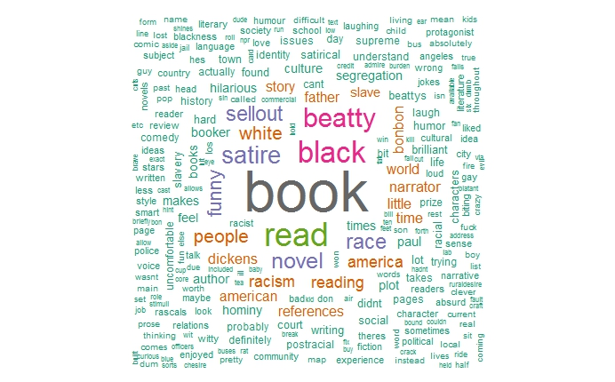
WordCloud

Slide 15
Conclusion
The number of reviews for different book varies, but the reviews provide accessible and plentiful data for relatively easy analysis for a range of applications.
This paper seeks to apply and extend the current work in the field of natural language processing and sentiment analysis to data retrieved from Goodreads.
Positive, Neutral and Negative sentiment were calculated separately.
On the whole, negative sentiment is more than the positive sentiment. Word frequencies were also formed and the most occurred word in the reviews has been tabulated.

Slide 16
Conclusion
Public sentiments which is difficult to comprehend differs with the expert, at least in this case of Goodreads users.
Popular reading differs from acclaimed or accomplish novel.
Unlike Twitter predictive data, Goodreads reviews did not show any indication that the book reviews would predict award winning novel by analysing the sentiments of the readers.
Hence, users driven acquisition are a popular choice among Librarian and it is believed that sentiment analysis has an important role to play.

Slide 17
Thank you

