Slide 1
VIVO: Faculty Research Information System and Discovery
Kannan P
Scientist C, INFLIBNET Centre | kannan@inflibnet.ac.in

Slide 2

How are research related information shared or disseminated?
Institutional repositories / National level repositories
Faculty profile
Preprint archives
Data repository
Open Access Journal System
Academic Identity registry
Citation databases

Slide 3
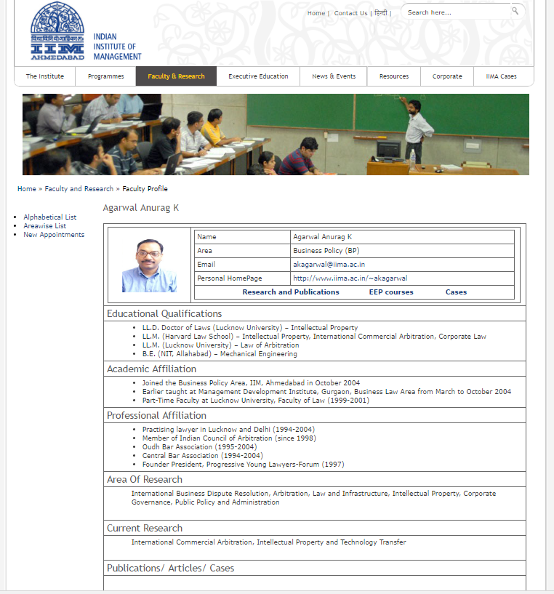
The Challenge
Research activities of
the faculty members or
Organizations are not discoverable
or interoperable in the Institute / National level.
Publications do not necessarily reflect expertise of individuals and organizations
Hard to find the right experts within and across institutions for collaborative research.
Many faculty, scholars are not aware about research happening within organization.
Non of the Indian Institute using Standard Profile Management System and no common forum

Slide 4



Expectation from the stakeholders
As a Scholar
As a Faculty / Scientist
As a Administrator
Ensure their work is discoverable and connected;
Showcase their contributions to the peers group and funding agency;
Increasing funding opportunity for research and greater exposure to the international community.
Find out the research progress;
Build research reports, carry out performance assessments, research impact analysis;
Improve faculty collaboration within or across departments and institutions; and
Grant Information Management
Locate mentors, advisors, & collaborators;
Locate facilities, events, and fellowship;
Find courses in an area of interest.

Slide 5





Request from the Administration
How the research information related queries addressed today?
Ex.
List of publications in which the Anna University author was first or last author.
List of publications in which the Anna University author was first or last author, appearing in journals of impact factor > 5
0.6% of the Higher Education Institution
33% of Degree Awarding Institutions
Other institutes using Google Scholar & Microsoft Academic Search
The legacy approach required lot of Sweat

Slide 6
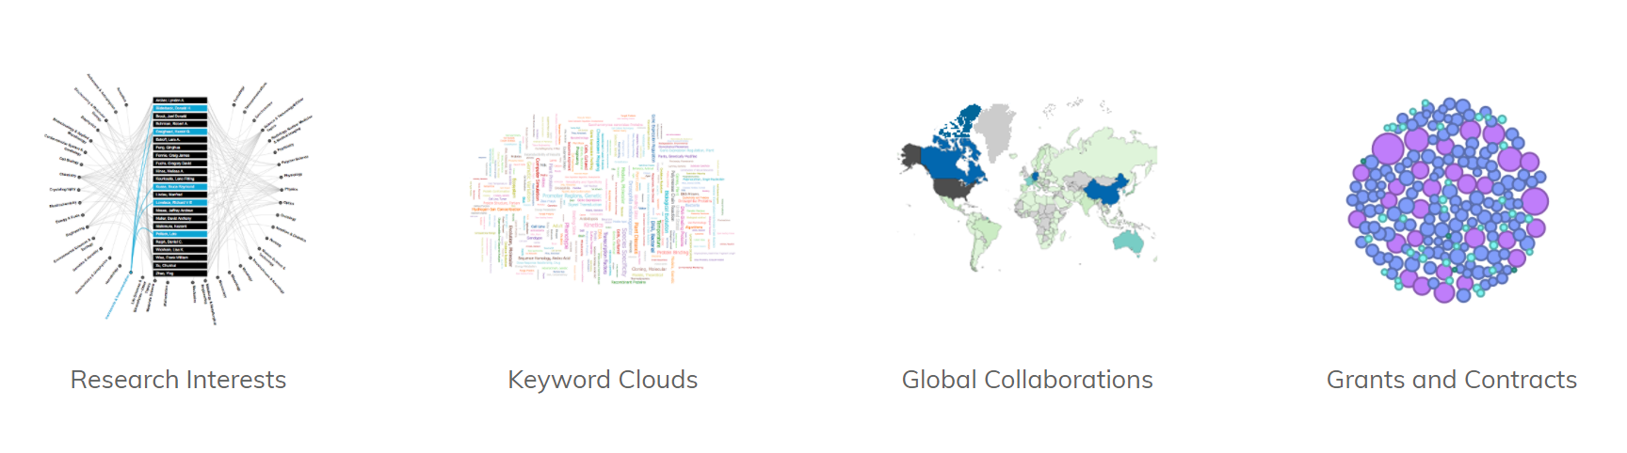
Why we need Faculty Research Information System?

Slide 7
Faculty Research Information System / Profile Management System
Software | Developed by
Activity Insight | Digital Measures
Symplectic Elements | Symplectic
Elsevier's Pure | Elsevier
InCites | Thomson Reuters
Pivot | ProQuest, LLC
Loop Research Profile | Nature Publishing Group
Digital Vita | Center for Dental Informatics - University of Pittsburgh
Profiles Research Networking Software | Harvard University
VIVO | Cornell / Duraspace

Slide 8
community-supported project under DuraSpace with open community development
Academic (115)
Research center (19)
Consortium (6)
VIVO Journey
NIH Grants, Enabling the National Networking of Scientists transforms VIVO to a multi-institutional open source platform led by the University of Florida
Profile for faculty members of Life Science at Cornell
Faculty Profile
Management System
Expansion to all disciplines and converted to Semantic Web
Born
(2003)
Bigger
2009-2012
2013 – present
2003 -2005
Stronger
2006-2008

Slide 9

Features
Profile information can be automatically imported from authoritative institutional data sources as well as from external sources.
Individuals can log in using institutional authentication procedures to modify their
profiles.
Information like research interests, publications, presentations, etc. can be
easily customized on the site.
Identify current work and find an expert with precision and reliability.
Simplify reporting tasks and provide visualizations such as co-author networks and the map of science network.
Adopted international standard: Consortia Advancing Standards in Research Administration Information (CASRAI)
Standard vocabulary such as AGROVOC, GEMET, LCSH, UMLS to describe the area of expertise
Notes:
External Vocabulary Services
AGROVOC (Agricultural Vocabulary)
GEMET (GEneral Multilingual Environmental Thesaurus)
LCSH (Library of Congress Subject Headings)
UMLS (Unified Medical Language System)

Slide 10
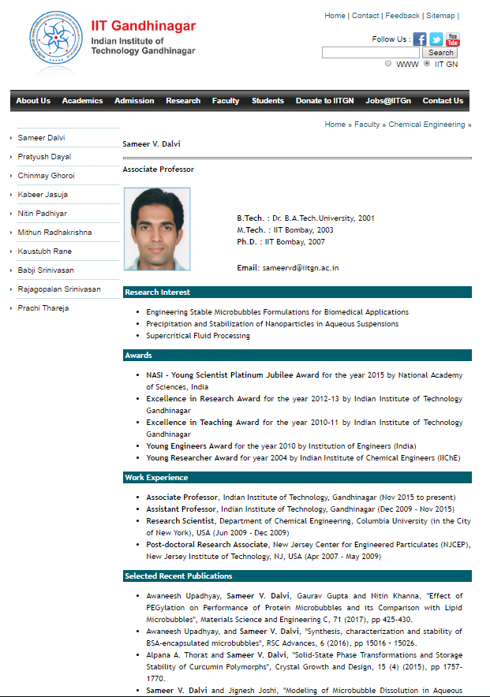
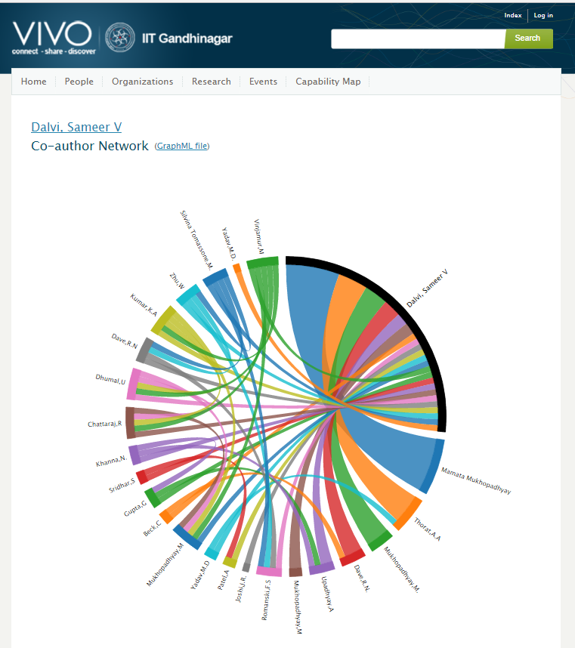
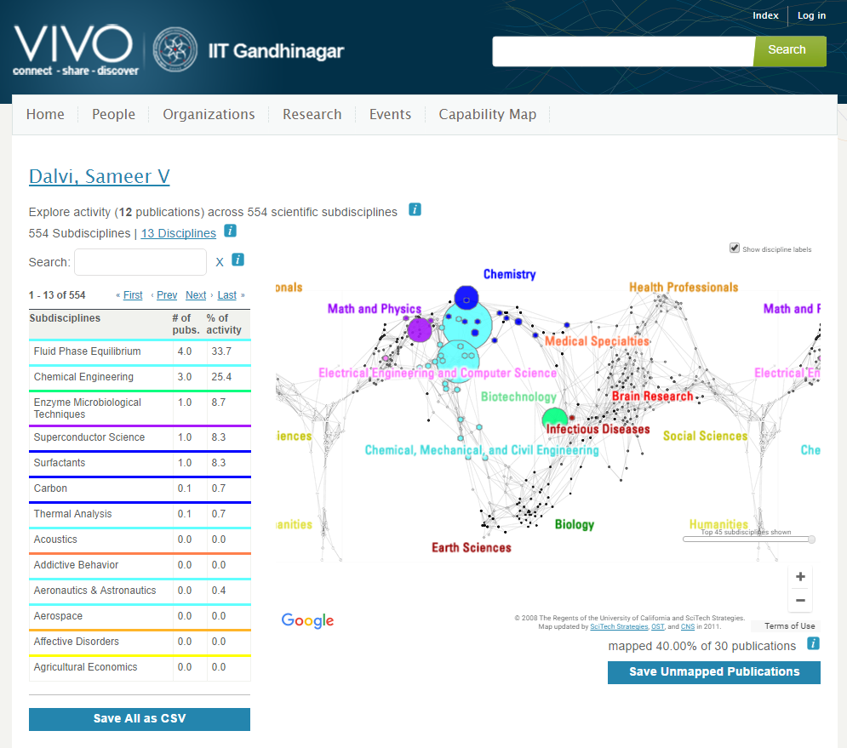
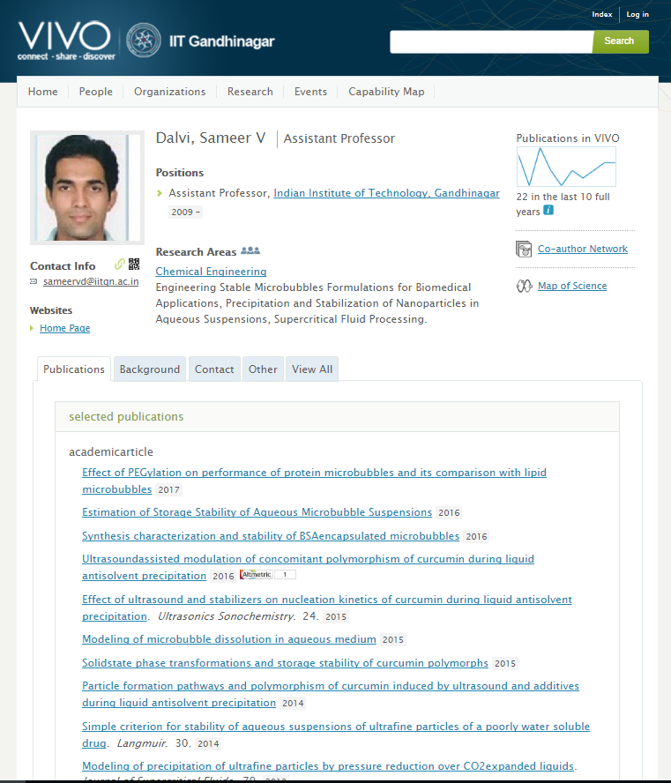
Before VIVO
After VIVO
Publication Count
Co-author Network
SKOS: AGROVOC, GEMET, LCSH, UMLS
Map of Science
Altmetric

Slide 11
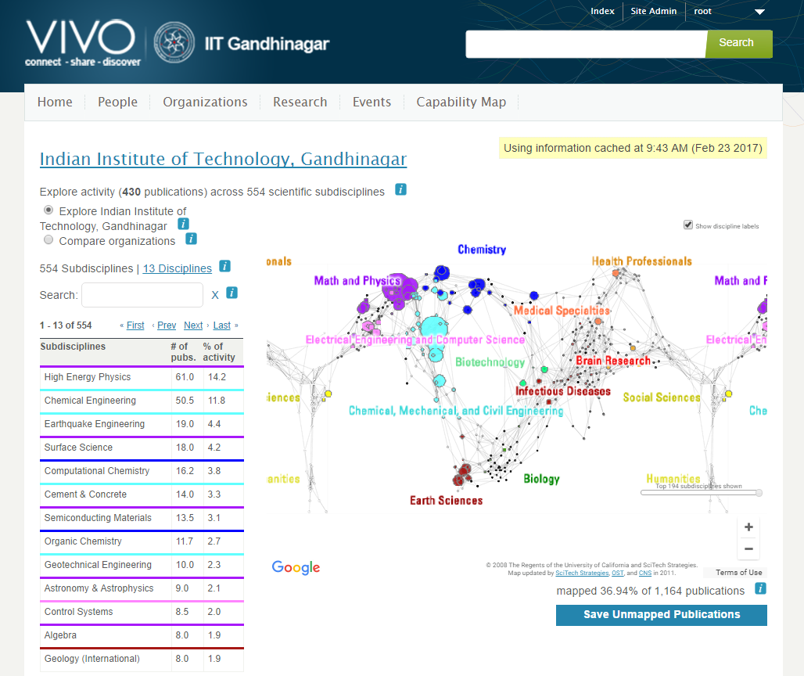
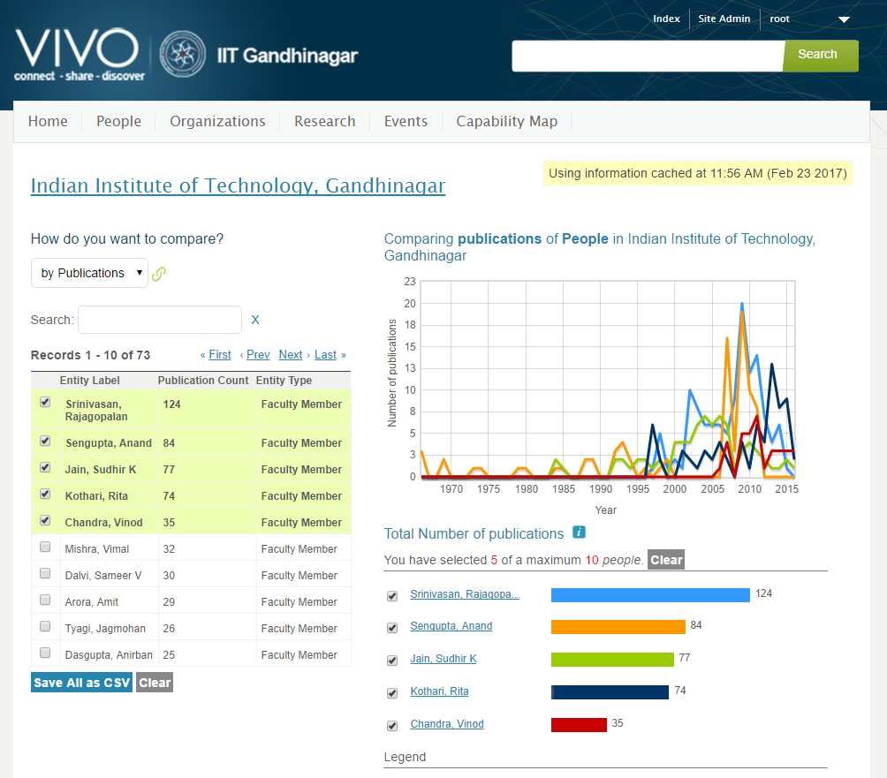
Map of Science for Institute
Temporal Graph for faculty

Slide 12
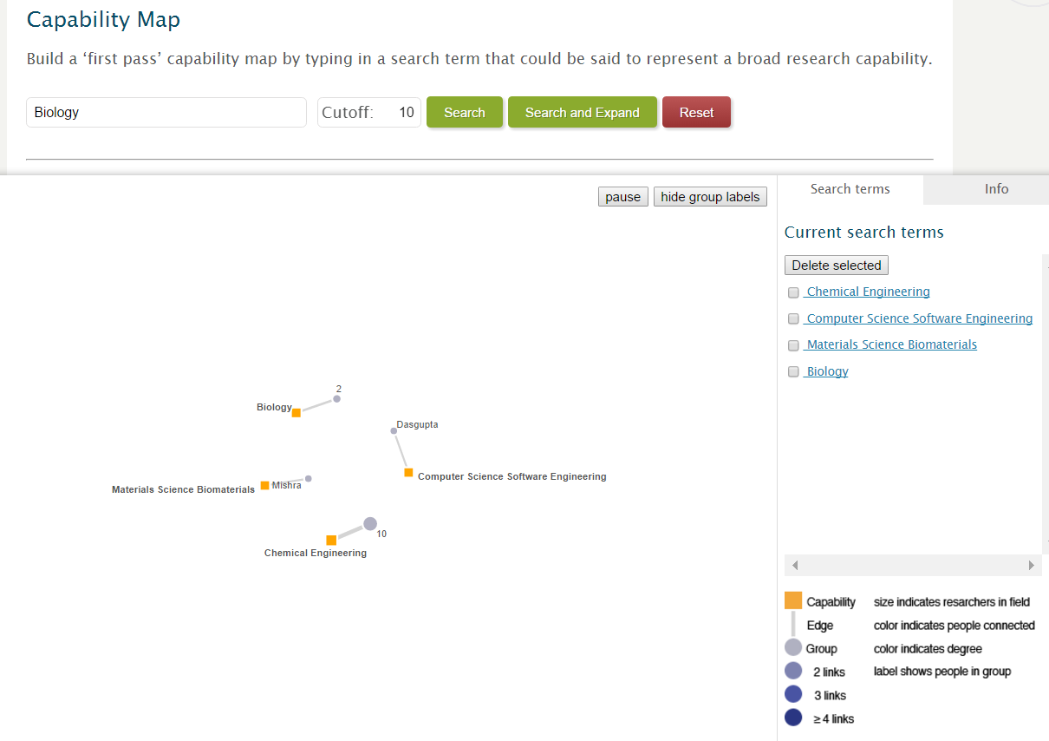
Capability Map

Slide 13
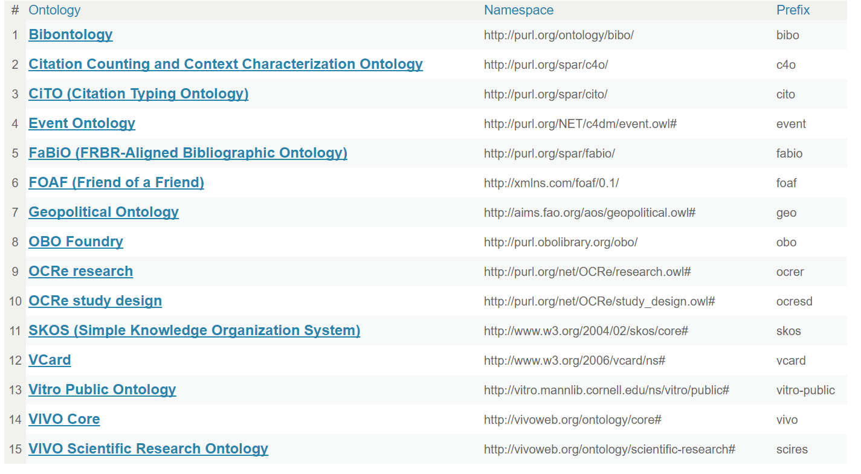
List of Ontology used in VIVO

Slide 14



Authorised Service Providers

Slide 15
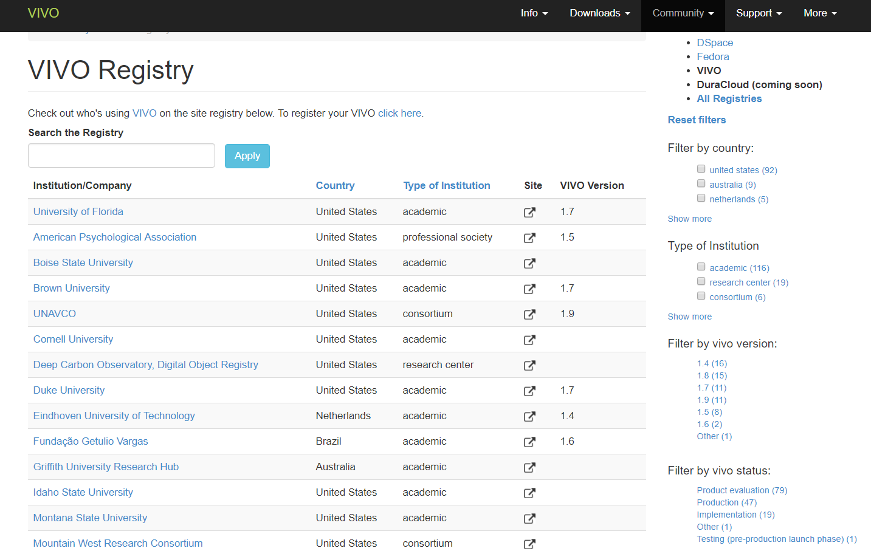
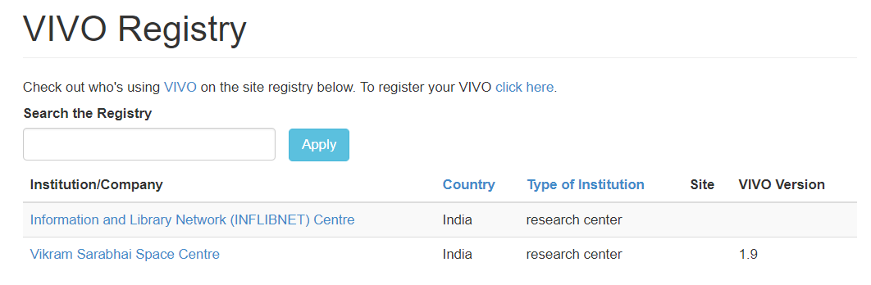
Who is using VIVO?

Slide 16






Who is using VIVO?

Slide 17
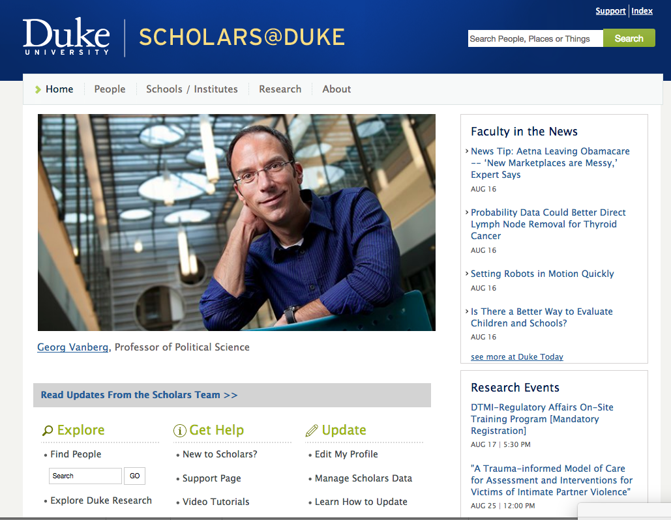
Who is using VIVO?

Slide 18
Who is using VIVO?
https://experts.colorado.edu

Slide 19
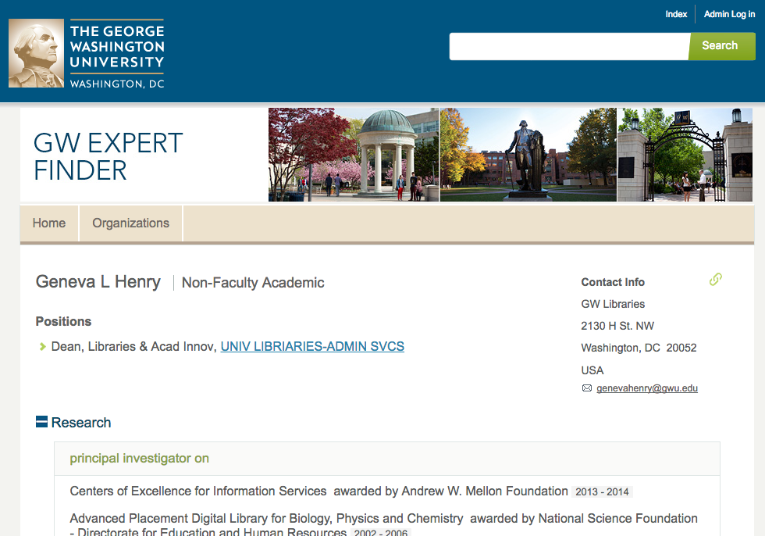
Who is using VIVO?
https://expert.gwu.edu

Slide 20
Who is using VIVO?
https://vivo.brown.edu

Slide 21
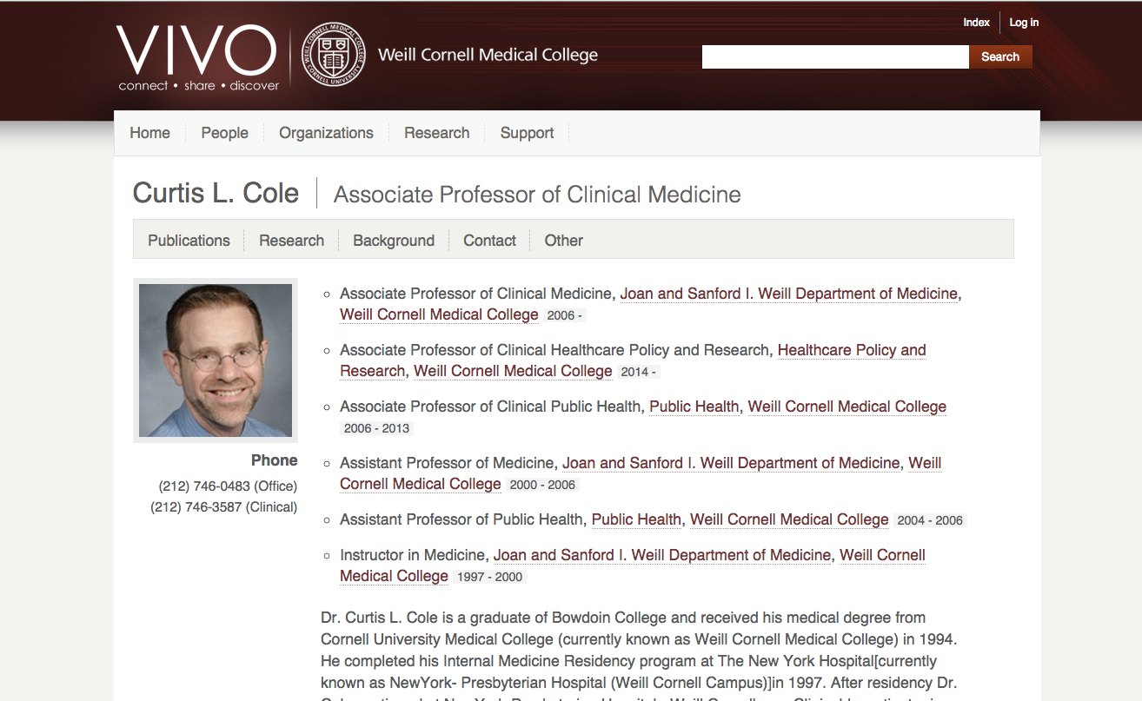
Who is using VIVO?

Slide 22


Use Case
Research Information System @
Group of Institutes /
R&D Laboratories
Single Sign on / Semantic CV
Single Sign on / Semantic CV
Research Information System @
Organisation
Research Information System @
National Level
Academic Associations
Multi-institutional
Search
Single Sign on / Semantic CV
Funding Agencies

Slide 23
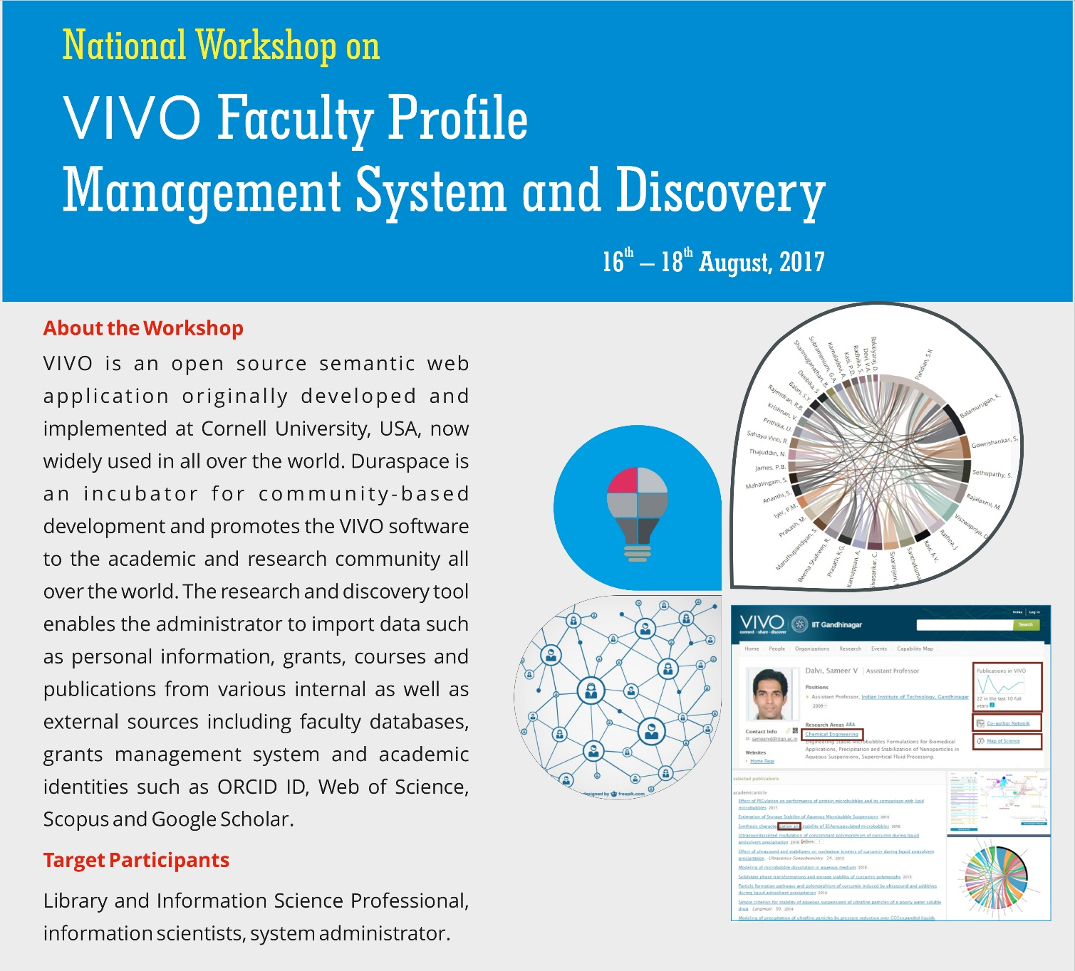

VIVO Workshop
16-18th August, 2017

Slide 24
THANKS !!!
Kannan P, INFLIBNET Centre
kannan@inflibnet.ac.in

Slide 25
Why we need Faculty Research Information System?
Find out all facilities and research carried out within universities or across universities and departments;
Organisation’s responsibility to inform the academic community about their faculty’s or researcher’s interest, skills, experience, accomplishment, projects and other scholarly activity;
To increase the funding opportunity for various research project; and
Research reporting for policy making and funding

