Slide 1

Entrepreneurship Education though a blended teaching approach
Rama Vaidyanathan, Ph.D.
Hepsibah Sharmil, Ph.D.
Dr. M.G.R. Educational and Research Institute
Maduravoyal, Chennai - 600095

Slide 2

Evolution of Teaching methods
Chalk and Talk
Transparancy Slides
LCD Projector
Video Lectures
Student lead Discussions
Notes:
Indian Education is poised at an interesting point. Both teaching pedagogy and assessment of students is changing. From a teacher centric we are changing to student centric methods. For example, the teaching methods are changing.

Slide 3
Assessment of Learning
Student Employability
Assessment Tests
Assignments
End Semester Written Examination
Practicals
Project
Notes:
The traditional assessment methods include a series of written tests, lab sessions and a project presentation in the end semester – for the credits.

Slide 4

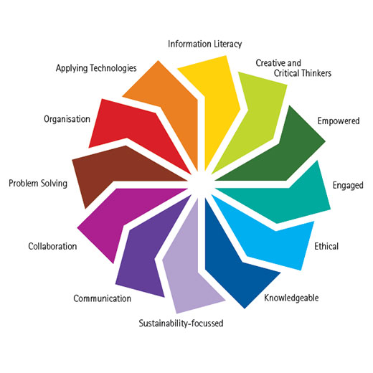
Graduate Attributes

Slide 5
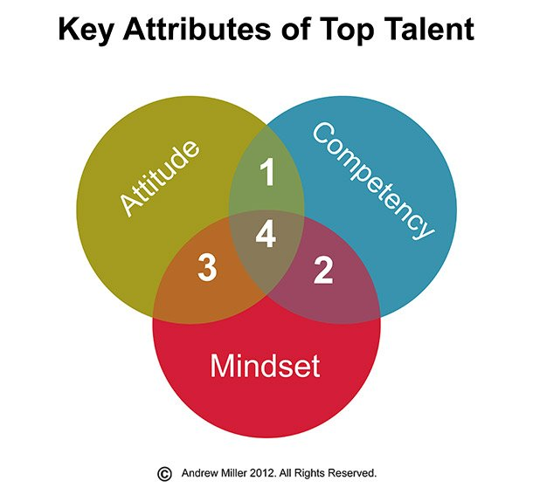
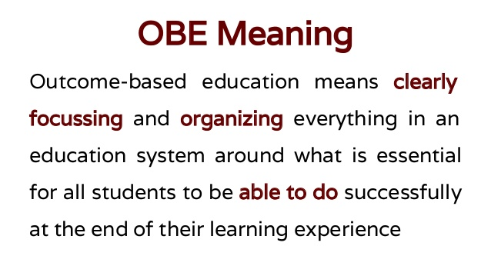

Slide 6

Next Generation learning
Anytime, anywhere
No prerequisites
Social learning methods
Blended learning methods
Outcome based education

Slide 7
Learning for the New Generation
MOOC
E - Learning
Technology Platform with an open environment
Anyone can access
Emphasis on learning process rather than evaluation and accreditation
Open at periodic session
An LMS platform with a closed environment
Prerequisites for registration
Evaluation and Accreditation oriented
Offered at specific times of the academic calender

Slide 8
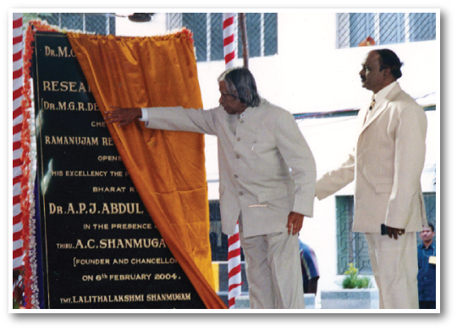
Dr. M.G.R. Educational and Research Institute
1985 | 1988 | 1991 | 2003 | 2008 | 2017
Tmt. Kannammal Educational Trust | Dr. M.G.R. Engineering College | Thai Mookambigai Dental College | Deemed University | A.C.S. Medical College and Hospital | NAAC A Certification 5000 Students
8 FACULTIES
23 UG Courses
26 PG Courses

Slide 9

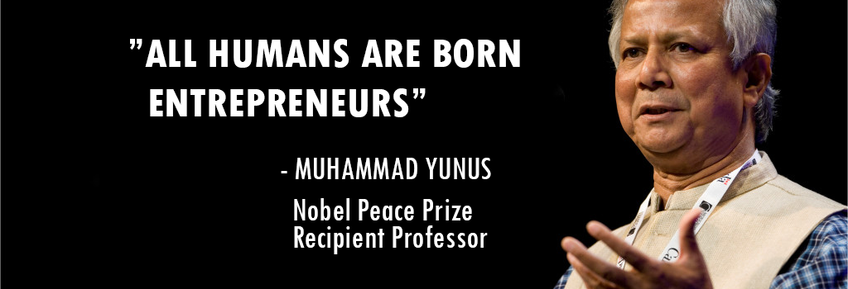
Institutional Vision
Job Creators and not Job Seekers

Slide 10
FACULTY - 9
Science
Engg. and Tech.
Commerce
Computer Applications
Management Studies
Medicine and Allied Sciences
Dental Surgery
Architecture
Education
8328 Students
7:3 Ratio of Male: Female

Slide 11
Need for Entrepreneurship Education in Campus
To change the mindset and attitude towards Entrepreneurship and Problem solving
Innovative thinking
Team work, leadership
Real job Experience in the Campus
Network across the Campus

Slide 12

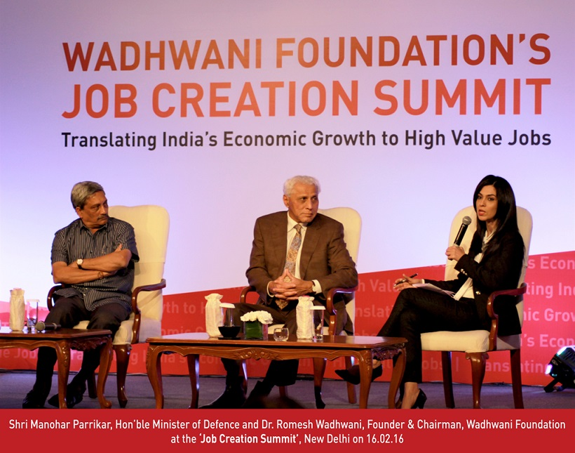
Partnered with Wadhwani Foundation

Slide 13
Approach to Entrepreneurship Education
Objective:
Educate and Equip potential and early stage entrepreneurs
Catalyze a culture shift to support aspiring entrepreneurs
Curriculum
Practicum
Certificate course in Entrepreneurship
Empowers Students with hard skills that are required to start and run a venture
Support students who have innovative ideas with mentoring, network and platforms
Structures EE into six phases: Orientation, Discovery, Practice, Start-Up, Growth and Expand
Entrepreneurial development through experiential learning at the Wadhwani E-cells
Students participate in entrepreneurship activities and apply learnings to real world situations and challenges
Students develop new age skills that will help them to become entrepreneurs & entrepreneurial leaders

Slide 14

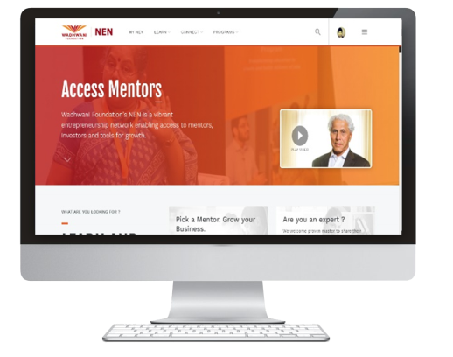
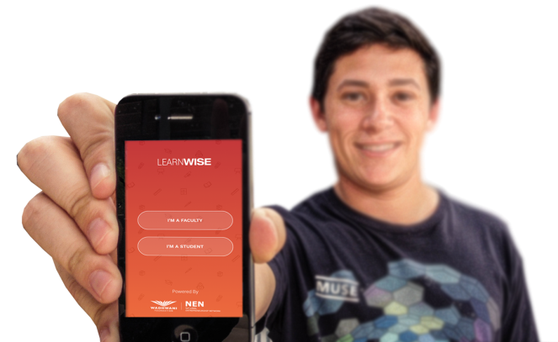
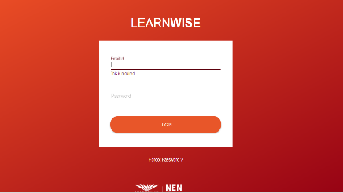
What is LEARNWISE™?
  LEARNWISE™ comprises a Web portal, called LEARNWISE.NEN.ORG and an Android App.
  An integrated learning platform that helps colleges admin, faculty, and students organize and manage entrepreneurship education.
  To be used by College Administration, Faculty, and Students.
learnwise.nen.org

Slide 15
ENTREPRENEURSHIP COURSES OFFERED BY NEN
SNO | Name of the Course | Title of the Course | Learning Outcomes
1 | WF 100 | Orientation Course in Entrepreneurship | Develop awareness about Entrepreneurship and develop key skills in Entrepreneurial thinking, Discover personal strengths and weakness
2 | WF101 | Basic Course in Entrepreneurship | learn about opportunity Idea Generation and evaluation, Design Thinking, develop a Capstone Project Presentation
3 | WF102 | Foundation Course in Entrepreneurship | Learn to Create a Business Model and building a prototype, Run a Campus Venture
4 | WF103 | Intermediate Course in Entrepreneurship | Launch a sustainable Venture with a valid Business Model and real paying customers; gain in-depth knowledge and relevant skills on a specific vertical
5 | WF104 | Advanced Course in Entrepreneurship | Manage and grow the Business; pitch to investors
6 | WF105 | Expert Course in Entrepreneurship | Reiterate the Business Model , scale up, look for partnership

Slide 16
WFNEN100
2016
Orientation Program to 600 Students of I year B.Tech.
38 Students registered for the program.

Slide 17
WFNEN100
Let’s Get Started
01
Explore E-cells on Campus
02
Listen to Some Success Stories
03
Characteristics of a Successful Entrepreneur
04
Communicate Effectively
05
Design Thinking for Customer Delight
06
Sales Skills to Become an Effective Entrepreneur
07
Managing Risks and Learning from Failures
08
Are You Ready to Be an Entrepreneur?
09

Slide 18
Session Plan
Ice Breaking
Overview of learning objectives
Quiz, Activity in class
3 min video describing the activity, debrief video
Assignment

Slide 19
Assignments
Interview
Interview a local entrepreneur
Team
Team activity – Design a backpack
Analyze
Analyze the communication style of your favorite entrepreneur
Craft
Craft an elevator pitch
Make
Make a Draft Action Plan

Slide 20
Practicum Events – at least 2
Think with the Box
Ideabox
Entrepreneurship Jeopardy
D.I.S.R.U.P.T.
One Dollar Venture
Meet an Entrepreneur

Slide 21
Facilitator Role
Class Delivery
Pause at the right time to restate some points
Ensure activities are done
Explain assignments
Grade Assignments
Facilitate Practicum events
Certify completion of course

Slide 22
WFNEN100 at Dr. MGR ERI
600 Students
38 Students enrolled for after College hours
30 Completed the course
Third Party Certification
27 Certified
3 Excellent, 8 Good, 16 Pass, 3 Redo
Teachers volunteered

Slide 23
Benefits – Student Perspective
Interaction with peers in the class
Development of communication skills – both oral and written
The practicum activities
  organize competitions for their class
  Planning, marketing and execution of the programs lead to a real job experience.
A few of the students emerged as leaders during the course.
Increased self-esteem when they participated in inter-college events
Three student groups prepared a plan for a campus start-up.

Slide 24
Benefits from Facilitator Perspective
Teachers were happy to align with Start-up India Campaign / Univ Mission
Use of Learnwise Platform – Teaching material prepared by International Experts
Participation from students of different background
Evaluation – each student assignment was different – no ready made answers
Outbound activities made students get over their shyness
Certification from NEN

Slide 25
Benefits to the University
Innovative Ideas for projects
NewGenIEDC funding
The Entrepreneurship Skills added to I year curriculum
More teachers were trained as EE Facilitators
Teachers were open to using MOOC in their other courses
We identified Star Performers among Faculty

Slide 26
Graduate Attributes & Programme Outcomes
PO | Graduate Attributes | Programme Outcome
1 | Engineering Knowledge | Apply knowledge of Mathematics, Basic Science and Engineering Science
2 | Problem Analysis | Identify, Formulate and solve Engineering Problems
3 | Design/Development of solutions | Design a system of process to improve its performance, satisfying its constraints
4 | Conduct Investigations of Complex Problems | Conduct experiments & collect, analyze and interpret the data.
5 | Modern tool usage | Apply various tools and techniques to improve the efficiency of the system
6 | The Engineer and Society | Conduct themselves to uphold the professional and social obligations
7 | Environment and Sustainability | Design the system with environment consciousness and sustainable development
8 | Ethics | Interact in Industry, business and society in a professional and ethical manner
9 | Individual and Team Work | Function in a Multidisciplinary team
10 | Communication | Proficiency in oral and written communication
11 | Project Management and Finance | Implement cost effective and improves system
12 | Life Long Learning | Continue professional development and learning as a life long activity

Slide 27
Program Outcome Matrix

Slide 28
Challenges
Most of the students depended on the faculty to screen the teaching material
Internet connectivity was a problem in some cases
Class room were not designed for teamwork
After class hours – some students found it difficult to make time
Need to recruit teachers across the campus

Slide 29
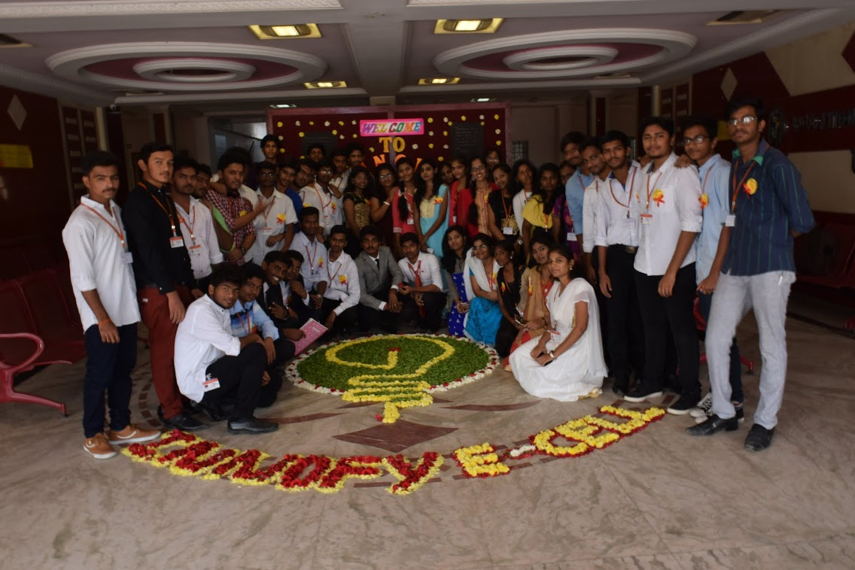
Acknowledgements
Wadhwani Foundation
Management, Dr. M.G.R. Educational and Research Institute
Star Faculty of Dr. M.G.R. Educational and Research Institute

