Slide 1

Ontology Engineering Methodologies: An Analytical Study
Syamili C.
Research Scholar
Dept. of LIS
Pondicherry University
csyamili@gmail.com
Dr. Rekha R. V.
Assistant Professor
Dept. of LIS
Pondicherry University
rekhatvm@gmail.com

Slide 2
OVERVIEW
What Is Ontology?
Why It is important?
Introduction to the Problem
Objective of the study
Methodology
Ontology Engineering Methodologies
Ontology engineering Methodologies, Tools and Languages: Comparison
Comparison of different ontologies and their ontology engineering methodologies
Findings

Slide 3

What is the problem ?
What information can we see
What Information can a machine see
WWW2002
The eleventh international world wide web conference
Sheraton waikiki hotel
Honolulu, hawaii, USA
7-11 may 2002
1 location 5 days learn interact
Registered participants coming from
australia, canada, chile denmark, france, germany, ghana, hong kong, india, ireland, italy, japan, malta, new zealand, the netherlands, norway, singapore, switzerland, the united kingdom, the united states, vietnam, zaire
Register now
On the 7th May Honolulu will provide the backdrop of the eleventh international world wide web conference. This prestigious event …
Speakers confirmed
Tim berners-lee
Tim is the well known inventor of the Web, …
Ian Foster
Ian is the pioneer of the Grid, the next generation internet …

Slide 4
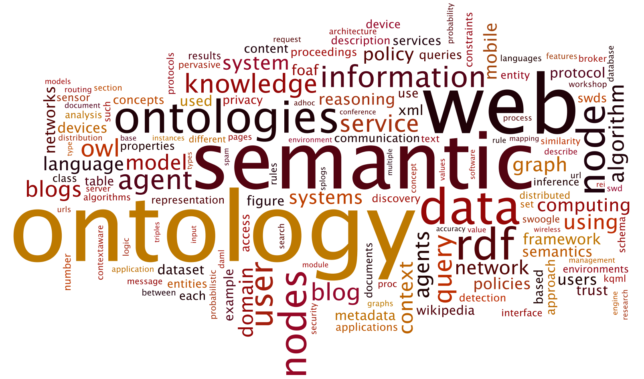
What Is Ontology?

Slide 5
Ontology Definition
-----By Thomas Robert (Tom) Gruber (1994)
‘A formal, explicit specification of a shared conceptualization’
must be machine
understandable
not private to some individual,
but accepted by a group
types of concepts and
constraints must be clearly
defined
an abstract model of some phenomenon in the world formed by identifying the relevant concepts of that phenomenon

Slide 6
Introduction to the Problem
When a new ontology is going to build, several basic questions arise related to the methodology, tools and techniques which are to be used in development process. The major questions related to methodology are
Which methodology can I use for building ontology?
Whether it should be start from scratch or using other ontologies available on the server?
Which is the life cycle of an ontology that is developed with a specific methodology?
Keeping these issues in mind the study attempts to critically evaluate the existing ontology engineering methodologies.

Slide 7
Objectives of the study
Discusses various ontology engineering methodologies
Compare major existing domain ontologies with these ontology engineering methodologies.
Critically analyses the problems of existing engineering methodologies and put forward some suggestions to overcome these limitations.

Slide 8
Methodology
The study includes two phases. In first phase an exhaustive literature search has been done to identify the existing ontology engineering methodologies. These methodologies were critically analysed and discussed in first section. Many individual projects also describe their specific methodologies; these are purposefully not included.
In the second phase of the study various documented ontologies of different domain has been compared with respect to their methodologies. For these various ontology libraries has been

Slide 9
Ontology Libraries
Ontology Library | URL
Swoogle | http://swoogle.umbc.edu/
TONES ontology repository | http://www.inf.unibz.it/tones/
Protege ontology library | http://protegewiki.stanford.edu/wiki/Protege_Ontology_Library
LOV | https://lov.okfn.org/dataset/lov/
Ontolingua ontology library | http:// www.ksl.stanford.edu/ software /ontolingua/
DMOZ | www.dmoz.org
DAML ontology library | http://www.daml.org/ontologies/
UNSPSC | www.unspsc.org
RosettaNet | www.rosettanet.org

Slide 10
Ontology Engineering Methodology
Cyc
Uschold and King 1995
Gruninger and Fox
SENSUS
METHONTOLOGY
On- To- Knowledge Methodology
Activity First Method AFM,
KACTUS
C04
YAMO

Slide 11
Cyc
The Cys project started by D.B. Lenat at MCC in 1984 as a knowledge representation project.
1st phase: In this step implicit and explicit knowledge will be coded without the help of natural language systems and machines. It includes the manual codification of articles and knowledge which contain common sense knowledge. This phase is carried out by hand.
2nd phase: This phase include the computer aided extraction of common sense knowledge by humans.
3rd phase: This phase include computer aided extraction of common sense knowledge, though no humans are involved in this process.

Slide 12
Uschold and King 1995
Identify Purpose
Building the Ontology
Evaluation
Documentation
Ontology Capture
Ontology Coding
Integrating Existing ontologies
The first methodology for developing ontology was put forwarded by Uschold and King in 1995. It is a four step process. This methodology is also based on the experience of developing ontology for enterprise modeling processes.
The four steps are shown in the diagram.

Slide 13
Bottom up
Most concrete to most abstract
Top down
Most abstract to most concrete
Middle out
Most relevant to the most abstract and most concrete
results in very high detailing

Slide 14
Gruninger and Fox
In 1995 Gruninger and Fox designed an approach for developing ontology. This methodology is based on the experience of developing TOVE (TOronto Virtual Enterprise) ontology(Gruninger, M., and Fox, 1995). This method is also called TOVE Methodology. The overall process can be represented using the diagram below.
Motivating Scenario
Informal Competency questions
Formal Terminology
Formal Competency question
Formal Axioms
Completness theorums

Slide 15
SENSUS
This is a method for domain specific ontology from large ontologies (Swartout, Knight, Russ, & Rey, 1997). It is developed by Information Sciences Institute Natural Language Group.
Identification of key terms. This key term is called seed term.
Linking manually the terms using Ontosarus
All concepts from the seed term to root are included.
Adding of new term which are relevant and not yet included.
Adding of sub trees to the final ontology

Slide 16
METHONTOLOGY
It has been created in the Artifical Intelligence Lab of Polytechnic University of Madrid. It is based on IEEE standards for developing software 1074-1995. This method can be used for developing ontologies from scratch, reusing and reengineering. Tools like WebODE support methontology. Other tools are also compatible with methontology.
It helps in identifying primary concept first. Later one can move on either to specialization or to generalization.

Slide 17
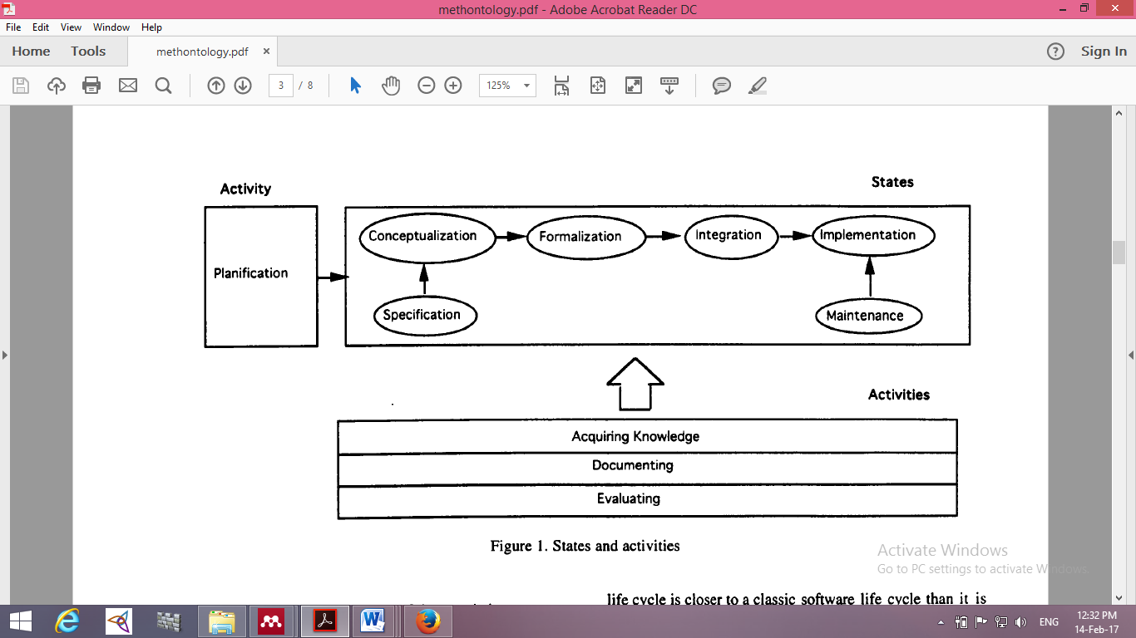
States and Activities involved in METHONTOLOGY

Slide 18
On- To- Knowledge Methodology
It includes identification of goals that is to be achieved by knowledge management tools and is based on an analysis of usage scenarios. The figure shows the steps followed in this method.

Slide 19
On- To- Knowledge Methodology

Slide 20
Comparison of different ontologies and their ontology engineering methodologies
No | Name of the ontology | Author | Year | Methodology used
1 | TOronto Virtual Enterprise ontology (TOVE) | (Gruninger, M., and Fox, 1995) | 1995 | Gruninger & Fox Methodology
2 | The Reference Ontology | (Arpírez, Gómez-Pérez, Lozano-Tello, & Pinto, 2000) | (1998) | Methontology
3 | Knowledge Acquisition Ontology | BLÁZQUEZ, J. FERNANDEZ, M. GARCÍA-PINAR, J. & GÓMEZ-PÉREZ, A. | (1998) | Methontology
4 | Chemical ontology | FERNADEZ-LOPEZ, M., et. al | (1999) | Methontology
5 | Environmental pollutants ontology | (Asunción Gómez-Pérez and Dolores Rojas-Amaya, 1999) | 1999 | Methontology

Slide 21
No | Name of the ontology | Author | Year | Methodology used
6 | Legal Ontology | (CORCHO, O., 2002) | 2002 | Methontology
7 | Pizza ontology | (Drummond, N., Horridge, M., Stevens, R., Wroe, C. and Sampaio, 2005) | 2005 | No clue on methodology
8 | Wine Ontology | (Graca, J., Mourao, M., Anunciacao, O., Monteiro, P., Pinto, H.S. and Loureiro, 2005) | 2005 | Enterprise Ontology+Methontology
9 | Information Science Ontology | Sawsaa, A. & Lu, J | (2010) | Methontology
10 | Beer Ontology | (Heflin, 2012) | 2012 | No clue on methodology

Slide 22
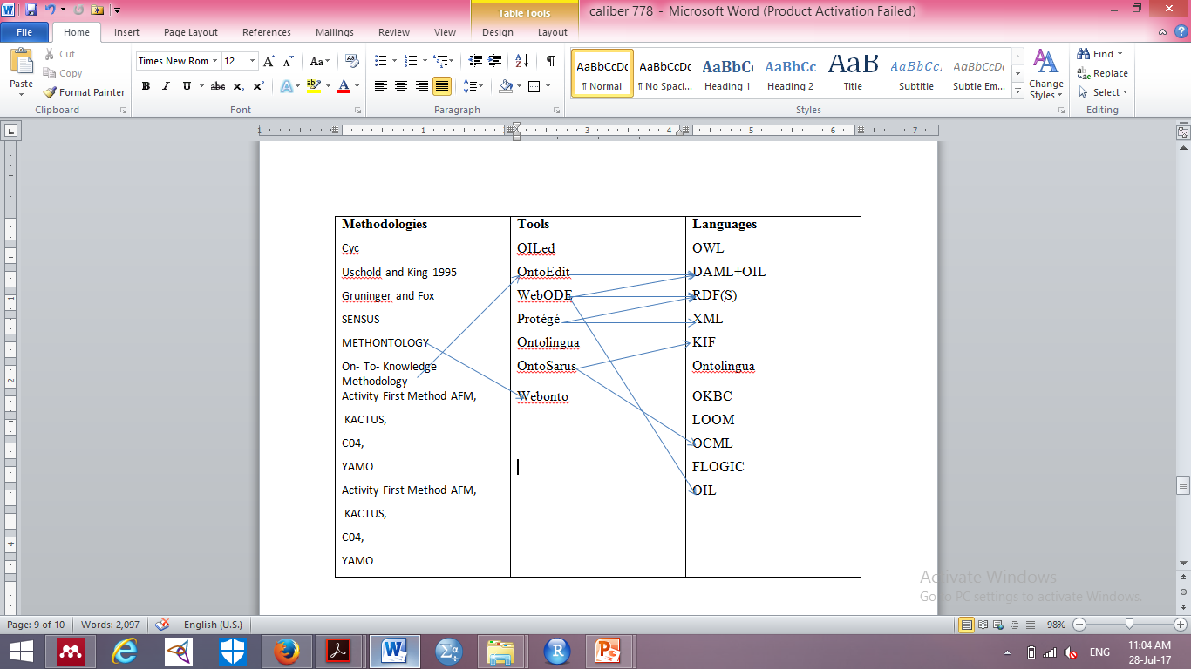
Ontology engineering Methodologies, Tools and Languages: Comparison

Slide 23
11 | Quran ontology for Juz’ Amma | (Iqbal, Mustapha, & Yusoff, 2013) | 2013 | ontology merging approach
12 | Textile chemical ontology | (Ferrero & Lloret, 2014) | 2014 | Methontology
13 | Food Ontology | (Dutta, Chatterjee, & Madalli, 2015) | 2015 | YAMO

Slide 24
Findings
By Comparing different domain ontologies and different ontology engineering methodologies the following observations were found.
Each of these methodologies following different approaches.
There is no correspondence between ontology building methodologies and tools, except for METHONTOLOGY and WebODE, and On-To-Knowledge and OntoEdit.

Slide 25
Since there is no technological support for most of the existing methodologies, they cannot be easily applied in the ontology construction task.
In fact, most of the tools just focus on few activities of the ontology lifecycle: design and implementation.
METHONTOLOGY is most widely used methodology in developing ontology irrespective of the time

Slide 26
Reference
Arpírez, J. C., Gómez-Pérez, A., Lozano-Tello, A., & Pinto, H. S. A. N. P. (2000). Reference Ontology and (ONTO)2 Agent: The Ontology Yellow Pages. In Knowledge and Information Systems (Vol. 2, pp. 387–412). http://doi.org/10.1007/PL00011649
Asunción Gómez-Pérez and Dolores Rojas-Amaya. (1999). Ontological Reengineering and reuse. In Dieter Fensel and Rudi Studer (Ed.), Proceedings of the 11th European Workshop on Knowledge Acquisition, Modeling and Management (EKAW ’99) (pp. 139–156). London: Springer-Verlag.
CORCHO, O., et. al. (2002). Building legal ontologies with METHONTOLOGY and WebODE. Retrieved November 3, 2016, from http://academic.research.microsoft.com/Paper/1856108.aspx
Corcho, O., Fern, Mariano, & Gómez-pérez, A. (2003). Methodologies , tools and languages for building ontologies . Where is their meeting point ? Data & Knowledge Engineering, 46, 41–64. http://doi.org/10.1016/S0169-023X(02)00195-7
Drummond, N., Horridge, M., Stevens, R., Wroe, C. and Sampaio, S. (2005). Pizza Ontology. Manchester.: The University of Manchester.
Dutta, B., Chatterjee, U., & Madalli, D. P. (2015). YAMO : Yet Another Methodology for large-scale faceted Ontology construction. Journal of Knowledge Management, 19(1), 6–24. http://doi.org/10.1108/JKM-10-2014-0439
Ferrero, C. P., & Lloret, E. (2014). Towards the Design of a Textile Chemical Ontology. International Journal of Advanced Computer Science and Applications, Special Issue on Natural Language Processing 2014, 35–41. Retrieved from www.ijacsa.thesai.org
Graca, J., Mourao, M., Anunciacao, O., Monteiro, P., Pinto, H.S. and Loureiro, V. (2005). Ontology building process: the wine domain. In Proceedings of the 5th Conference of EFIT, Vila Real. Vila Real.
Gruninger, M., and Fox, M. S. (1995). “Methodology for the Design and Evaluation of Ontologies”,. In Workshop on Basic Ontological Issues in Knowledge Sharing, IJCAI-95,Montreal.
Heflin, J. (2012). Beer Ontology 1.0 (Draft). Retrieved November 3, 2016, from www.cs.umd.edu/projects/plus/SHOE/onts/%0Abeer1.0.html
Iqbal, R., Mustapha, A., & Yusoff, Z. M. (2013). An experience of developing Quran ontology with contextual information support. Multicultural Education & Technology Journal, 7(4), 333–343. http://doi.org/http://dx.doi.org/10.1108/METJ-03-2013-0009
Matteo, S. (2014). 14th EAHIL 2014 Conference 11-13 June , Rome , Italy What is Altmetrics ? The impact of Altmetrics on San Matteo researchers and on librarians ’, 1–38.
Swartout, B., Knight, K., Russ, T., & Rey, M. (1997). Toward Distributed Use of Large-Scale Ontologies. AAAI Technical Report SS-97-06., 138–148.

Slide 27


