Slide 1

Functioning of ‘Research’ Tools in the Enrichment of Research in K. K. Handiqui Library, Gauhati University
Nitya Nanda Pathak Konika Malakar
Assistant Librarian Library Assistant
K.K.H.Library, Gauhati University K.K.H.Library, GU
npathak@gauhati.ac.in konikamalakar@yahoo.com

Slide 2

Abstract :
Overview of the quality of research as enhanced by the ‘Research’ Tools in knowledge management practices in K. K. Handiqui Library, Gauhati University
Investigates the potentiality of digital scholarship with the help of Internet and website.
The paper identifies the strengths and opportunities of the ‘research’ tools in improving the quality of research in the near future.

Slide 3

Objective:
The main purpose of this study is to spread information on the functioning of the ‘research’ tools as well as on the significance of ETD and the concept of plagiarism within academic communities
find the most desirable factors out of various items which are going to have an impact on the research quality, researcher’s intentions for using the research tools and their intention to plagiarize.

Slide 4
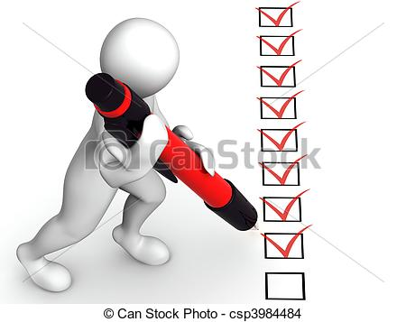
Methodology:
questionnaire
Personal interview of selected faculty members was also conducted on the use and satisfaction of URKUND’s software activities
Data from URKUND

Slide 5



GAUHATI UNIVERSITY………..
As rated by NIRF- MHRD during 2017, GU occupies --
Top position amongst the North Eastern Universities
5th amongst the state Universities,
27th amongst all State and Central Universities
43rd amongst all Institutions (State & Central Universities, All Technical Institutes, All Management Institutes etc.)

Slide 6
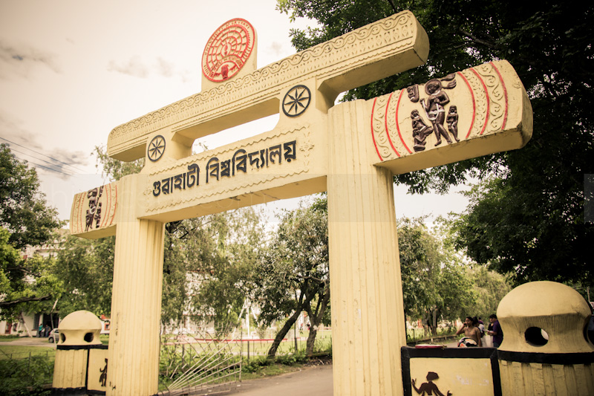
The University has
more than 750 Ph.D Research Scholars,
1750 M.Phil students and
349 Faculty members.
Every year more than 250 student are awarded M.Phil/Ph.D degree by the university

Slide 7
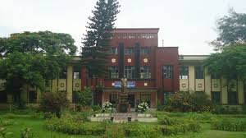
As of 30th April, 2017, Krishna Kanta Handiqui Library has over
5200 nos. thesis,
5800 nos. Dissertations,
4500 manuscripts,
4726 nos. Report Literature,
7593 volumes in 11 different languages in the K.K.Handiqui Collection,
150000 pages Digitizd Manuscripts,
852524 pages digitized theses.
At the same time, the library actively organizes programmes and training session to support the students/researchers.

Slide 8
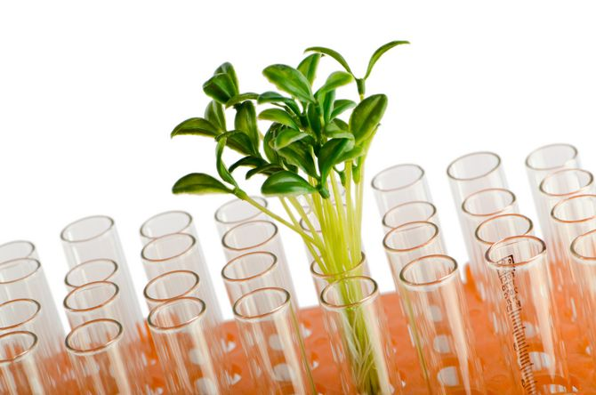
Plagiarism Policy of Gauhati University
According to the UGC Regulation 2009 “Minimum standards and procedure for award of M.Phil/Ph.D degree” it has become mandatory to check the research work through turnitin/Urkund. Accordingly Gauhati University has made it compulsory for all Ph.D thesis to check the similarity index before uploading the Ph.D theses into ShodhGanga.

Slide 9
Under the GU Plagiarism policy the university has mandated :
URKUND check and certification for all theses by Ph.D. scholars to be verified by supervisors/guides. Finally University Librarian issues a plagiarism verification certificate of similarity report for obtaining Ph. D degree.
Regular awareness and training has been given by the librarians to the research scholars and faculty member.
Ph.D. Scholars are allowed to take content other sources not exceeding 20%.

Slide 10
  Anti plagiarism software in Gauhati University
Analysis from Turnitin/URKUND
April 30, 2017

Slide 11
Analysis from URKUND

Slide 12
URKUND Similarity Index Report
DISCIPLINES | TOTAL NO. OF
 | SIMILARITY REPORT ANALYZED
Arts and Fine Arts | 421
Science | 329
Technology and Engineering | 16
Commerce | 23
Management | 2
Law | 24
Analysis from URKUND

Slide 13
DISCIPLINES | MINIMUM SIMILARITY | MAXIMUM SIMILARITY
 | REPORT FOUND (%) | REPORT FOUND (%)
Arts and Fine Arts | 0 | 18
Science | 1 | 19
Technology and Engineering | 1 | 11
Commerce | 0 | 19
Management | 7 | 14
Law | 1 | 14
Analysis from URKUND

Slide 14
Data Analysis from the collected questionnaire
Responses from different streams
Stream | Response | Percentage
Arts and Fine Arts | 43 | 28.10
Science | 52 | 33.98
Technology and Engineering | 22 | 14.37
Commerce | 15 | 9.8
Management | 12 | 7.84
Law | 9 | 5.88

Slide 15

Use of Website/Internet Resources in Research Work
How often do you use the Internet/Websites resources to Complete your Research work | Responses | %
Very often | 81 | 52.94
Often | 36 | 23.52
Sometimes | 36 | 23.52
N/R | 00 | 0
Data Analysis from the collected questionnaire

Slide 16
References/Bibliography in the research work
How often do you correctly cite references to what is used in your Research work | Responses | %
Very often | 81 | 52.94
Often | 18 | 11.76
Sometimes | 54 | 35.29
N/R | 00 | 0
Data Analysis from the collected questionnaire

Slide 17

Research Work and Resources
How often do you use the Academic and Electronic Resources for your Research Work provided by KKHL, GU | Responses | %
Very often | 63 | 41.17
Often | 36 | 23.52
Sometimes | 40 | 26.13
N/R | 9 | 5.88

Slide 18
Pressure of obtaining the Ph. D Degree
Do the pressures of obtaining PH.D Degree lead you to think of plagiarism ? | Responses | %
Yes | 18 | 11.76
No | 108 | 70.58
N/R | 18 | 11.76
Personal Rating
How do you personally rate the KKHL initiative of providing Plagiarism software ? | Responses | %
Highly Appreciable | 99 | 64.70
Appreciable | 45 | 29.41
Not appreciable | 9 | 5.88

Slide 19
Support by Similarity Report
Does similarity report help in improving research work | Responses | %
Yes | 126 | 82.35
No | 9 | 5.88
N/R | 18 | 11.76
Instant feedback
Does your Guides/supervisors provide instant feedback through URKUND ? | Responses | %
Yes | 54 | 35.29
No | 36 | 23.52
N/R | 63 | 41.17

Slide 20



Reference Management and Citation Tools
Which of the citation tools and Reference Management Tools have you used | Responses | %
M endely | 18 | 11.76
Z otero | 18 | 11.76
Bibexcel | 9 | 5.88
Endnote | 63 | 41.17

Slide 21
Selected views from faculty members of Gauhati University
Professor and Dean, Department of Commerce
“Urkund has been found to be very user-friendly, less time consuming, fast, dynamic and effective software for academic purpose”
Professor and Head Department of ELT, GU
“The anti-plagiarism software that Gauhati University is using is a very user friendly. It should be used by all students, Research Scholars and teachers”
Professor, Department Library and Information Science
“Regular interaction is suggested”.
Professor and Head, Dept. of Physics
“Two Ph.D. theses were checked and they had published paper. But the result showed only 1% similarity index which is very surprising. We very much need the software”.
Professor, Department of Statistics.
“The anti plagiarism software is found to be user friendly, and very useful to know the amount of work found duplicated. It is useful for the students, Research Scholars, academicians and other for improved and quality work”

Slide 22
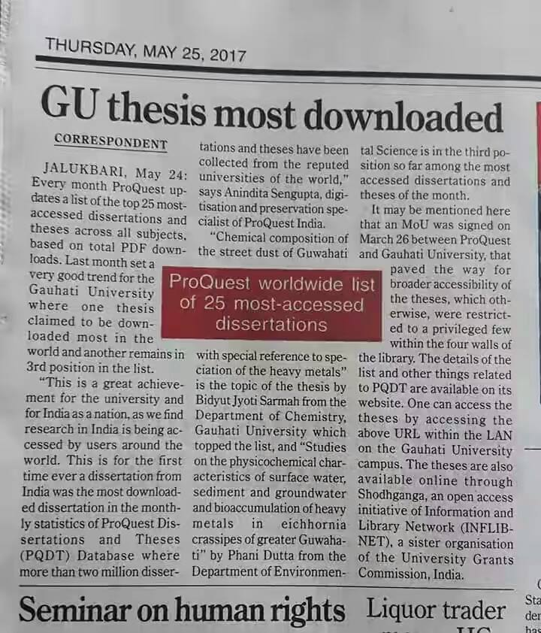
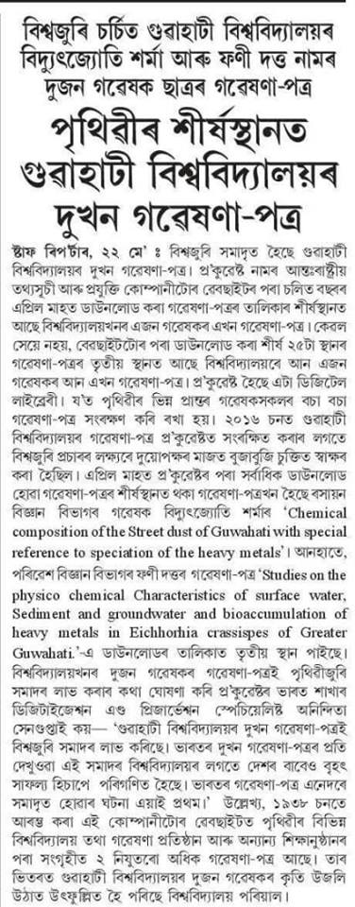
Highest Access of Ph. D theses from Gauhati University in the World through PQDT:
Author | Subject | Title | Rank(World)
Dr. Bidyut Jyoti Sarmah | Chemistry | Chemical composition of the Street dust of Guwahati with special reference to speciation of the heavy metals. | 1st
Dr. Phani Dutta | Environmental Science | Studies on the physico chemical characteristics of surface water, Sdiment and groundwater and bioaccumulation of heavy metals in Eichhornia crassipes of Greater Guwahati P | 3rd
BEST PRACTICES

Slide 23

Summary of Findings:
‘Research’ tools including the anti-plagiarism software has been found to be of great help by the research community. Yet, there remains a gap regarding its understanding and use, basically that of Zotero, Endnote, Bibexcel, which were found to be unheard by most of the academicians.
In this sense we recommend that initiatives should be taken by the concerned Departments and UGC Academic Staff College in including awareness of the programme within the Ph.D. course work and the skill development programme respectively.

Slide 24


