Slide 1


Implementation of a Web based Text Extraction Tool using Open Source Object Models
S.Rajeswari
Head , Scientific Information Resource Division
Indira Gandhi Centre for Atomic Research
Kalpakkam. 603102
raj@igcar.gov.in

Slide 2
Motivation
Scanned documents older than 2 decades are available in libraries and institutional repositories in large number.
To retrieve meta data from these documents, text extraction tools are necessary.
To extract text from such scanned documents, the tool used is Optical Character Recognition (OCR).

Slide 3
Scope of this work
Open source libraries were used in the implementation of a web based OCR tool to extract text from scanned documents.
Developing an in-house OCR tool would make it possible to customize Text extraction from documents and store the extracted text in the format that is required for further processing.
In addition to an OCR tool, a pre processing tool to remove skew introduced in the document during scanning was developed using open source tools

Slide 4
Scanner – The tool that generates scanned documents
Scanner involves recording changes in light intensity reflected from the document as a matrix of dots.
The light/ colour values of each dot is stored in binary digits, one bit being required for each dot in a black/white scan and up to 32 bits for a colour scan.
- Reference : Haigh, Susan. Optical character recognition (OCR) as a digitization technology. Network Notes #37. November 15, 1996.

Slide 5
Optical Character Recognition
Optical Character Recognition (OCR) is the ability of a computer to read the content of a document from a scanned image.
Normally a scanned document is one large graphic file.
OCR enables the computer to recognize letters and turn the document into regular text.
An OCR document is smaller to store on the computer.
It can be searched or edited like other text documents.

Slide 6
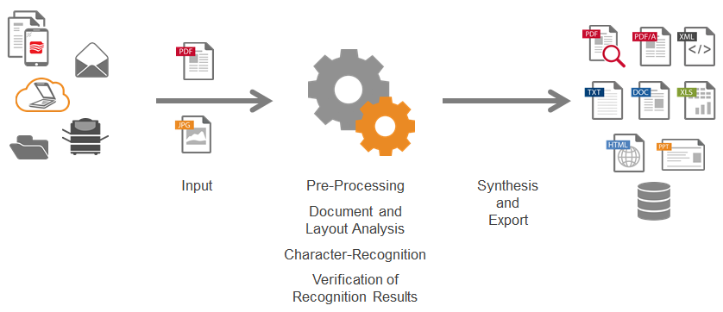
What is OCR
Ack: https://abbyy.technology/en:features:ocr:start

Slide 7
OCR Step 1 : Pre-Processing
Image cleaning routines
Skew correction
Binarisation

Slide 8
OCR Step 2 : Layout Analysis
Page analysis is the next major routine used in character recognition process.
Find page elements like blocks of text, tables, lines, single characters .
Line segmentation
The word segmentation.
The character segmentation separates the various letters of a word.
If the characters have fixed pitch, character segmentation is easy.
Notes:
Page analysis is the next major routine used in character recognition process. It is finding page elements like blocks of text, tables, lines, single characters .
Line segmentation consists of slicing a page of text into its different lines.
The word segmentation isolates one word from another.
The character segmentation separates the various letters of a word. If the characters have the same width (fixed pitch), character segmentation is easy.

Slide 9
OCR Step 3 : Character Recognition
The pixels of a scanned image has to be organised into characters.
To do this a library of characters in pixel form is necessary.
This library should support different fonts, styles and sizes.
At this point either a feature extraction routine or matrix matching routine compares the characters in the scanned image file to the characters in the library.

Slide 10
Microsoft Object Document Imaging (MODI)
It was found MODI consisted of object libraries for
Binarization
Segmentation
Pixel Library for a lot of fonts, libraries for font expansion, glyphs, inversions, font styles(italics, bold,..) were available in MODI
So it was decided to use MODI – a script engine using ASP.Net
A web based tool using MODI was developed.

Slide 11
Evaluation of OCRs
It was decided to evaluate other OCR tools with the OCR tool developed in-house.
Two OCRs (Adobe Acrobat Pro, Abby Fine Reader) and open source OCR ( Tesseract ) was selected for the study .
Different Documents were chosen and used for evaluating the OCR engine . The documents are chosen with
o many columns, o multi font,
o blurred, o bevel, o invoices,
o text embedded within images , o distorted in different formats .

Slide 12
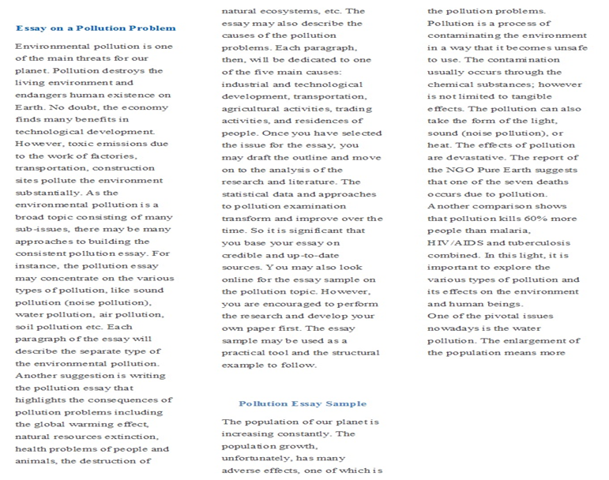
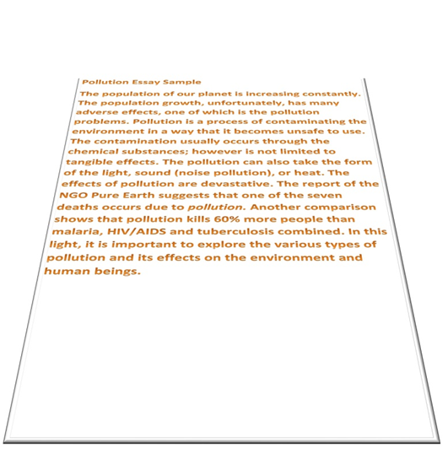
Documents used to check their accuracy
1. 3 column
2. Bevel

Slide 13
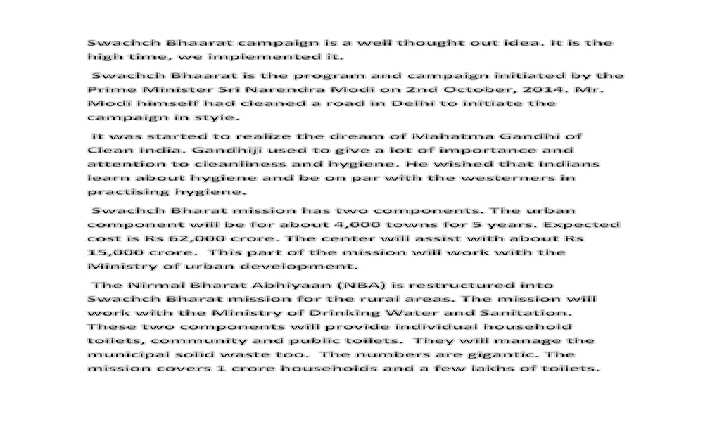

4. Conversation
3. Blur

Slide 14
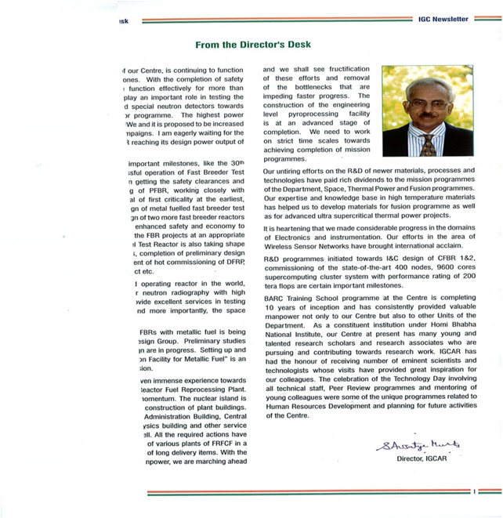
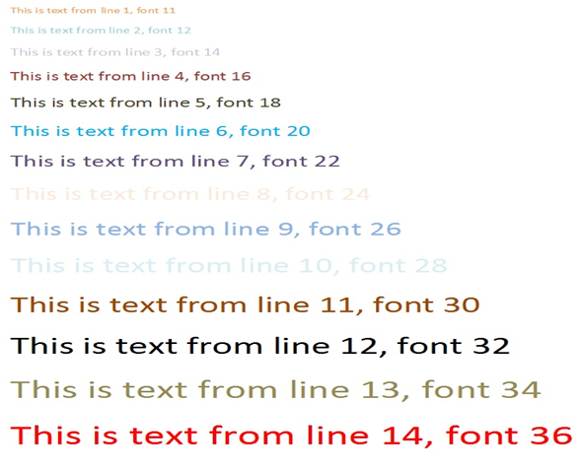
6. Distorted
5. Different Fonts & Colours

Slide 15

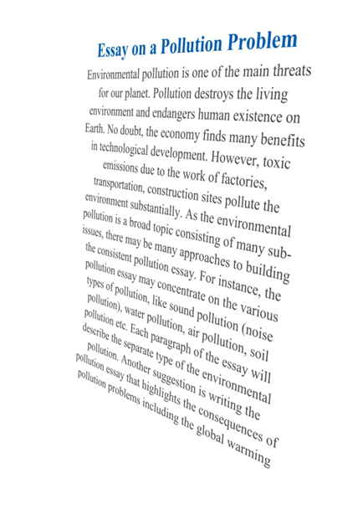
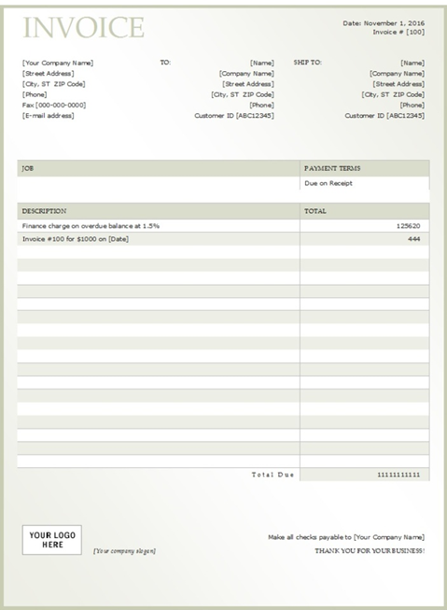
9.Less image
8. Isometric rt up
7. Invoice

Slide 16


11. More image
10. More image

Slide 17
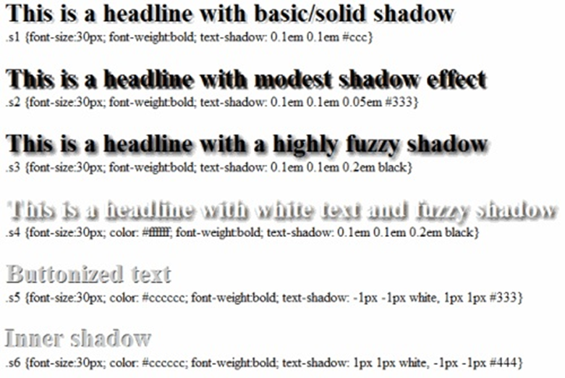
12. Shadow

Slide 18
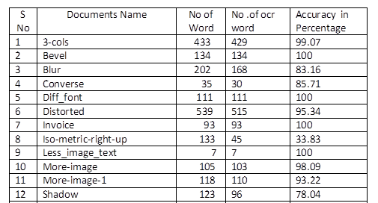
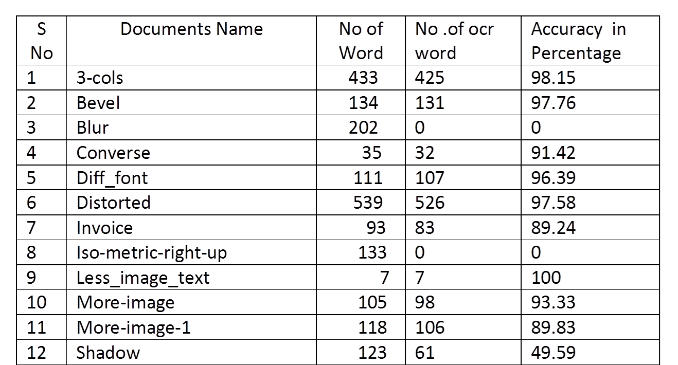
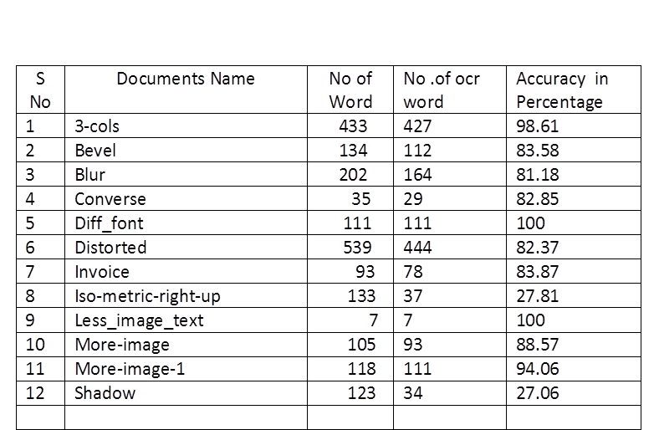
With the above 12 documents accuracy was tested with in house developed MODI OCR and ABBY Fine Reader OCR , Adobe Acrobat and TessNet OCR and the results are given below.
ABBY Fine Reader OCR
Adobe Acrobat
Tesseract
MODI OCR
S No | Documents Name | No of Word | No .of ocr word | Accuracy in Percentage
1 | 3-cols | 433 | 421 | 97.22
2 | Bevel | 134 | 132 | 98.50
3 | Blur | 202 | 172 | 85.14
4 | Converse | 35 | 26 | 74.28
5 | Diff_font | 111 | 111 | 100
6 | Distorted | 539 | 470 | 87.14
7 | Invoice | 93 | 93 | 82.79
8 | Iso-metric-right-up | 133 | 35 | 26.31
9 | Less_image_text | 7 | 7 | 100
10 | More-image | 105 | 98 | 93.33
11 | More-image-1 | 118 | 107 | 90.67
12 | Shadow | 123 | 34 | 27.64

Slide 19
Inference
On developing the text extraction tool (MODI OCR), it was found, the OCR engine extracts documents with 90 , 180 degrees skew perfectly but has some difficulty with less than 20 degree skew. So survey & study of skew correction algorithms was done.

Slide 20
Skew
During the scanning of the document, skew is being inevitably introduced in the document image.
A skew in the scanned document reduces the accuracy in the text extraction of the document.

Slide 21
Skew correction algorithms used in our project
Projection Profile algorithm
Hough Transform algorithm

Slide 22
Projection Profile algorithm
To determine the skew of a document, the projection profile is computed at a number of angles and for each angle, a measure of difference of peak and trough height is made.
The maximum difference corresponds to the best alignment with the text line direction which, in turn, determines the skew angle.
The projection profile methods are, however, well suited for skew angle less than ±10°
B.B.Chaudhuri and U.Pal, (1997) “Skew Detection of Digitized Indian Script Documents” IEEE Transactions on pattern analysis and machine intelligence, Vol. 19, pp. 182-186.

Slide 23
Hough Transform
In general, the straight line y = mx + b can be represented as a point (b, m) in the parameter space.
The (b,m) plane is sometimes referred to as Hough space for the set of straight lines in two dimensions.
Given a single point in the plane, then the set of all straight lines going through that point corresponds to a sinusoidal curve in the (b,m) plane, which is unique to that point. A set of two or more points that form a straight line will produce sinusoids which cross at the (b,m) for that line.
Thus, the problem of detecting collinear points can be converted to the problem of finding concurrent curves.

Slide 24
Features of the developed Tool
Facility to Upload Files from anywhere
Retrieves Text and displays Text– all through a standard web browser.
Text File saved to Desktop
OCR Facility
OCR Skew correction (Preprocessing)

Slide 25
Architecture of the Tool
Windows Server
Web Server : IIS
Script engine : Dot Net

Slide 26
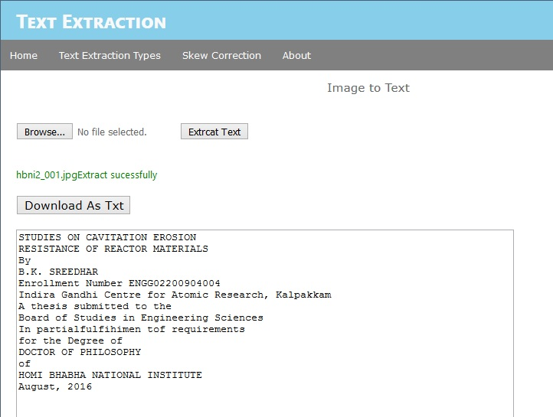

Slide 27
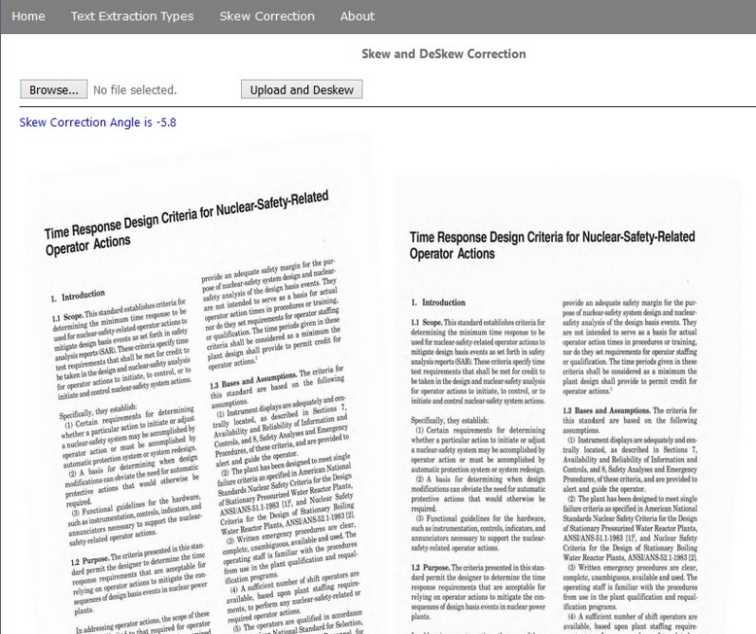

Slide 28
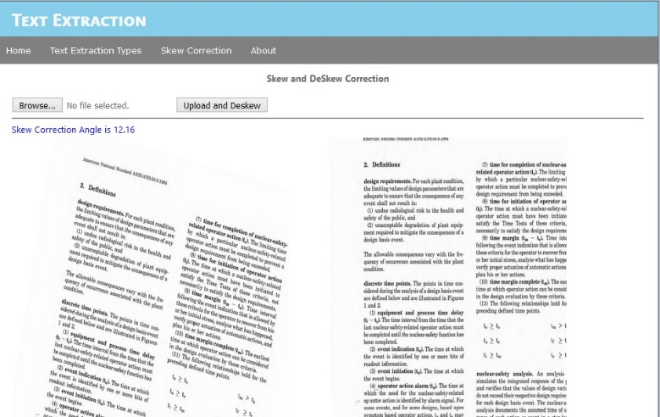

Slide 29
Thank You
S.Rajeswari
Head, Scientific Information Resource Division
Indira Gandhi Centre for Atomic Research, Kalpakkam
Tamil nadu
raj@igcar.gov.in
044-27480281

