Slide 1
Scholarly Communication & Institutional Ranking:
A study based on NIRF
Dr. Surendran Cherukodan
Dr. Sheeja N.K.
Dr. Susan Mathew K
Cochin University of Science and Technology, Kochi, Kerala

Slide 2
Objectives
Examine the correlation between scholarly communication and institutional ranking in NIRF

Slide 3
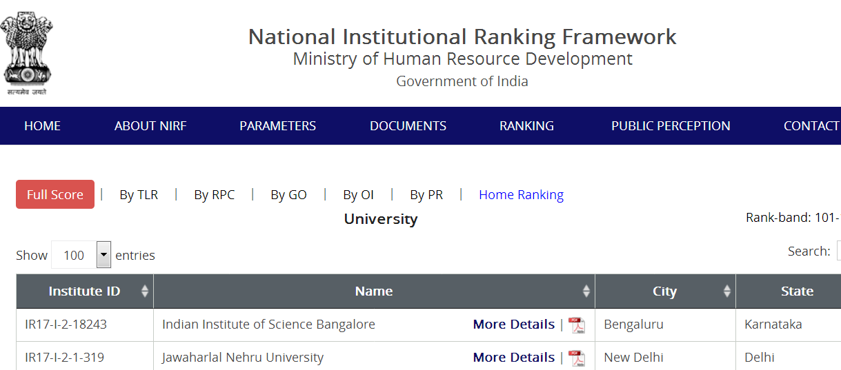
Methodology data collected from

Slide 4


Slide 5

Methodology

Slide 6
Population-Strategy- Tool
100 Top Institutions in NIRF 2017
Web Content analysis
Overall Score & Research Performance Score of top 100 institutions in NIRF ranking 2017 –Compared –Microsoft Excel

Slide 7
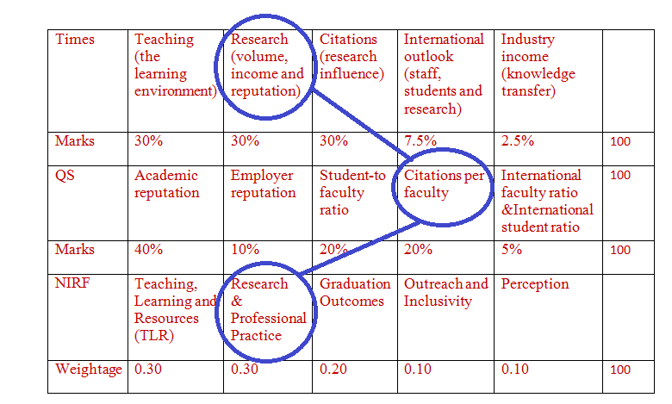
Results

Slide 8
Results

Slide 9
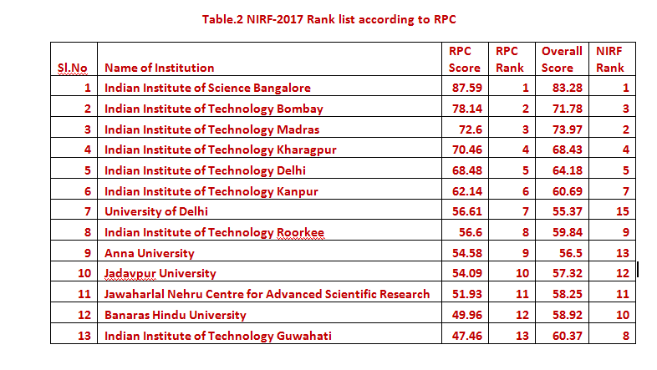

Slide 10
Inference
Library and Information Professionals can contribute towards increasing the research output of their institutions through planned services of Author Workshops, Workshops on Research Productivity, Research Methodology, Citation, Ranking of Universities, Scholarly Publishing etc.
                Thank you

