Slide 1



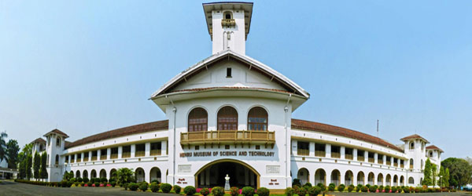

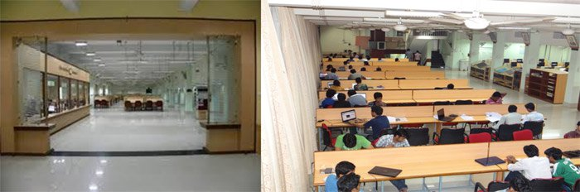
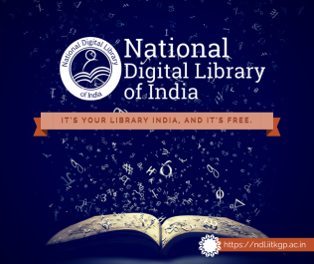
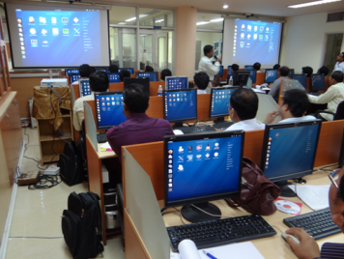
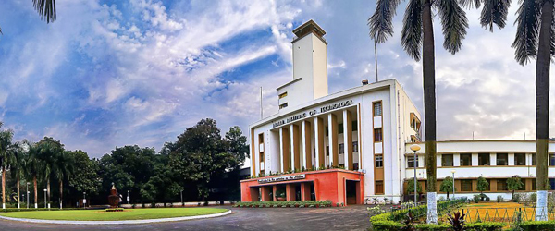
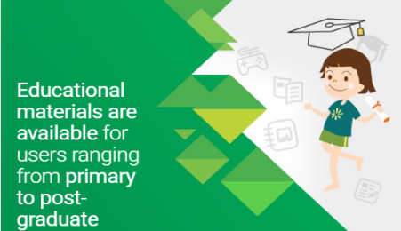
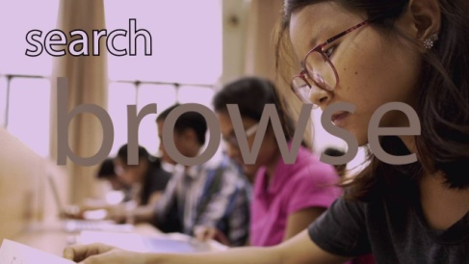
Development of National Digital Library of India
Towards Building a National Asset
NMEICT: National Mission on Education Through Information and Communication Technology
NDL Overview and Value Added Services for Libraries
By
Dr. B. Sutradhar
Librarian & Co-PI of NDL Project
Central Library, IIT Kharagpur
Notes:
NOTE:
To change the image on this slide, select the picture and delete it. Then click the Pictures icon in the placeholder to insert your own image.

Slide 2

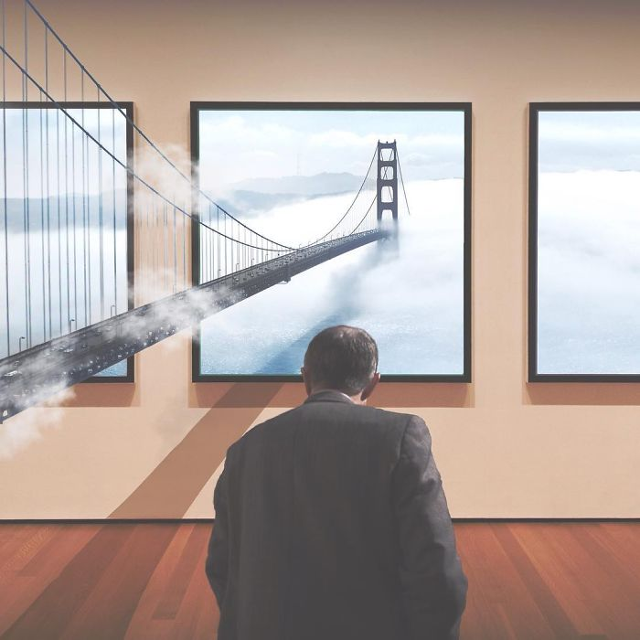
NDL Vision
Build up
National Digital Library of India
as a National Knowledge Asset –
the key driving force for education, research, innovation, and knowledge economy in India

Slide 3
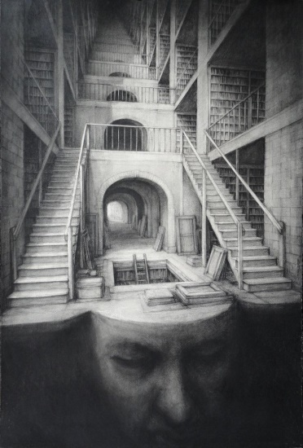
NDL Mission
To create a 24X7-enabled integrated NDL as a ubiquitous digital knowledge source of the Nation – catering to immersive e-Learning for all leaners at all levels in all areas
To initiate a movement for integrated digital learning across India

Slide 4



NDL Motto
Inclusive
&
Open

Slide 5
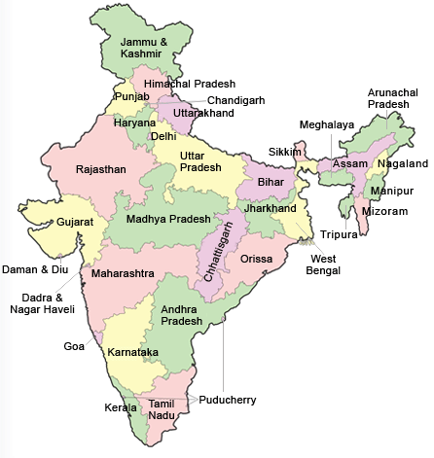
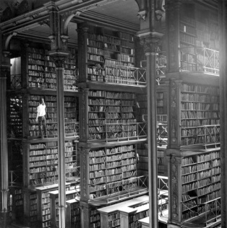
National Digital Library of India
Issues, Architecture And Use Models
Libraries are more important to the education system than the institutions such as schools, colleges and universities
– Rabindranath Tagore

Slide 6
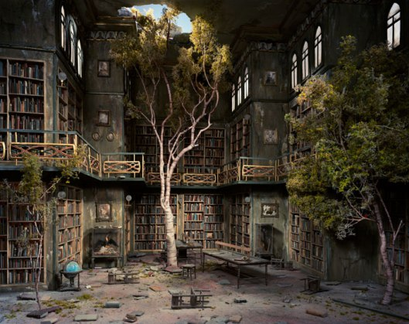
National Digital Library: Issues
User-side
Wide geographic expanse & Large population
Huge number of students
Large number of institutions
Varied linguistic diversity
Severe lack of Teachers
Provider-side
Wealth of digital content
  Books and Articles
  ETD
  Question Papers and Solutions
  Video Lectures - MOOCs
  Simulations & Animations
  NMEICT Projects
  Data
No single-window search
Google search uses keyword – no metadata search
Widely varied DL technology
Lack of Interactivity, Vernacular support
Low integration between content and learning system
Weak ecosystem between learners and teachers
Notes:
TEL: Technology-Enabled Learning

Slide 7
National Digital Library: Service Architecture
Content Creation
Learning Services
Personalization Services
Localization Services
Open Services …
National Digital Library
Dissemination Services
Digital Library
Content Borrowing
Authoring Services
Acquisition Services
Digital Repository
Content Search
Content Access
Learning Content
Experience-based Learning
Multi-faceted Interface
Multi-Lingual Content
APIs
Mobile Apps

Slide 8

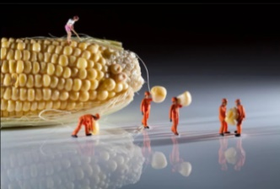
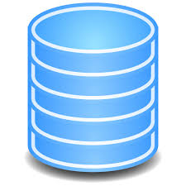
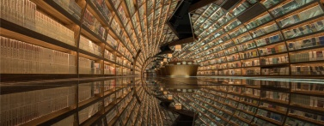
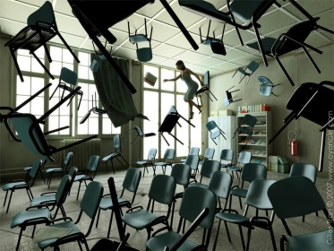
Use Models
Physically Challenged
Institutional Digital Repositories
Researchers
Content Access
Web Content Harvesting
Web
Content
Learners
Professionals
Content Contribution
NDL Repository
Learning Management System
Contributing Institutions
Educators

Slide 9
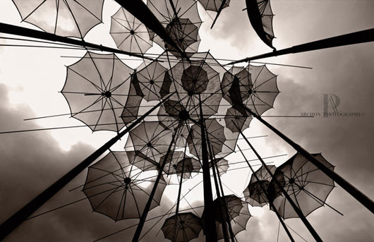
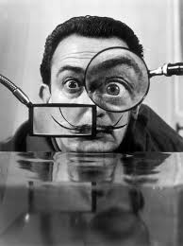
Presentation Model
Not a new library – an umbrella
Collects and ingests metadata only
Presents full-text from source view
Provides:
  Search
  Browse

Slide 10
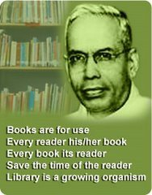
Objective and Scope
S R Ranganathan Laws
Targets
Contents,
Stakeholders,
Contributors,
Users,
Architecture, and
THE Big Picture
Books are for use
Every reader his [or her] book
Every book its reader
Save the time of the reader
The library is a growing organism

Slide 11
Objectives
Create a 24X7-enabled Infrastructure for NDL with single window search facility – To include h/w systems, networks, s/w tools, applications and interoperability standards
Harvest IDRs (Institutional Digital Repository) across institutions of the nation to provide integrated access
Facilitate select institutes to disseminate existing content and create new digital content
Provide support for immersive E-learning environments at multiple levels spanning across
  All academic levels – school to college to university to life-long learning
  All disciplines – Science, Arts, Humanities, Engineering, Medical, Law, and
  All languages (vernacular) used as medium of instruction.
Support interfaces in vernacular & for differently abled users

Slide 12
Lecture Slides, Videos, Class Notes, Courseware
Term Papers, Assignments, Solutions
Lab Experiments,
Manuals, Case Studies
Question Banks (JEE / GATE / NET / CAT ), Model Answers
Faculty Publications,
ETD (Electronic Thesis & Dissertation):
DSc-PhD-Masters-Undergrad,
Research Projects
Institutions of School & Higher Education, Boards
Research and Professional Institutions, Central / State University
Books & Periodicals, Open Access Journals ,
E-Books & Subscribed E-Resource
Institutional Digital Repository of
Contributing Institutes
Range of Contents
Annual Reports,
Project Reports,
Convocation,
Working Papers,
Others
Institutional and Open Contributions. Multi-modal, Multi-faceted
Encyclopaedia
Dictionaries
Directories Others
Datasets,
Benchmarks, Models, Maps, Software
Manuscripts,
Painting, Sculpture, Music, Dance, Drama
Audio & Video Content

Slide 13
Content View Architecture
Vertical-Specific Custom Interface and Search
Domain Metadata
Data Browser
App Launcher
Textbook, Lesson View
MCQ / MSQ / …
School Vertical
Domain Vertical
(Medical/ Legal/…)
Competitive Exam Vertical
Data Vertical
Application Vertical
…
Content Baseline
Search
Browse
Generic Interface and Search

Slide 14
Vertical Content View
School | Medical
Legal Bombay High Court Judges Library India Code Legislative Department Human Rights Law Network Legal Information Institute of India* Indian Law Institute* | Culture & Heritage

Slide 15

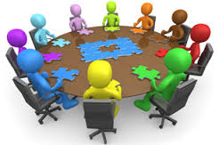
Stakeholders
Roles and
Responsibilities
Stakeholder | Roles and Responsibility
Government | Sponsor and facilitator Content Contributor Ministries / Departments R & D Labs
Institutions Public / Private Academic / R & D / Educational | Host Institution – IIT Kharagpur Contributing Institution – Supporting IDRs Participating Institution – Providing Users & Feedback
Public NGOs Individuals | Use and Feedback Metadata by Crowd Sourcing Content by Crowd Sourcing
Industry | Technology Providers
Publishers | Metadata Provider Content Provider (under various licensing schemes)

Slide 16

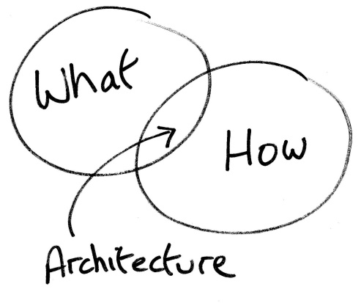
Architecture
Index Management
  Ingestion of Metadata
  Indexing of Metadata for Search
Content Management
  Dissemination of local contents
Learning Management
  Creation of Content
  Handling learning interactions

Slide 17
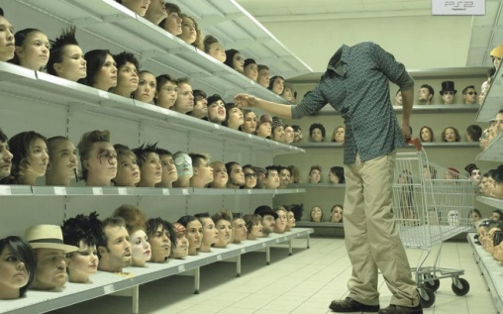
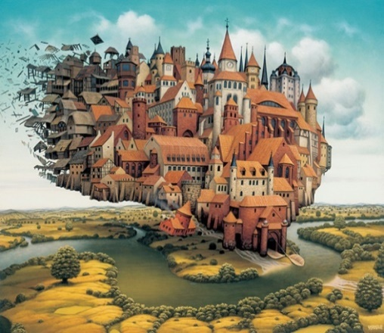
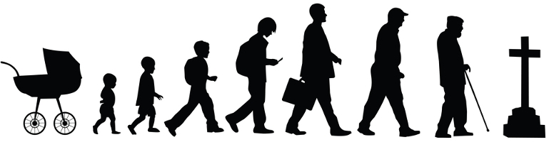
Users & Access
Individual
Institutional
Registration is Open to all
Registration Types:
  Individual
    Registers directly
  Institutional
    By request from Institution
    Managed by authenticated Nodal Person
    Convenient for bulk upload of users
NDL Users
Life-long
Learner
College
School
Professional

Slide 18
















































Contributors
CFTI, State and Central Universities, R & D Labs, Govt. Depts, Free Portals, Publishers, etc.

Slide 19
The Big Picture
National Digital Library of India
MOOCs
LMS
NDL:
  Content Repository
LMS:
  Content Delivery for Learning
VUC:
  Certification & Credit Transfer
Virtual University
and
Certification

Slide 20
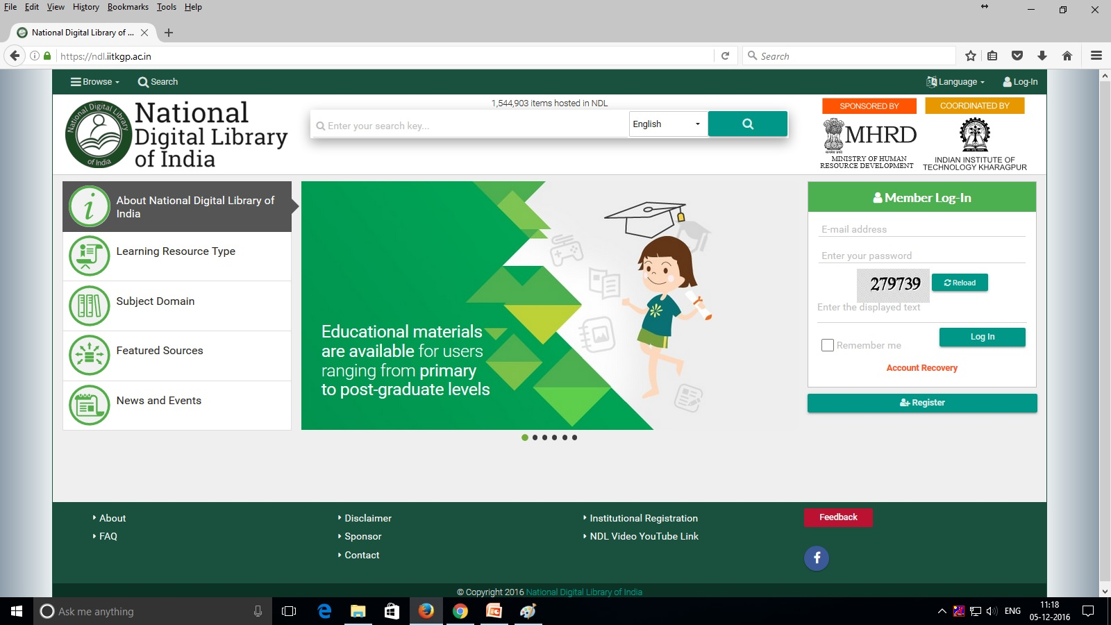
Landing Page

Slide 21
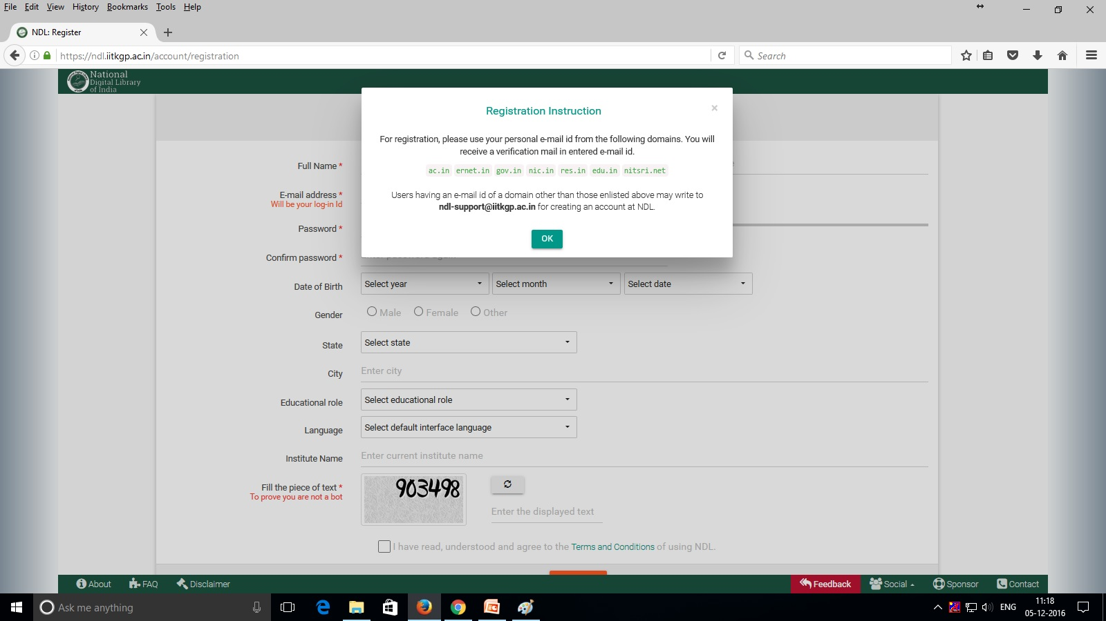
Registration Page

Slide 22
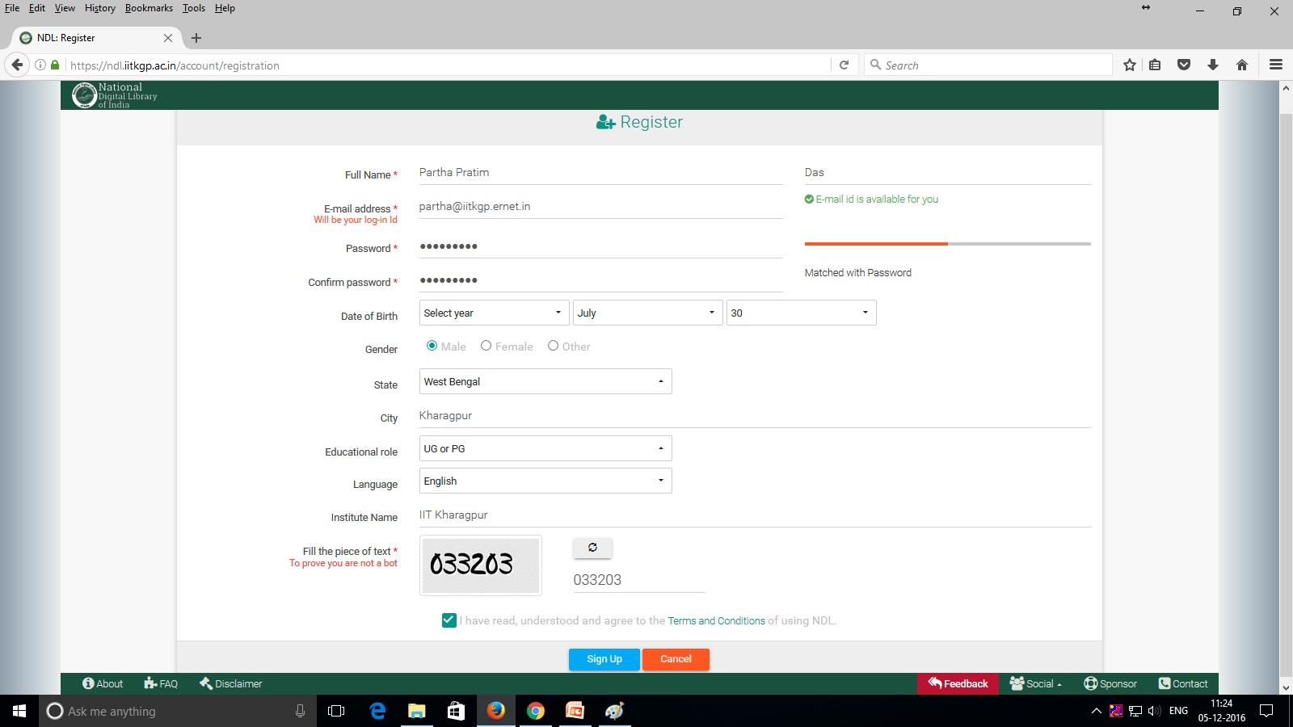
Registration Page

Slide 23
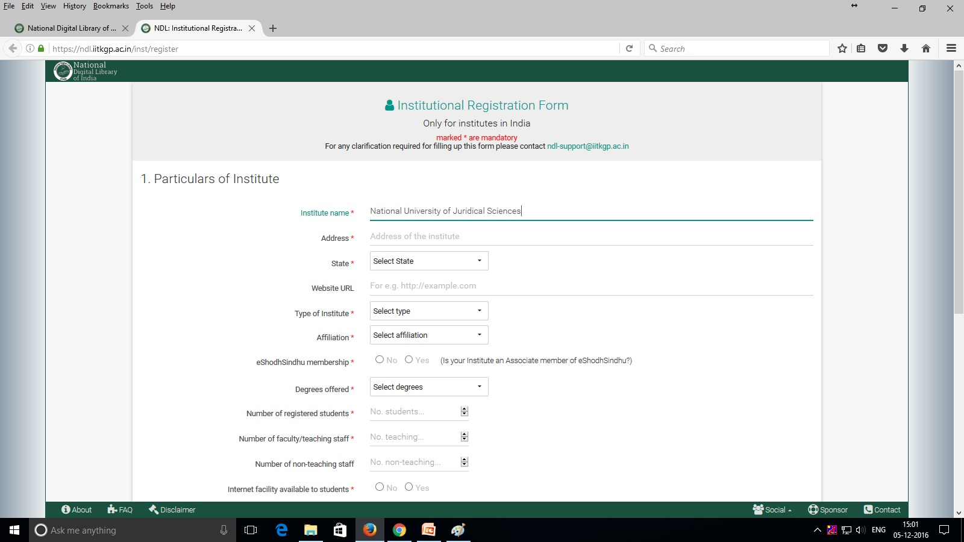
Institutional Registration

Slide 24
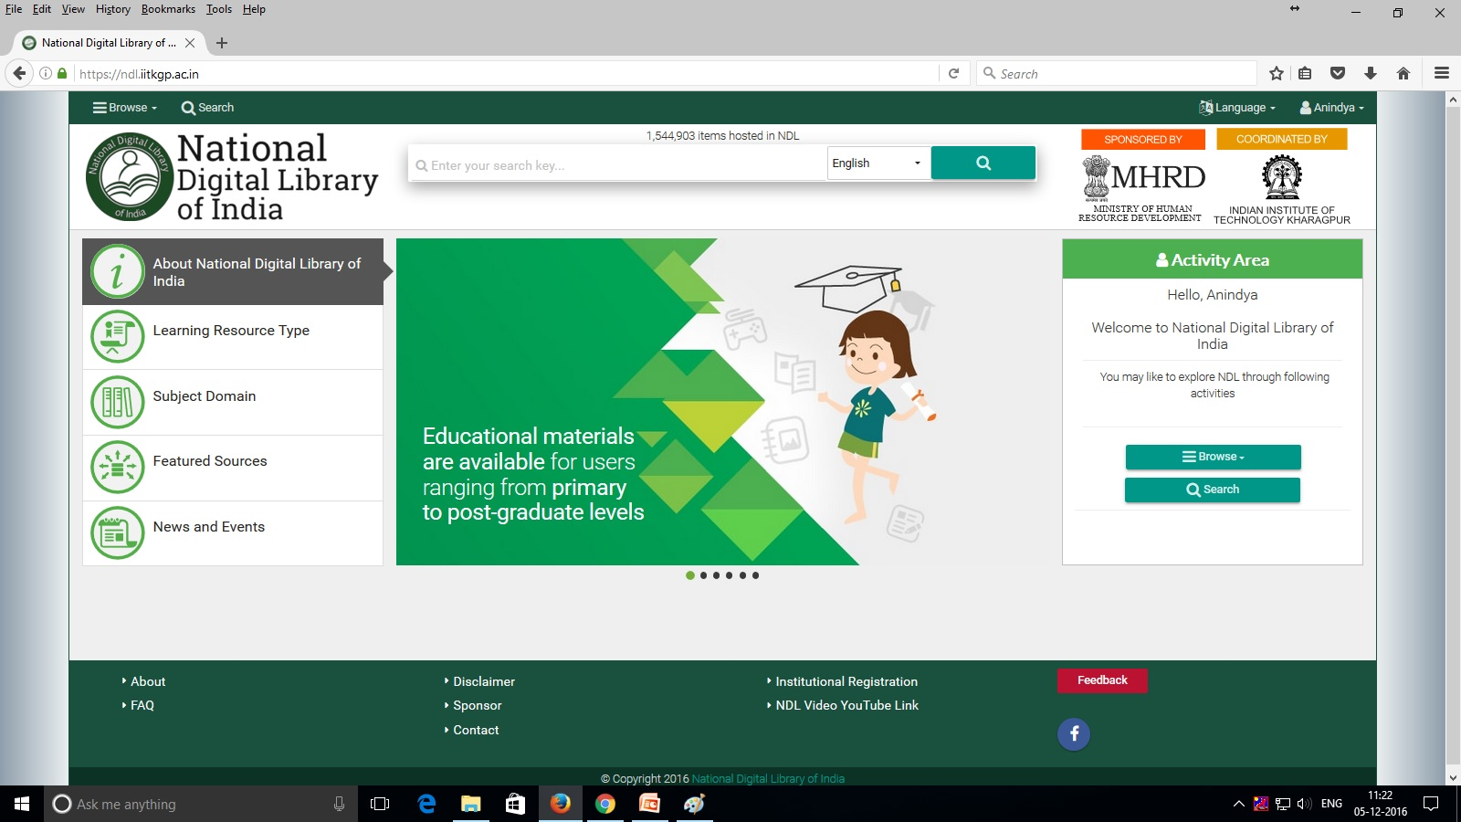
Home Page

Slide 25
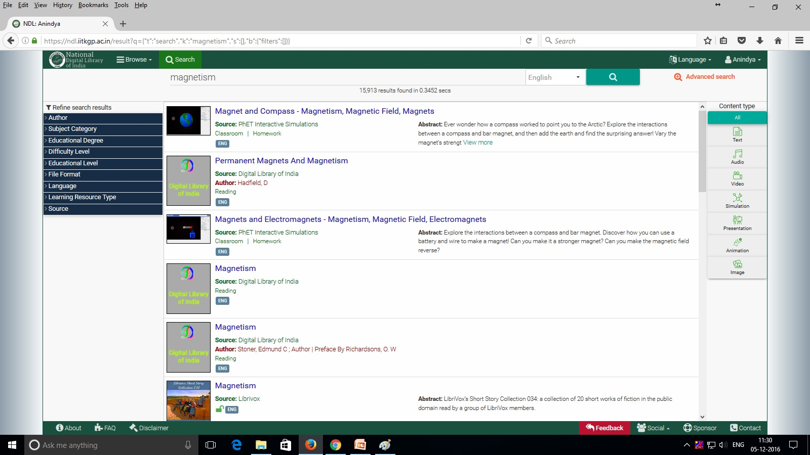
Search Result Page

Slide 26
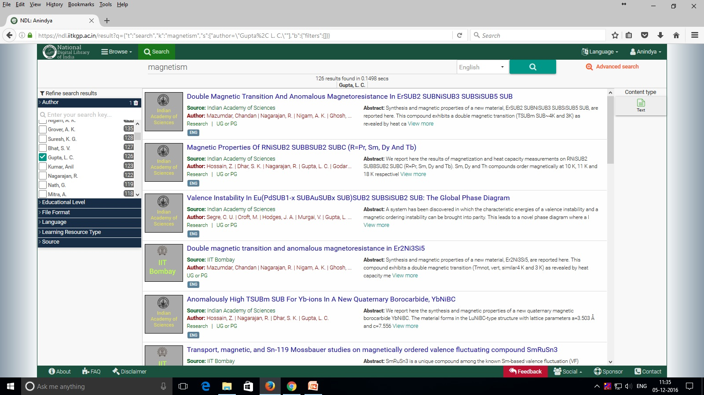
Refine Search (Author) Page

Slide 27
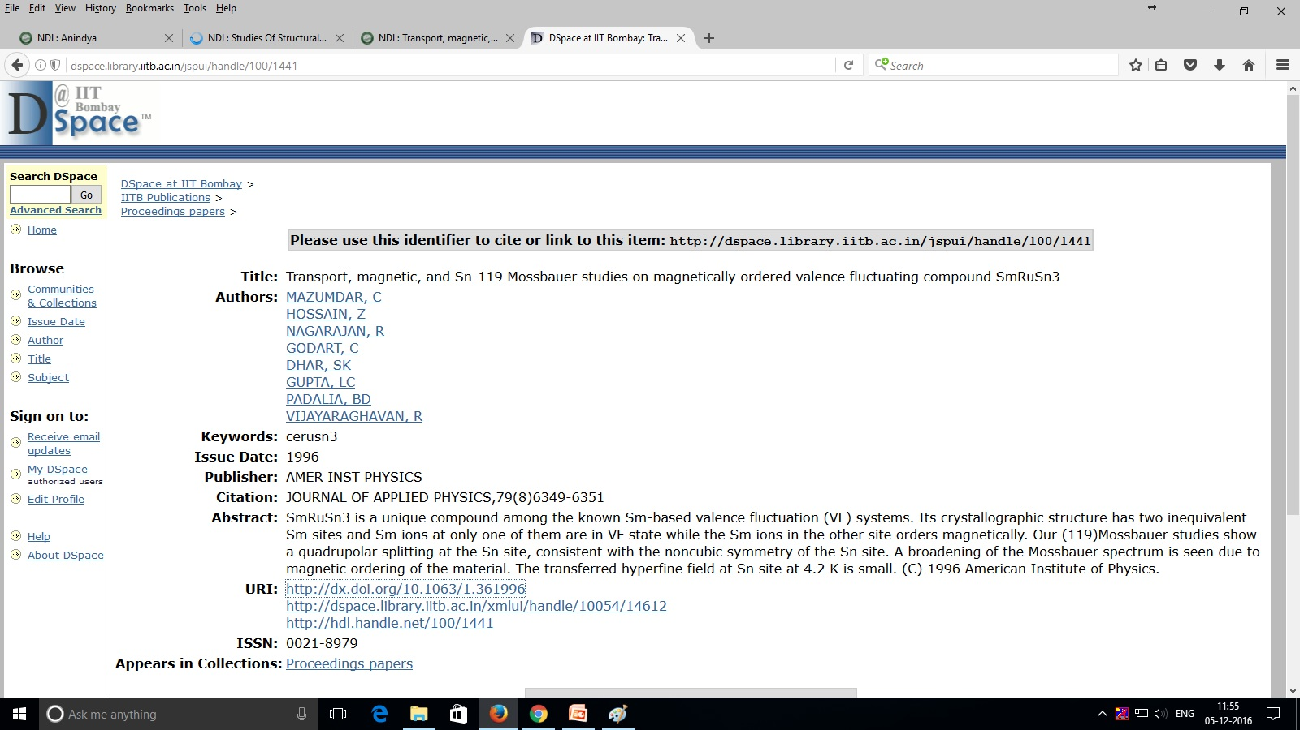
Full Text (Contents) Page

Slide 28
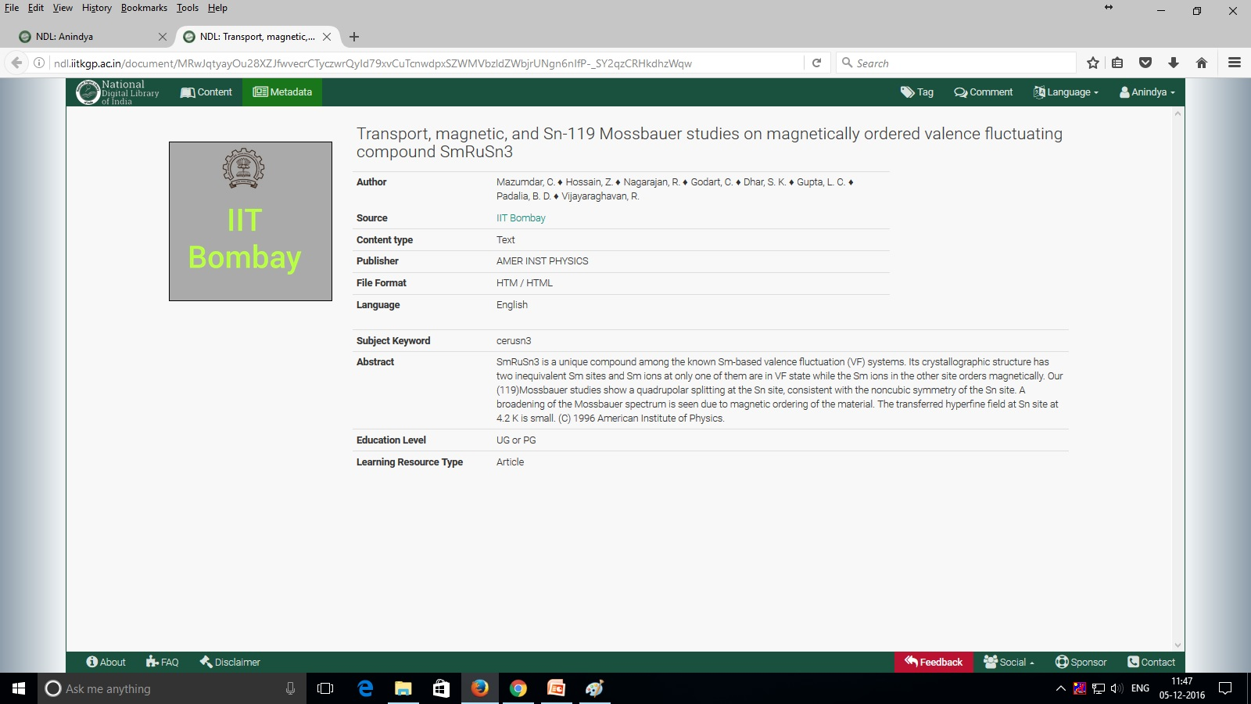
Full Text (Metadata) Page

Slide 29
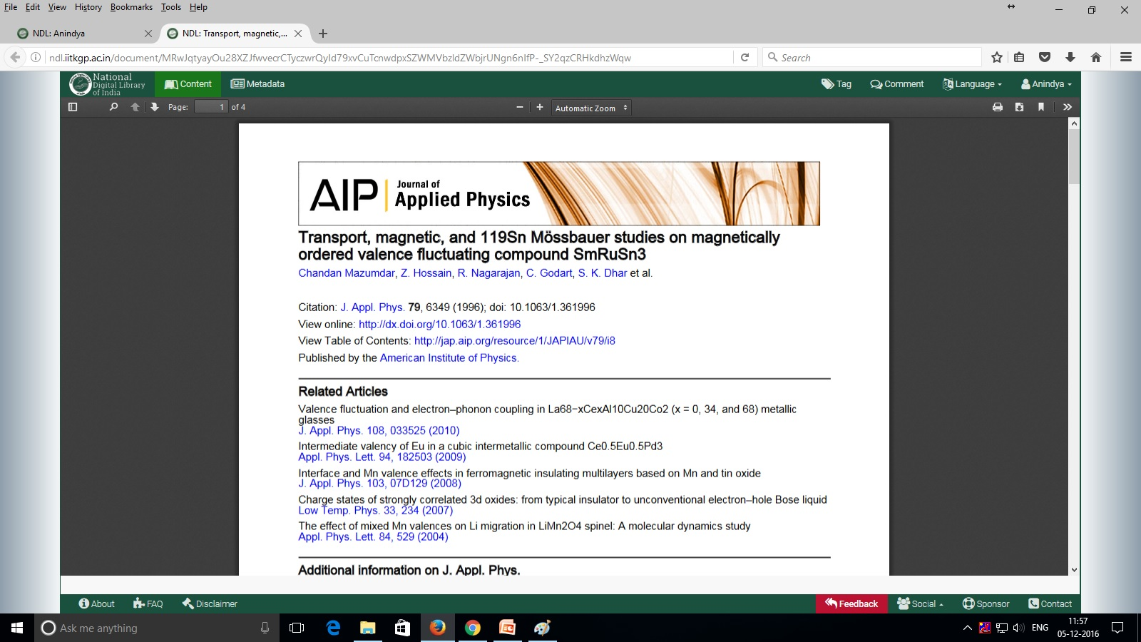
Full Text Page

Slide 30
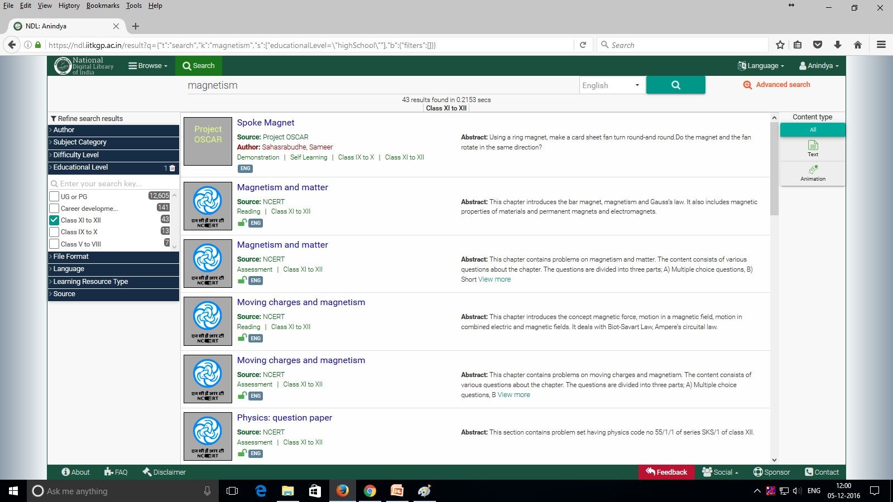
Refine Search (Educational Level) Page

Slide 31
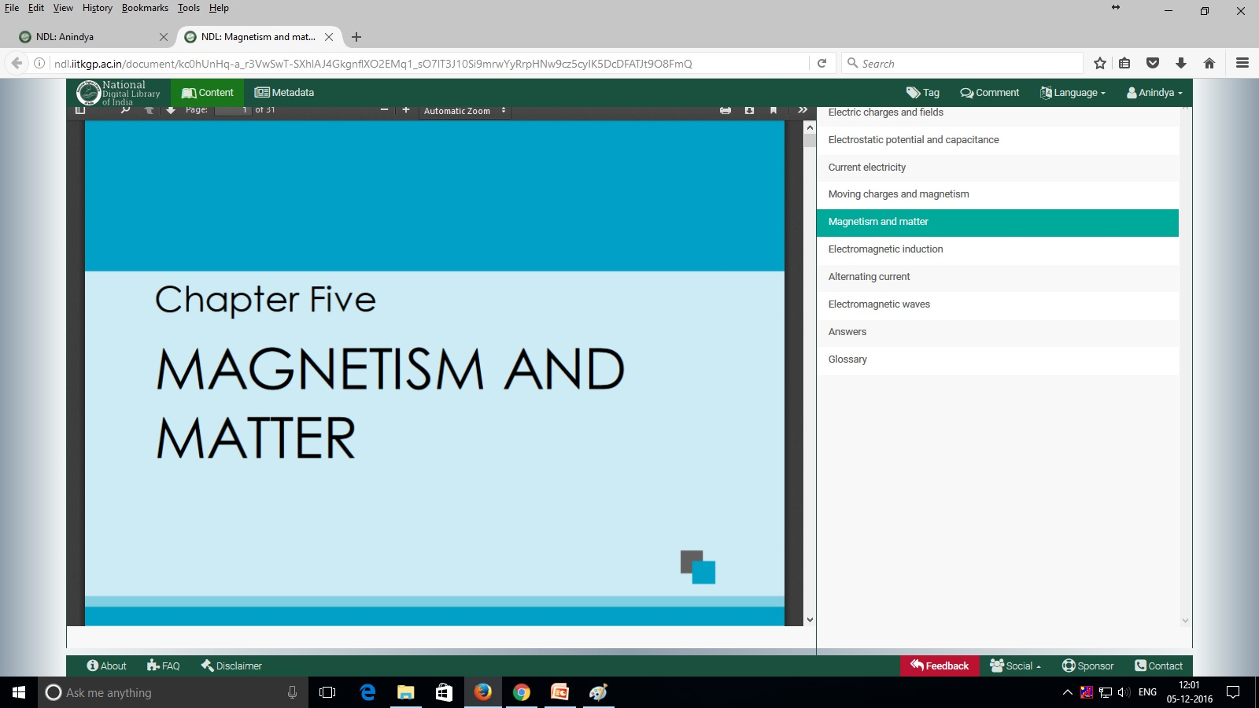
Full Text (NCERT) Page

Slide 32
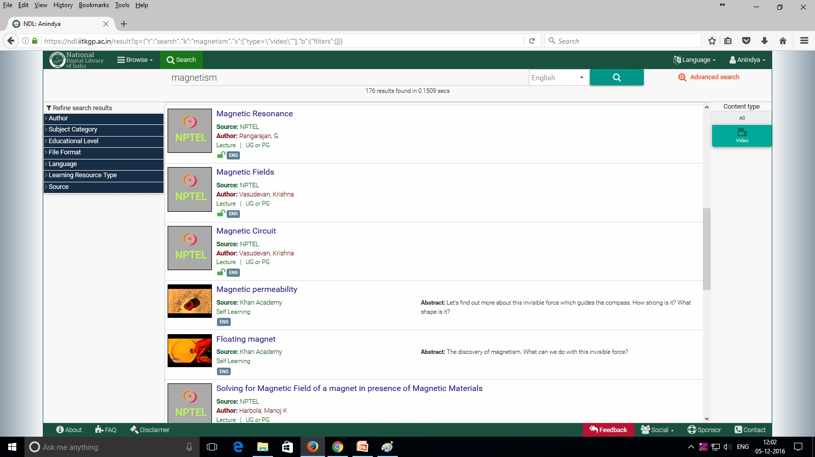
Search Filter Page (Video)

Slide 33
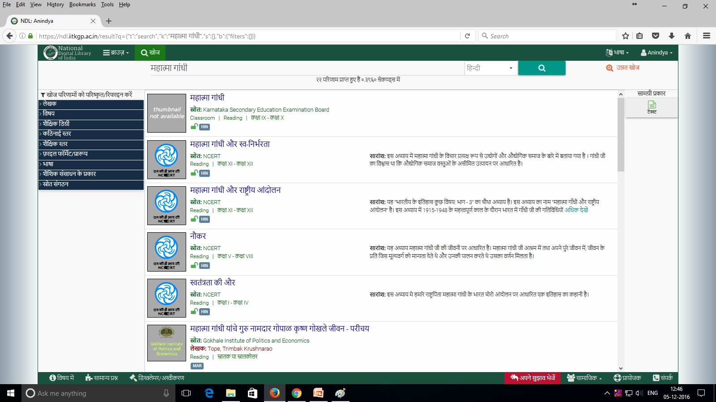
Vernacular (Hindi) Interface Page

Slide 34
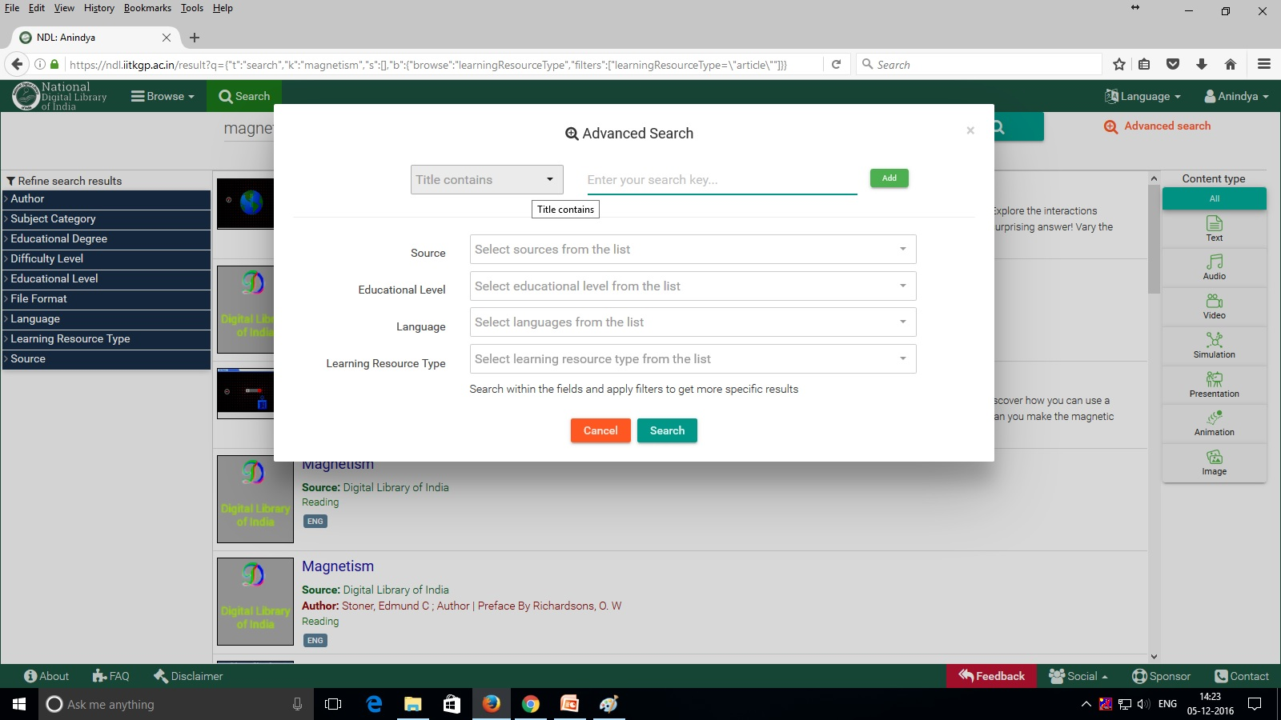
Advance Search

Slide 35
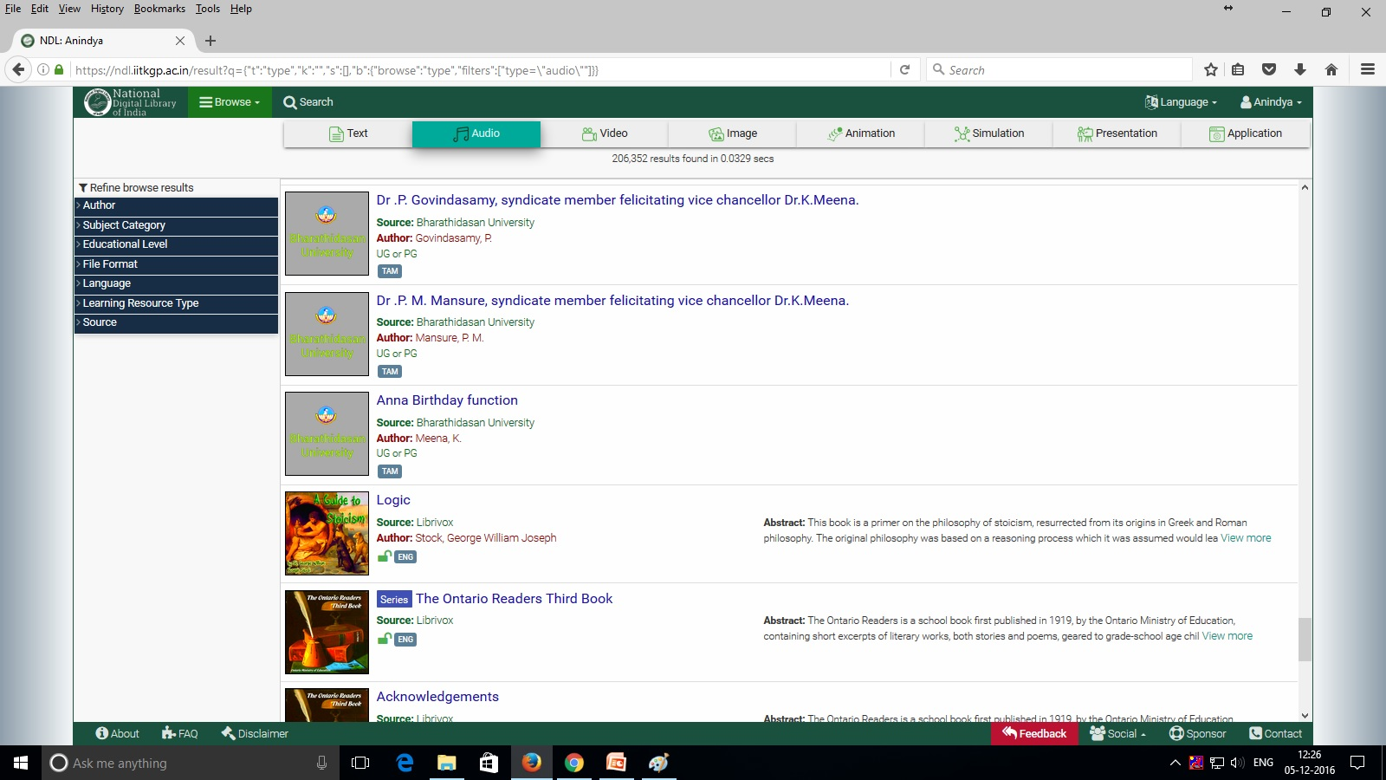
Browse (by Type) Page

Slide 36
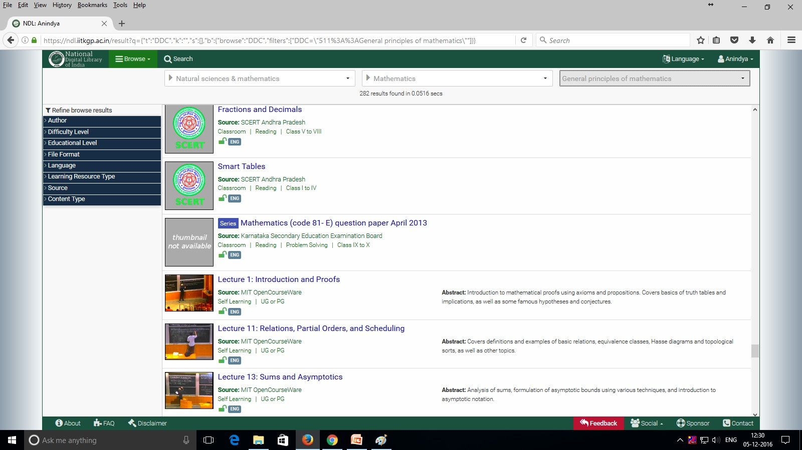
Browse (by Subject) Page

Slide 37
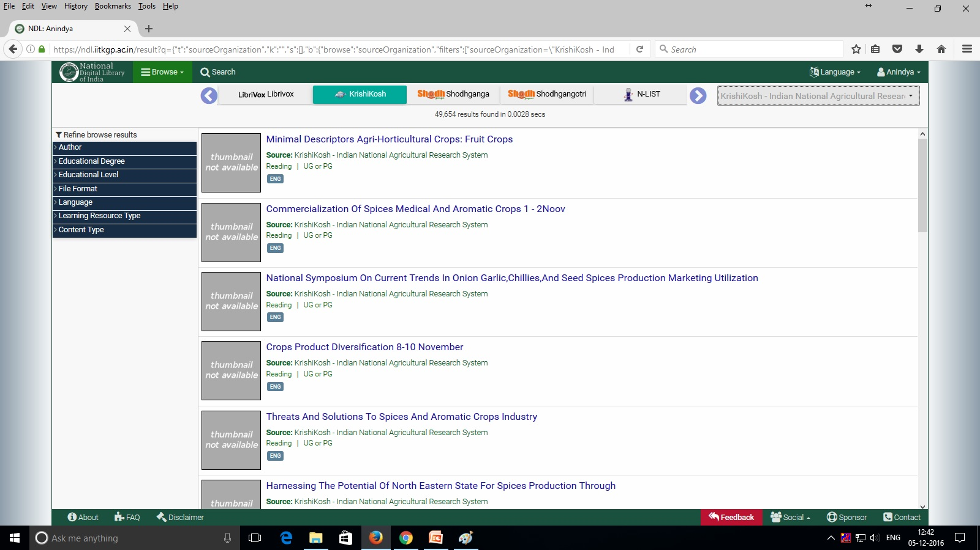
Browse (by Source) Page

Slide 38
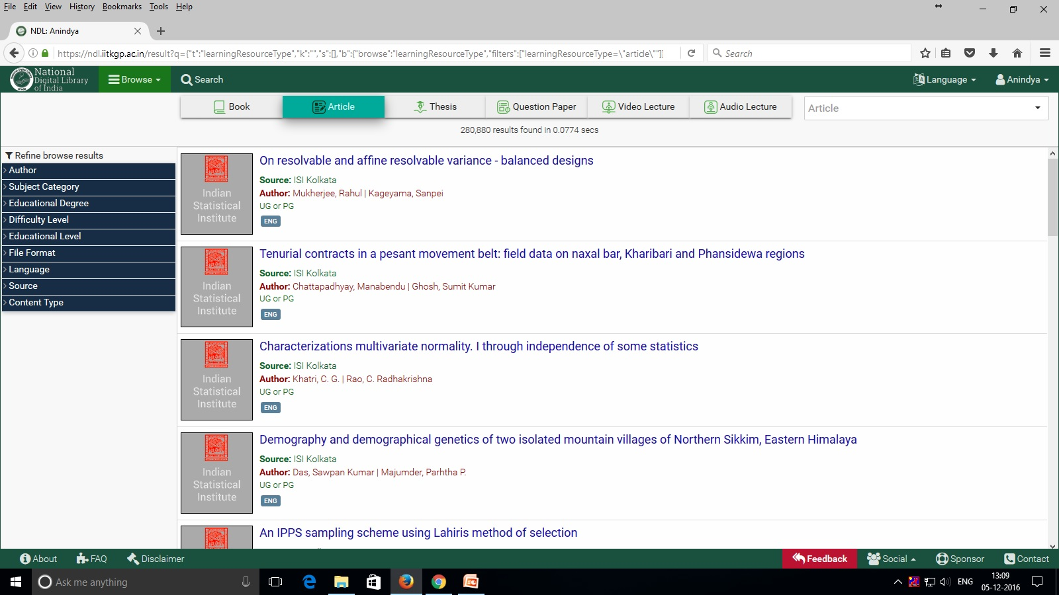
Browse by (Learning Resource Type)
Page

Slide 39
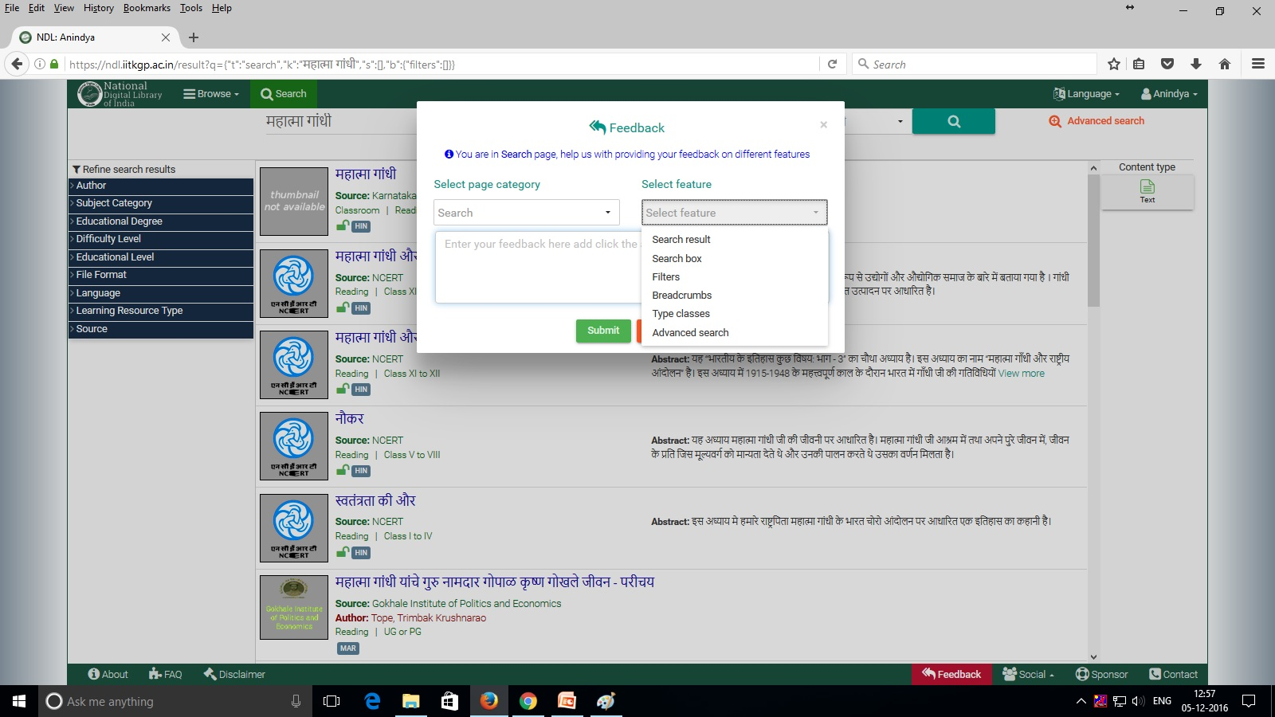
User Feedback Page

Slide 40
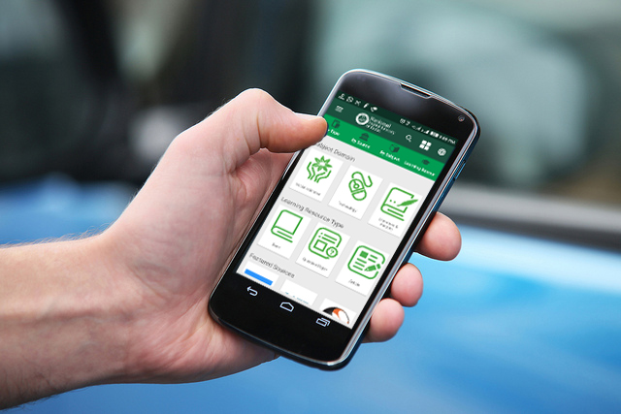
NDL Mobile App
Available on Android

Slide 41


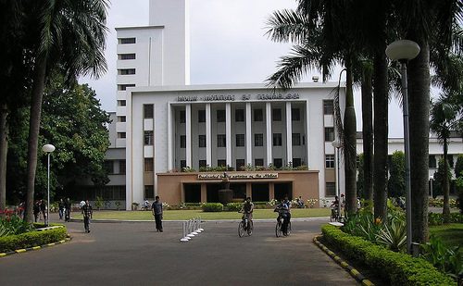



Institutional
Roles and Responsibilities
Terms of Reference to contribute to NDL
The worth of a librarian should be gauged by his power of attracting and looking after such circles by acting as the intermediary of an intimacy of relationship between reader and the library.
– Rabindranath Tagore

Slide 42
Roles and Responsibilities
Host Institution
Contributing or Participating Institution
IDR
  Support for Setting up IDR
  Installation CD
  Manual
  Training
  IDR Service, if needed
Metadata
  NDL Metadata Standard
  Creation, Curation Workflow
User
  Institutional Registration for Nodal Person
  Bulk Addition of Users
Ongoing Support
  Over email, phone
  Hands-on at NDL, if needed
IDR (CI only)
  Setup IDR in Institutional LAN
  Register with OPENDOAR / ROADMAP
  OAI-PMH compliance for harvesting
  OAI-ORE compliance for full-text access
  Allow external access & Update regularly
Content (CI only)
  Add Content
  Encourage faculty, students, staff to contribute
  Create and Curate Metadata
User
  Register as an Institution
  Add users in bulk or send to NDL
Promote
  Organize Workshop
  Identify and Integrate Source
Notes:
Directory of Open Access Repositories (OPENDOAR) or Registry of Open Access Repositories Mandatory Archiving Policies (ROARMAP)
Open Access Initiative Protocol for Metadata Harvesting (OAI-PMH)Compliant for metadata harvesting
Open Archives Initiative Object Reuse and Exchange (OAI-ORE) Compliant for full-text harvesting

Slide 43
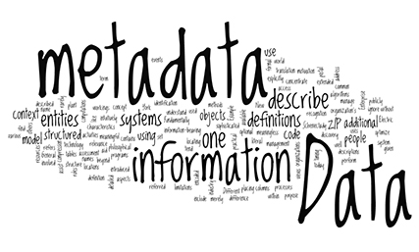
Metadata Engineering
Metadata Standard
Metadata Acquisition

Slide 44
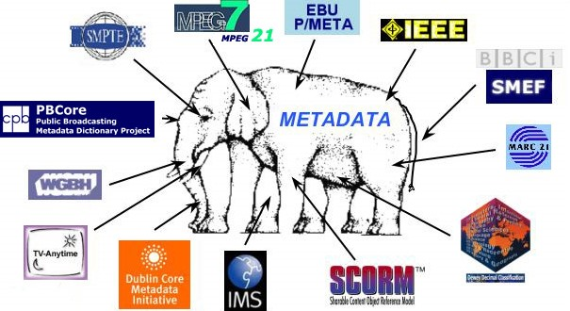
Metadata Standard
Source: http://courseweb.ischool.illinois.edu/~butler9/LIS501b/current.html

Slide 45
Metadata Standard
Metadata
  Is primarily textual information relating to Content
  Includes information that enables users to identify, discover, search, browse, interpret, or manage Content
  Includes hyperlinks that direct users to Content on the Source
  May include an expressive description of the Content
Metadata Standard
  Defines common understanding of the semantics of the data
  Ensures correct and proper use and interpretation of the data
  Defined through a set of fields, vocabs (optional), and instructions for fill-up

Slide 46

NDL Metadata Design Challenges
Wide category of resources
  Generic metadata or domain specific?
Openness of repository
  Closed metadata standard may fail to describe a new resource
Scale is enormous
  Manual annotation is infeasible
  Automatic annotation guided by crowd sourcing?

Slide 47
Metadata Requirements Specs
To describe any digital resource
  Generic content metadata
    Contributor, Description, Language, Format etc.
To describe domain specific resources
  Educational content metadata
    Educational level, ToC, Type of learning material etc.
  Thesis metadata
    Institution, advisor, degree, researcher

Slide 48
NDL Metadata Standard
NDL Metadata Standard v 1.0 is an Open Virtual Standard
  URL: http://www.ndlproject.iitkgp.ac.in/ndl/header.php?mname=Metadata%20Schema
Schema is categorized into three profiles:
  Generic Metadata:
    Describes general attributes of the contents
    Adopted from Dublin Core Metadata Standard
  Educational Metadata:
    Describes the educational attributes of the resources and helps in enumerating properties of the contents relevant to teaching-learning process
    Adopted from Learning Resource Metadata Initiative (LRMI)
  Thesis Metadata:
    Describes dissertation or thesis related metadata fields
    Adopted from Shodhganga Thesis Metadata Standard
  More profiles may be added in future
Uses the namespace of Dublin Core (dc.)

Slide 49
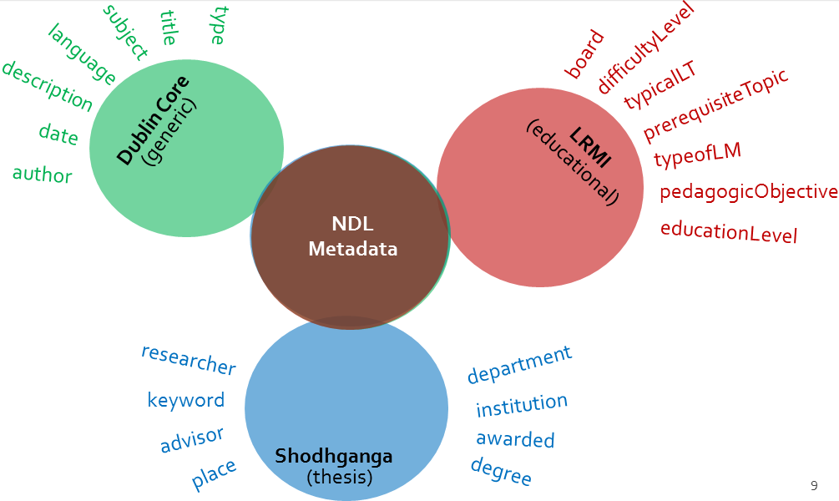
Metadata Envelop

Slide 50
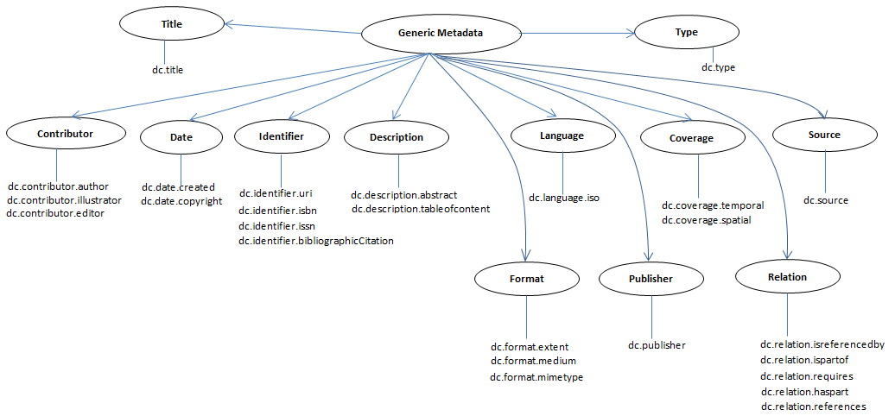
Generic Metadata

Slide 51

Learning Resource Metadata

Slide 52

Thesis Metadata

Slide 53

Metadata Acquisition

Slide 54
Acquisition Scenarios
Locate Content
Acquire Metadata
Harvest Institutional IDRs
Crawl Websites
In Bulk – from Publishers
Donated by Source
Source-supported API
…
Creation
  Manual
  Automated
Translation
  Format
  Standard / Schema
Curation
  Manual
  Assisted
Ingestion

Slide 55
Challenges in Metadata Acquisition
Different sources follow different norm in annotation
  Automation of curation
Errors in sourced data
  Error listing
  Manual curation
Errors in manual annotation
  Review step before actual submission in database
  Manual curation
Set up norm/guideline
  Controlled vocabulary

Slide 56

Specifying Metadata Values
How do we ingest contents?
Metadata Translation
Metadata Annotation
Institute N
Institute 1
Portal 1
Metadata Extraction
IDR Harvesting
Manual Submission
Automatic Crawling
Portal N

Slide 57
Multi-format Translator
CSV
MARC
JSON
XML
Creation
  Manual
  Automated
Translation
  Format
  Standard / Schema
Curation
  Manual
  Assisted
Ingestion
Reader
Metadata Translator
CMS Compliant Format

Slide 58
IDR Harvesting
IDR1
IDR2
IDRn
Creation
  Manual
  Automated
Translation
  Format
  Standard / Schema
Curation
  Manual
  Assisted
Ingestion
Harvester
Metadata Translator
IDR1
IDR2
IDRn

Slide 59
Web Crawling
Portal 1
Portal 2
Portal n
Creation
  Manual
  Automated
Translation
  Format
  Standard / Schema
Curation
  Manual
  Assisted
Ingestion
Crawling Engine
Metadata Generator
CMS Compliant Format

Slide 60
Translation Issues
Variation in Subject classification standards
  Dewey Decimal Classification (DDC)
  Library of Congress Classification (LCC)
  Library of Congress Subject Headings (LCSH)
Mapping terminology for different languages
  Translate when equivalent terminology is present
  Transliterate otherwise

Slide 61




Automated Metadata Extraction
Creation
  Manual
  Automated
Translation
  Format
  Standard / Schema
Curation
  Manual
  Assisted
Ingestion
Extractor and aggregator
Metadata Generator
CMS Compliant Format

Slide 62
NDL Metadata Extraction Toolkit
Automated metadata extraction workflow
Syntactic metadata extractor
  Author name, ISBN, Publisher, dates etc.
Table of content extractor
Wikification for keyword extraction
Learning resource metadata
Toolchain for metadata extraction
Once completed and tested, the toolkit will be released to public and open-sourced

Slide 63


Experience Tracking and UI
Experience Tracking
  To offer customized search results
Multi-lingual Support
  Reduce cognitive load for native use
Personalization
  Customized UI to suit user grade
Source: http://www.brandquarterly.com/tracking-customer-experience-essential

Slide 64

Copyright & License
How does NDL cope with
Copyright and Licensing Issues

Slide 65

Copyright Act, 1957 (Amendment 2012)
Is metadata copyrighted?
  Yes / No / May be
Copyright of Metadata is contested
  Source: http://lj.libraryjournal.com/2013/02/opinion/peer-to-peer-review/metadata-and-copyright-peer-to-peer-review/
Copyright is a bundle of rights given by the law to
  Creators of literary, dramatic, musical and artistic works and
  Producers of cinematograph films and sound recordings
Rights are:
  reproduction of the work,
  communication of the work to the public,
  adaptation of the work and,
  translation of the work
Creator / Author is the first Owner
Ownership (Title) can be transferred (assigned)

Slide 66
Copyright of Metadata
NDL principles as follows:
  Vast Majority of Metadata is Not Subject to Copyright Restrictions
  NDL’s Partners Share the NDL’s Commitment
  NDL Asserts No Rights Over its Database of Metadata and Dedicates its Contributions to the Public Domain
  Free and Unencumbered Access to Metadata
  Adapted from: https://dp.la/info/wp-content/uploads/2013/04/DPLAMetadataPolicy.pdf

Slide 67
License Mechanisms
Content Access Views in NDL
  Metadata View
    This shows the metadata of the item – as maintained in NDL
  Full Text View
    This shows the view and provides access to full text – offered by the content source
A license encapsulates the rights & privileges that a copyright holder grants to someone else vis–a–vis something they have created

Slide 68

Content Access View: Metadata
Source Page is rendered within NDL showing free Metadata

Slide 69

Content Access View: Full Text
Full-Text URL from Source

Slide 70





Access Options
 | Open
 | Full-text available to all (Example: NCERT)
 | NDL Users
 | Full-text available through NDL, not directly from Source (Example: South Asia Archive)
 | Limited Access
 | Part of text available but full-text requires authorization by Source authority (Example: IISER, Bhopal)
 | Subscribed
 | Full-text available from institutions that have subscribed to the Source (Example: Springer)
 | Restricted
 | Full-text access requires authorization by Source authority and separate login to the Source (Example: IIT Jodhpur)

Slide 71

National Licensing
An initiative by eSS:
  e-ShodhSindhu: Consortium for Higher Education Electronic Resources
Licensing being negotiated with Publishers
  Institutional License:
    Accessible from within designated institutional network: IP filtered
  NDL Supported License:
    Accessible if requested from NDL: Concurrent use-basis

Slide 72
NDLIndia Live: https://ndl.iitkgp.ac.in/
NDLIndia on Facebook: https://web.facebook.com/NDLIndia/
NDLIndia on YouTube: https://www.youtube.com/watch?v=LEwAyHGKeLw https://www.youtube.com/watch?v=qIZB-G9ywF0
https://www.youtube.com/watch?v=UCoJwfPrQFs&t=115s
NDL Project: http://www.ndlproject.iitkgp.ac.in/ndl/

Slide 73
Publications
Samrat Guha Roy, B. Sutradhar, Partha Pratim Das, Large-scale Metadata Harvesting – Tools, Techniques and Challenges: A Case Study of National Digital Library (NDL), Presented in International Conference on Digital Library, TERI New Delhi, Dec. 13th – 16th, 2016.
Subhayan Roy and Plaban Bhowmick, Augmenting Online Video Lectures with Topically Relevant Assessment Items, The 24th International Conference on Computers in Education, IIT Bombay, Nov 28th - Dec 2nd, 2016: Best Technical Design Paper
Poonam Anthony and Plaban Bhowmick, Architecture for User Experience Tracking and Analytics in National Digital Library (NDL), The 8th IEEE International Conference on Technology for Education, IIT Bombay, Dec. 2nd -4th, 2016.
The NDL Team, National Digital Library: A Platform for Paradigm Shift in Education & Research in India, Science and Culture (published by: Indian Science News Association), vol. 82, No. 1-2, pp. 4-11, Jan.–Feb. 2016.
The NDL Team, National Digital Library: Building a National Asset, YOJANA, vol. 60, pp 19-23, Jan. 2016. Also in Hindi, Bangla, Marathi, Gujarati, Punjabi, Urdu, Telugu, Kanada, Malayalam, and Tamil.

Slide 74
Status …
Items: 87 Lakh+
Metadata: Version 1.0 of Standard Published
Sources: 121 (IDRs: 100+)
Registered Users: ~9.5 lakh+ from ~600 institutions
Nature of contents
  Subject domain: Most of the major educational areas (except medical and law)
  Language: 20+
  Learning Resource type: 15+
  Educational Level: School Level (Class-I to XII) UG and PG
Nature of Sources: 145 (IDRs: 100+)
  Featured: 7 (DLI, Shodhganga, Shodhgangotri, Spoken Tutorial, SNLTR, OECD, Satyajit Ray Archives, JEE / GATE Questions & Solutions, South Asia Archives, WeL)
  Crawled Repositories: 5 (NPTEL, Khan Academy, PhET, Project-OSCAR, LibriVox (audio books), PubMed)
  Manually-annotated sources: 6 (NCERT, CBSE, Boards of WB, Tripura, AP, Karnataka)
  MARC data from Publishers: 2 (CRC Press, Springer)
  Through API: 1 (INFLIBNET N-LIST)

Slide 75
Access Options
NDL presents a content with following options:
  Open and Free
    User can access from anywhere without any payment
  Selectively Subscribed
    User can access from subscribed institutional network
  Subscribed / Purchased
    User needs to pay / subscribe to get the content
  Source Registered
    User needs to register with the Source institute
  Author Consensual
    User needs to approach the Author to get the content

Slide 76
Licensing Icons
  : Open – full-text available to all (Example: NCERT)
  : NDL Users – full-text available through NDL, not directly from Source
  (Example: South Asia Archive)
: Limited Access – part of text available but full-text
requires authorization by Source authority (Example: IISER, Bhopal)
: Subscribed – full-text available from institutions that
have subscribed to the Source (Example: Springer)
: Restricted - full-text access requires authorization by
Source authority and separate login to the Source (Example: IIT Jodhpur)

Slide 77

Summary
The only thing that you absolutely have to know (may use Google, though), is the URL of NDL:
ndl.iitkgp.ac.in
Rest you find in NDL
An umbrella over all IRs of India
User-Centric Design
  Multi-lingual Indic Interface
  Multi-faceted Search
  Multi-modal Filters
  User Experience Tracking for Personalization
Rich Set of Contents
  National Licensing
  Domain / Usage -focused Verticals
Metadata Engineering
  Metadata Standard
  Open Source Toolkit
NDLServices
  Open APIs for 3rd party development
Platform for Educational Ecosystem where all stakeholders participate, contribute and benefit
Spearheads NDL Movement
Why are you waiting?

Slide 78
Value Added Services for Libraries
  Libraries staff can participate in the workshop on Institutional Digital Repository organized by the NDL in different states and they can develop Institutional Digital Repository to upload Institute’s contents for digital preservation and online access
  Librarians can upload their local content into IDR for global access through NDL
  Librarians can take help from NDL team remotely for developing IDR
  Librarians can organize user workshop in their library about NDL contents access
  Librarians can help the users for registration to access NDL contents

Slide 79
Value Added Services for Libraries
  Librarians can give a NDL link in their library website for better access
  Librarians can initiate personalized services through NDL
  Librarians can do research on various NDL data to discover a new services

Slide 80




Jai Hind!
Join
Movement
to
Make-in-India

Slide 81
  Thank You

