Slide 1

781
WhatsApp used by
LIS professionals in India:
Impact and Implications
Dr Achala Munigal
Asst. Prof. (LIS)/Asst. Libn.
NERTU, Osmania University
Hyderabad
AchalaMunigalRao@gmail.com

Slide 2
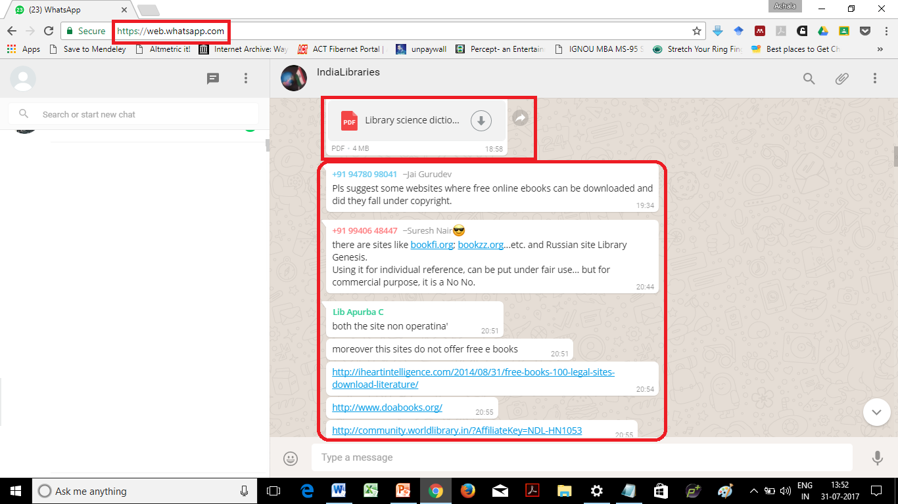
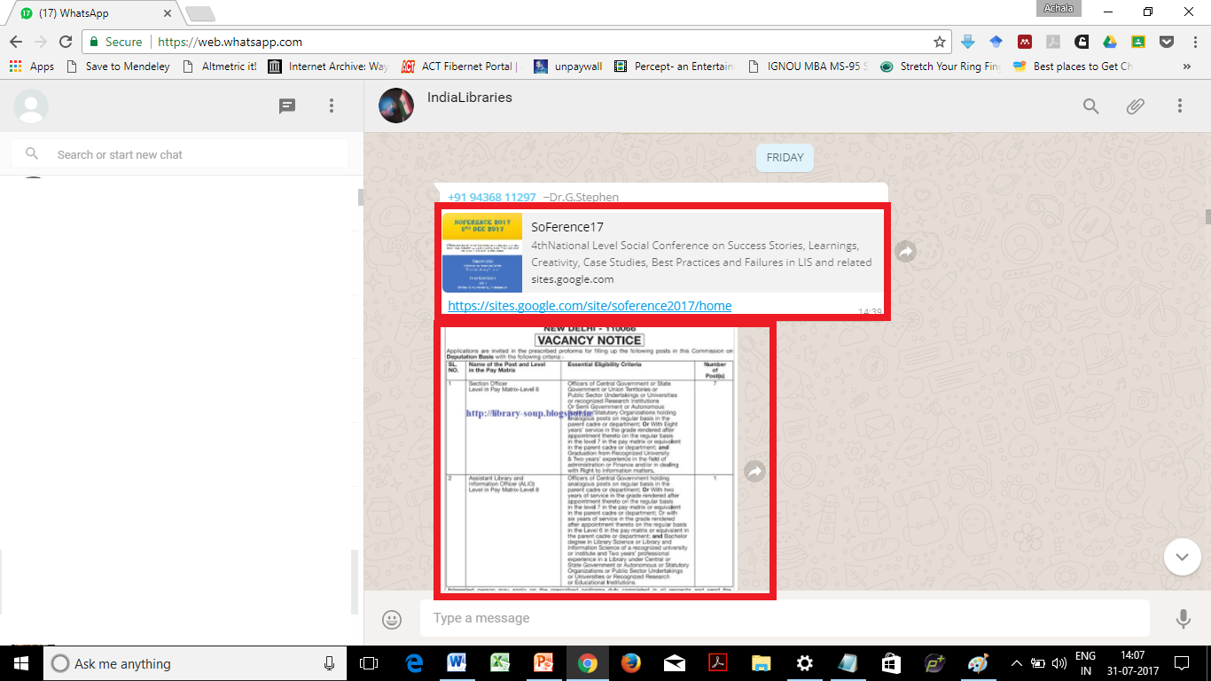
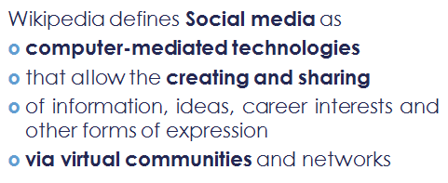
WhatsApp
Instant Messaging Service vs.
Social Media
Google Play
Wikipedia
a FREE messaging app available for Android and other smartphones.
Social media are computer-mediated technologies that allow the creating and sharing of information, ideas, career interests and other forms of expression via virtual communities and networks
WhatsApp fulfils all criteria of social media

Slide 3
RELEVANCE
Information is the forte of a Librarian
With introduction of Internet and various tools/technologies/applications on the web and mobile
How information is created, shared, communicated and consumed has changed.
Social tools (WhatsApp) - gaining prominence in information communication
Each social tool has Terms and Conditions to become a member; giving rise to legal implications of using these apps and jurisdiction they fall, should a problem arise.
These tools and technologies did not exist when Indian Penal Code (IPC) was written
Since it is difficult to make new rules/amendments to existing ones.
So the existing rules are interpreted to encompass today’s challenges.
Librarian responsibility
Member
Admin
Professional Responsibility - educating library members and public
  Impact of sharing/oversharing/under-sharing
  identify fake news from real
  Authentic/validated information from untruths
  Legal Implications of using/misusing social tools - WhatsApp

Slide 4

WhatsApp
Started by Jan Koum & Brain Acton in 2009 globally and 2010 in India
109 countries are using (26 May 2016)
1 billion users worldwide including 200 million users in India (25 Feb 2017)
100 – 256 – 1000 members (hack-slack.com!)
Notes:
WhatsApp Now Has 200 Million Monthly Active Users in India available at http://gadgets.ndtv.com/apps/news/whatsapp-now-has-200-million-monthly-active-users-in-india-1663332

Slide 5
What is it used for?
Personal Connections
Professional Groups
Broadcasting

Slide 6
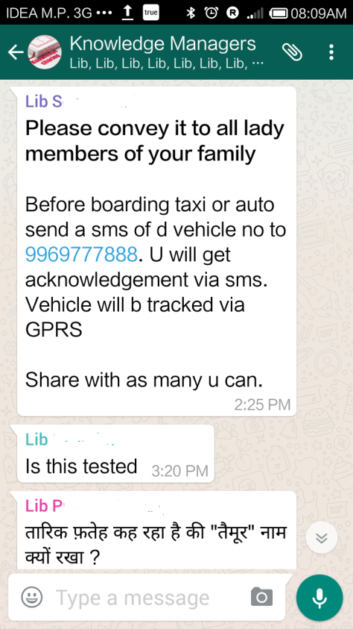
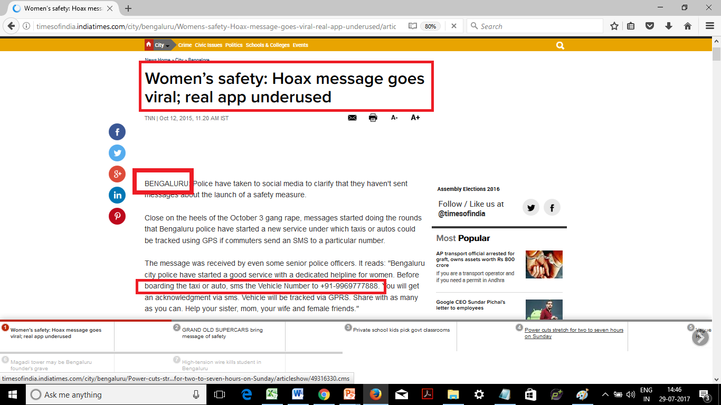
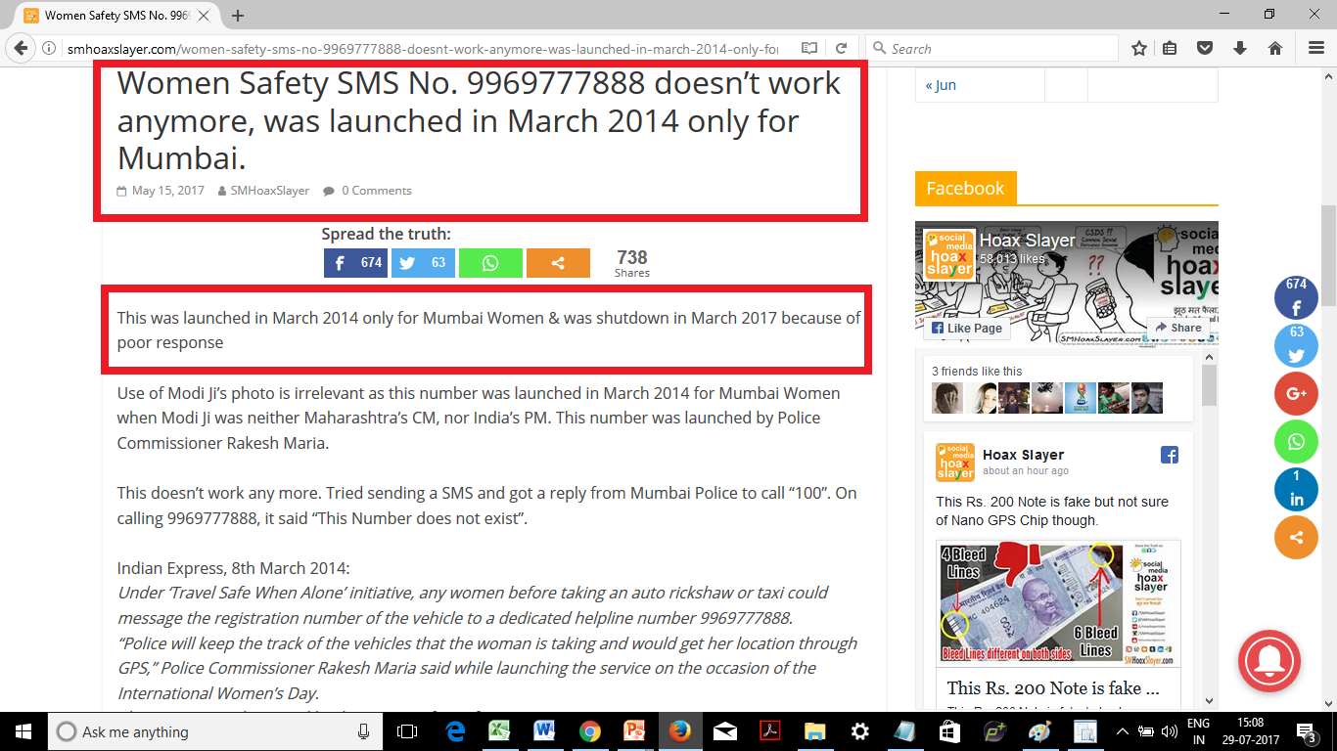
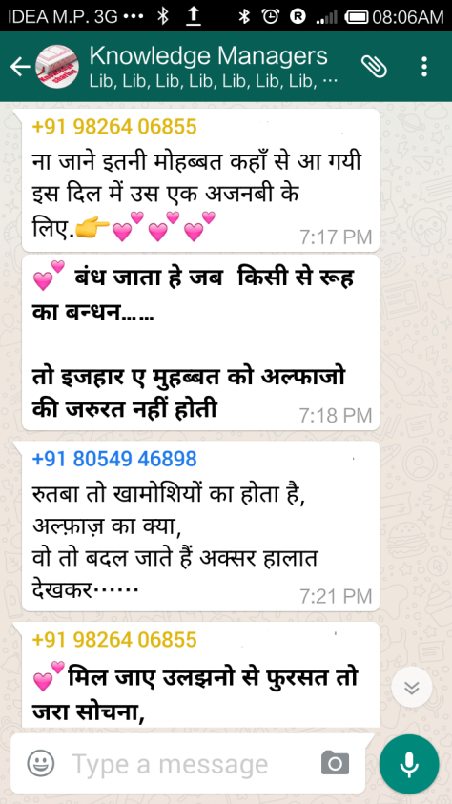
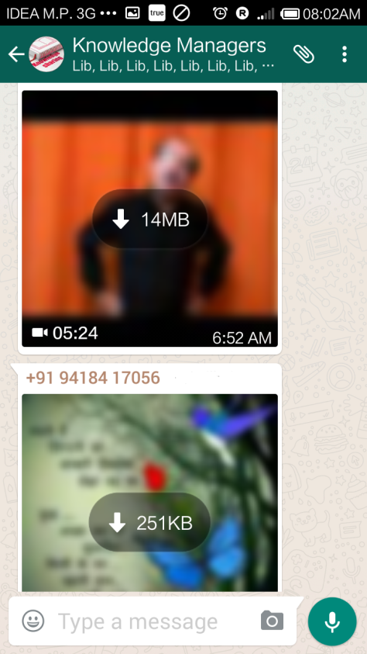
Notes:
Launched by Rakesh Maria in March 2014: http://indianexpress.com/article/cities/mumbai/mumbai-police-starts-sms-helpline-for-women-travelling-alone/
ShutDown in March 2017 : http://www.mid-day.com/articles/mumbai-police-shuts-down-special-helpline-for-women-heres-why/18040192

Slide 7
Do people read message and check information before forwarding/reposting it?
Compulsively forward messages!
Forwarded as Received!
(Are You Absolved of Your Responsibility?)

Slide 8
Chain messages that people love to forward/post/repost/share like
Don't drink bottled/tetra-packaged drinks or eat chocolates/sweets/savouries from a particular brand!
Aids from vendor cutting any fruit!
God of various religions blessing/cursing if message is forwarded!
Get free recharge from Company/Govt./Political figure/Film Star!
Promotional messages or advertising!
Flash sale from online companies!
International organisations recognising best anthem/prime minister etc.
Forwarding message to various groups changes colour!
Be surprised/shocked messages!
Notes:
-Forward this message, the victim gets donation of 1 Rupee for every forward from Whatsapp,
-Send this message to 10 people to get 200 Rupees recharge instantly’,
-Forward this picture to 10 people within two minutes after reading this, people who forwarded earlier faced good luck and a person who didn’t, heard the news that their one of his dear ones is expired
etc.
https://www.quora.com/Why-are-chain-messages-created-and-circulated-on-Whatsapp-Facebook-Email-and-other-social-media-platforms-Who-creates-them-What-could-be-the-motive

Slide 9




Stegano graphy practice of concealing a message/image/video within another message/image/video.
Hidden malware and infect the device
Frauds & Phishing

Slide 10
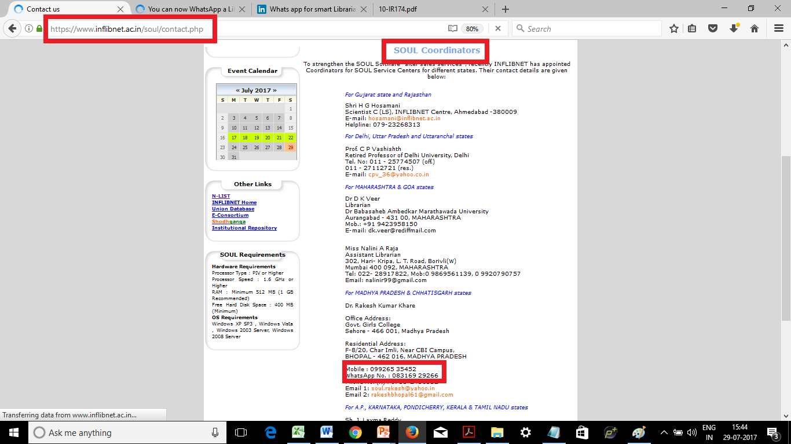
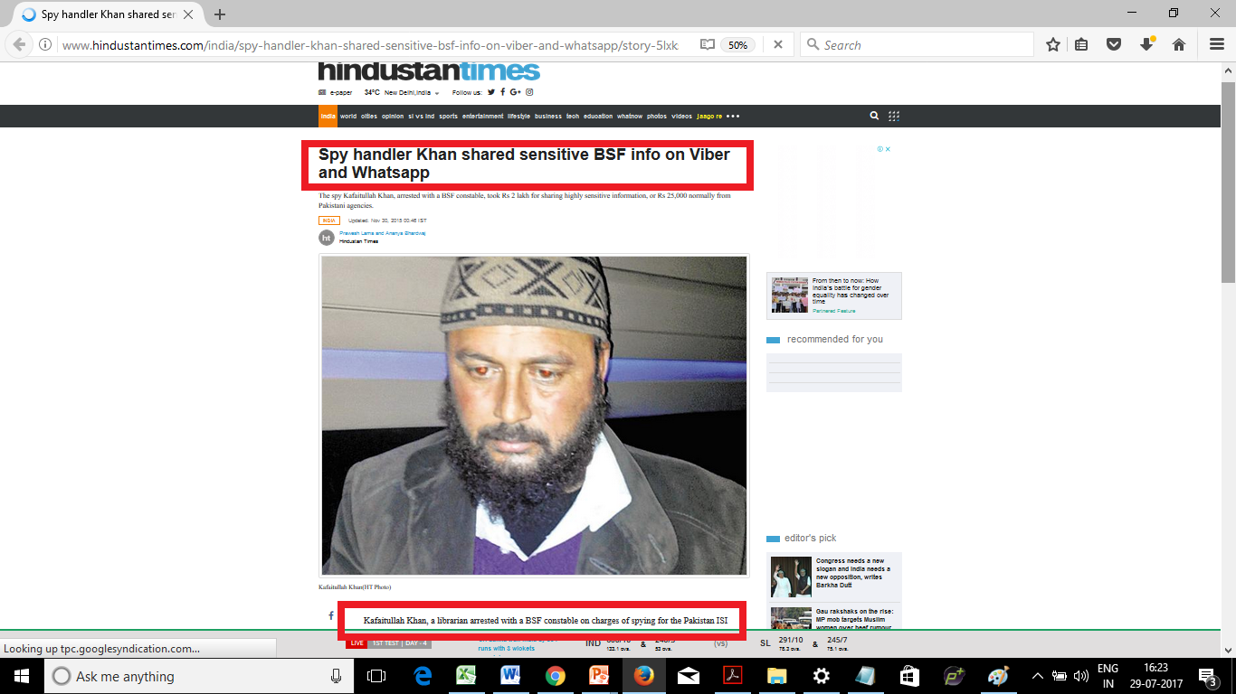
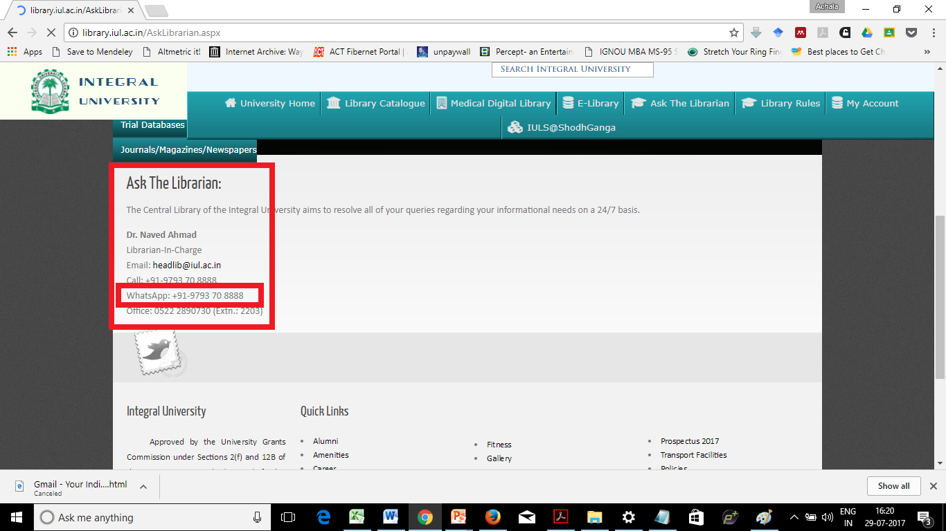

LIS WhatsApp Groups
Effective utilisation
Broadcasting
Conference
Job
Queries posted & answered
Discussion
Support with tool & technologies
Marketing Self & Organisation
Notes:
http://www.hindustantimes.com/india/spy-handler-khan-shared-sensitive-bsf-info-on-viber-and-whatsapp/story-5lxksvTY9t1dOH5ZsdnNwJ.html

Slide 11
List of LIS WhatsApp Groups in India
1 Dream Librarian 16-Oct-13
2 LIS Professional 09-Jan-14
3 LIS Cool Buddies (earlier LIS Group) 03-May-14
4 IndiaLibraries 11-Aug-14
5 Intellectuals (earlier Intellectual Group) 23-Aug-14
6 Academic Library 12-Sep-14
7 LIS Friends 03-Oct-14
8 Telangana Librarians 27-Nov-14
9 Young Lib. Association 20-Dec-14
10 Library Group 27-Jan-15
11 Library Knowledge Pool 17-Feb-15
12 IndiaLibraries Students Group 21-Feb-15
13 Knowledge Manager 4 LIS 06-Apr-15
14 Librarian Group 12-Apr-15
15 Knowledge Managers 22-Apr-15
16 JALIS Friends Group 29-Apr-15
17 LIS in West Bengal 30-May-15
18 Library Dot Com 21-Jun-15
19 Hyderabad Librarians 06-Jul-15
20 LIS Teachers 15-Jul-15
21 LIS Professionals in MP 18-Aug-15
22 LIS-Forum India 05-Sep-15
23 OU - LIS Group 15-Sep-15
24 Informations 17-Sep-15
25 DLIS SNGGPGCollege, Bhopal 29-Sep-15
26 ISLA (Indian School Library Association) 28-Oct-15
27 STAR Librarians (earlier Librarians Indeed) 28-Oct-15
28 Medical Librarian 12-Nov-15
29 Medical Librarian 12-Nov-15
30 Linux for Librarians 19-Nov-15
31 INFO Library 18-Jan-16
32 Madhya Pradesh Lib. Asso. 06-Feb-16
33 LIS Friends-IAMR 09-Feb-16
34 UGC CBSE NET SET 15-Feb-16
35 KUDCollege LibrariansAss 21-Mar-16
36 www.LISSetNet.com 1 2016 29-Mar-16
37 LIS Professionals 03-Apr-16
38 Library & Information Sc 08-Apr-16
39 Academic 5 (LIS) 03-Aug-16
40 Librarians Group 18-Aug-16
41 IndiaLibraries Ambassador 30-Aug-16
42 School Librarium 15-Sep-16
………….and many more……….

Slide 12
Dream Librarian started in 16-Oct-13 is the first LIS WhatsApp group in India but it is not so much in use now with just 28 members as on 29 Jul 2017.
Academic 5 (LIS) started on 03-Aug-16 suddenly closed down on 10 Nov 2016.
Telangana Librarians; Hyderabad Librarians posts predominantly Telugu with few English posts.
LIS in West Bengal posts in Bengali and English.
Others post predominantly general content in Hindi, Hinglish (Hindi in English script!) & sometimes in English. interspersed with lot of Good Morning Images, Good Thought of the Day, Poetry (Shayari) and Jokes!

Slide 13
Legal Terms & Conditions
Legal terms and conditions of using WhatsApp are mentioned at their site at https://www.whatsapp.com/legal/
Don’t Agree=Cannot Use!
Notes:
But how many take time to read the terms and conditions; the fine print, the between the lines legal import. As per the WhatsApp policy if you don’t agree to the terms and conditions, then you cannot use it. So most people just agree to the terms assuming them to be ‘safe enough’ and would realise the implications only when there is a foul.

Slide 14
Legal Age 13
Peer Pressure
Reasoning safety in numbers
Democratic country - have freedom of speech and expression
Can evade law
Most assume that they will plead ignorance and escape.

Slide 15
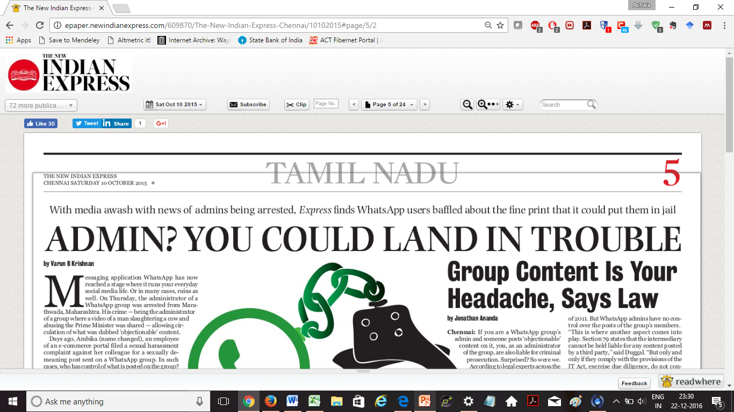
There were numerous reports online & print newspapers regarding Admin being liable for criminal prosecution
if objectionable posts are shared on the group.
Notes:
http://epaper.newindianexpress.com/609870/The-New-Indian-Express-Chennai/10102015#page/5/2

Slide 16
T&C – legal boundaries
Jurisdiction
Member
Location
  app made in which country
  app downloaded
    Citizen of which country
    using which internet/mobile provider
  app used
    Citizens of a country
    Citizen of a country – residing/travel in another country
What is objectionable (ambigious)? Infringing nature of post!
Admin
One admin from one country
Many admins from same country
Many admins from different countries (each country having own laws regarding apps on internet-conflict to settle dispute)

Slide 17
What is objectionable?
Term ‘objectionable’ is ambiguous.
Define what is universally objectionable
Thumb rule anything that is biased (for or against) caste, race, religion, gender, creed, sexual orientation, age, marital status, political affiliations, social status, heritage, education, financial ability, country of origin, citizenship, immigration status, physical/mental ability; religious affiliations can be termed objectionable which can be just information, satire, jokes etc. in form of text/images/videos.

Slide 18
Administrator was arrested when video of man slaughtering a cow and abusing the Prime Minister was shared.
A Press Trust of India report said that the four were arrested by the police under
sections 153 of the IPC [promoting enmity and ill will]
section 34 [deals with roles of Certifying Authorities] and
section 67 of IT Act, 2000 [deals with obscene content transmitted in electronic media].

Slide 19
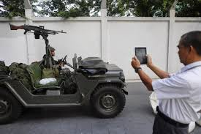

Section 505(1)(b) in The Indian Penal Code
(b) with intent to cause, or which is likely to cause, fear or alarm to the public, or to any section of the public whereby any person may be induced to commit an offence against the State or against the public tranquillity;
Information impacting National security
Geotagging military movements
3,000 armed men are roaming in parts of Solapur district with the intention of kidnapping children.’
Rumour – Mis-Information & Panic

Slide 20
VIRAL
Police issue alerts and warnings “Do not open door for strangers”
Media creating a scare that WhatsApp administrators are in danger of being arrested for what is posted on their group.
Notes:
http://www.deccanchronicle.com/150813/technology-latest/article/watch-out-if-you-are-group-admin-whatsapp-you-could-get-trouble

Slide 21
WhatsApp biggest source of untruths and fake news!
District Magistrate of Varanasi, and Senior Superintendent of Police jointly issued an order that the administrators are to only include people ‘personally’ known which is ‘difficult’ in professional group as there can be more than one admin who may add friends or colleagues known to them on group.

Slide 22
Analogies supporting why admin is held responsible similar to a
Boss responsible for behaviour of those working under him/her
Principal responsible for whole school/college including the faculty/student behaviour.

Slide 23
Dicey Example
Where an employee filed a sexual harassment complaint against his/her colleague for a sexually demeaning post sent on a WhatsApp group.
What will the authorities do if the person reporting is herself/himself is the admin of the group? Will they arrest her/him?

Slide 24
Admin
Admin is volunteering – not full time paid job!
Person who created the group changed the mobile number.
Person stops using the sim, the mobile carrier assigns the same number to some other person; who can continue using the group without verification; the implications of which are scary.
Person who created the group exits the group - the software randomly assigns a person as next admin - without the persons knowledge. No notification provided to the new admin.
Person who created group out of goodwill gives admin rights to other people, it was noticed that other admins have removed the actual admin who created the group
Sometimes there is more than one admin – from various states/countries.

Slide 25
According to the Indian IT Act
If you are an admin of a group, you are the 'intermediary' who created a service and you have certain obligations under the Act.
Being an admin of WhatsApp group puts the admin on same footing as other intermediaries such as telecom, ISPs, web hosting providers etc.
There is no demarcation.
Notes:
(http://www.thenewsminute.com/article/whatsapp-group-admin-you-are-intermediary-and-here%E2%80%99s-what-you-need-know-35031)

Slide 26
Since these tools and technology were not existing when Indian Penal Code was written; and since it is difficult to make new rules or amendments to existing ones; the existing rules are interpreted to encompass todays challenges.

Slide 27
Pavan Duggal, a cyber law expert says thats where Section 79 comes into play where the intermediary (admin) cannot be held liable for any content posted by a third party but only if they comply with provisions of the IT Act and
exercise due diligence
do not conspire to circumvent the law and
are cooperative.

Slide 28
The admins not be held liable for content posted on their group if they have
set terms and conditions
notified every member
received acknowledgement

Slide 29
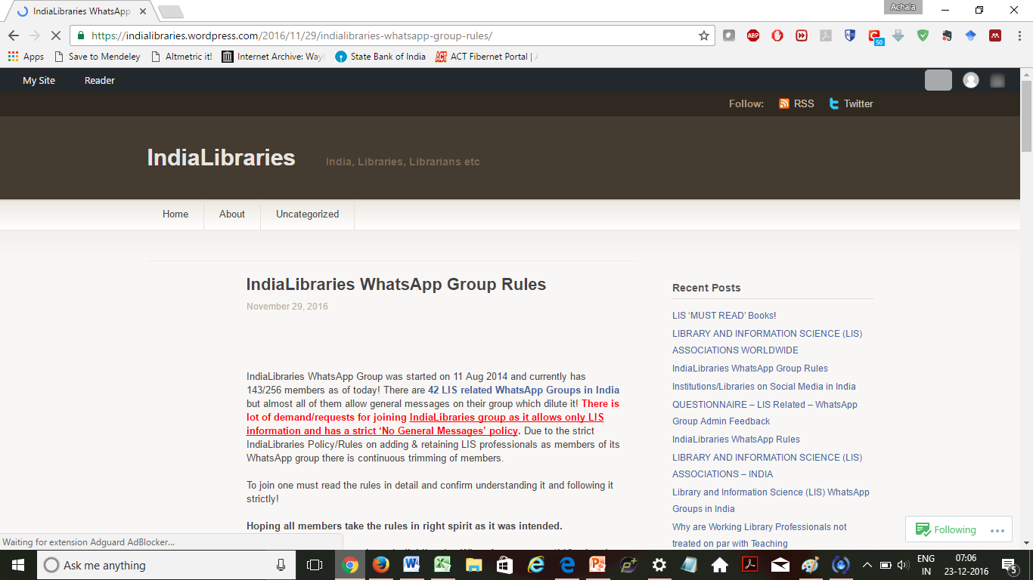
IndiaLibraries WhatsApp Group Rules https://indialibraries.wordpress.com/2016/11/29/indialibraries-whatsapp-group-rules/

Slide 30
STRICT POLICY
NO POSTS OR OPINIONS OR DISCUSSIONS
CASTE
RACE
POLITICS
SEX
RELIGION
Any SENSITIVE/CONTROVERSIAL topic
Topic impacting National security!

Slide 31
T&C
IP infringement https://www.whatsapp.com/legal/#ip-policy
Claims can be
emailed to ip@whatsapp.com
snail mail
WhatsApp Inc.
Attn: WhatsApp Copyright Agent
1601 Willow Road
Menlo Park, California 94025
United States of America

Slide 32
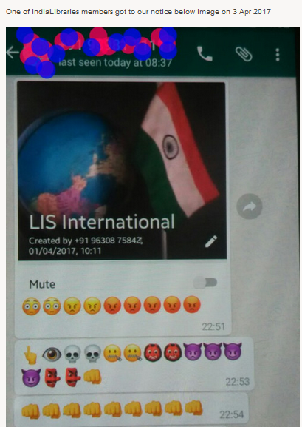
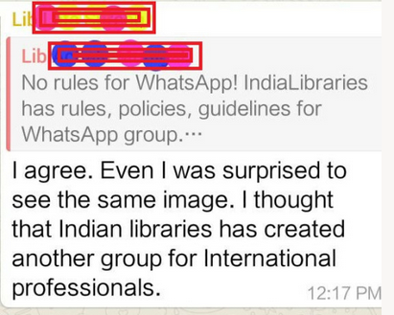

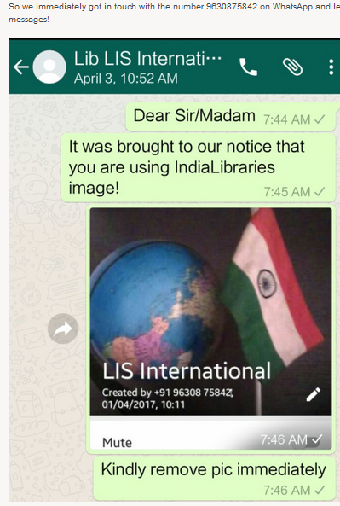
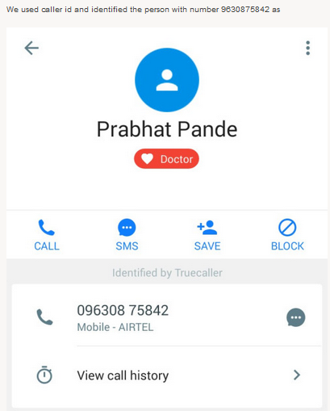
Copyright Infringement of IndiaLibraries Image by ‘LIS International’ WhatsApp Group! https://IndiaLibraries.wordpress.com/2017/04/10/1459/
Notes:
Technology is double edged sword; it can be constructive or destructive; a boon or a bane depending on circumstances; similar to fire. You can use fire to light a lamp or to cook; or it can be used to burn down and destroy. With great power comes great responsibility.

Slide 33
What can LIS Professionals Do?
Use Judiciously
Create Awareness of Etiquette on WhatsApp
Ensure that ‘if’ they are admins
  Create Scope & Publish Group Policy
  Share Relevant Information - Scope of group
  Ensure there is no Copyright Infringement
  Privacy and Security Safeguarded
  Share Best Practices
Effective Use Vs Misuse

Slide 34
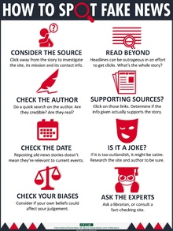
IFLA https://www.ifla.org/publications/node/11174

Slide 35
Encryption
November 2014 - April 2016
Another legal matter that has security and privacy impact on WhatsApp users is Encryption.
End to end encryption safeguards the privacy of the individual but is creating a problem for governments to battle crime and terrorism.
But citizens have a valid argument based on constitutional right to privacy

Slide 36
In India, an encryption of up to 40-bit is considered legal and services that are implementing this type of encryption have to register with the government.
Those who are using higher encryption are presently in the gray area, and so is the case with WhatsApp
indirectly, WhatsApp is presently illegal in India
there are no guidelines as yet in India which can ban them

Slide 37
RTI activist Sudhir Yadav, has filed a petition under the registration number DOTEL/R/2016/50413 in the Supreme Court seeking a complete ban on the messaging platform WhatsApp.
According to Sudhir mentions that in order to decrypt any message on WhatsApp, you would need a whopping 115,792,089,237,316,195,423,570,985,008,687,907,853,269,984,665,640,564,039,457,584,007,913,129,639,935 key combinations, which is almost impossible for any super computer.
Decrypting a single 256-bit encrypted message, according to him, would take trillions of years.

Slide 38
Delhi High Court directed Internet messaging service WhatsApp to delete all data and information of all users from its servers up until September 25 2016 when its new privacy policy comes into effect.

Slide 39
JOIN
IndiaLibraries WhatsApp Group
Those interested in joining IndiaLibraries WhatsApp Group please email your details to IndiaLibraries@gmail.com
1. Full Name
2. University/College/Company/Institution Name
3. WhatsApp - Mobile Number

Slide 40
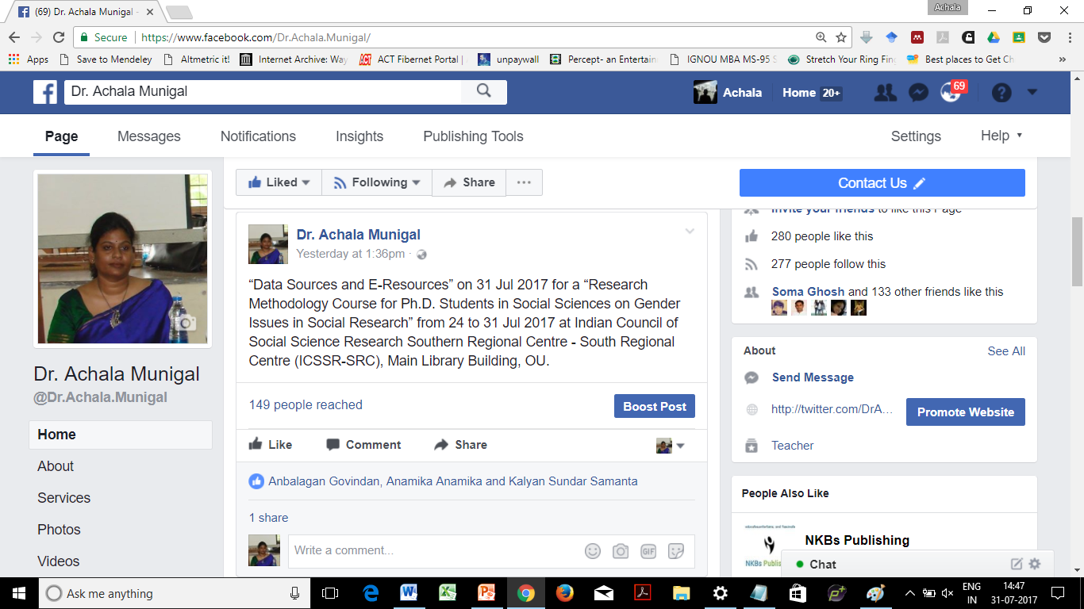
LEAVE FEEDBACK https://www.facebook.com/Dr.Achala.Munigal
AchalaMunigalRao@gmail.com

Slide 41

Social Presence @
Official Email: AchalaMunigal@Osmania.ac.in
Personal Email: AchalaMunigalRao@gmail.com
Academia: http://osmania.academia.edu/AchalaMunigal
Blog: http://www.AchalaMunigal.wordpress.com
Delicious: https://delicious.com/#AchalaMunigal
Delicious: https://delicious.com/#AchalaMunigalRao
Facebook: http://www.facebook.com/AchalaMunigal
LinkedIn: http://in.linkedin.com/in/DrAchalaMunigal
Paper.li: http://paper.li/AchalaMunigal/1365503310
Pinterest: http://www.pinterest.com/AchalaMunigal
Skype ID: @AchalaMunigalRao
Twitter: http://twitter.com/DrAchalaMunigal
Website: http://AchalaMunigalRao.webs.com/ (under construction)

Slide 42


Slide 43

Thank you

