Slide 1
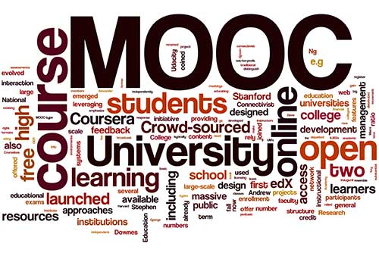
Swayam
MOOC
An e-Campus
MOHIT GUPTA
SHEEL BHADRA YADAV
APARNA DIXIT
VISHAL CHAWLA
DLIS, BUNDELKHAND UNIVERSITY JHANSI
Notes:
Image source: https://www.learndash.com/moocs-proving-useful-for-tech-skills/

Slide 2



MOOCs ..
MASSIVE
OPEN
ONLINE
COURSE

Slide 3
MASSIVE
  Unlimited Number Of Participation
  Unlimited Number Of Courses
  Unlimited Institutions

Slide 4
OPEN
Study any Course at anytime from any place
Learning Beyond the geographical boundary
Open for everyone
No eligibility criteria for courses
Simple and quick to join

Slide 5

ONLINE
  As opposed to face-to-face or blended
  Virtual learning
  No documentation
  zero paper wasted
Notes:
Image source http://www.potenzaglobalsolutions.com/blogs/e-learning

Slide 6
COURSES
A Big list of Courses
Introduce short term trending courses
Freedom to choose the course
Freedom to design own degree content

Slide 7

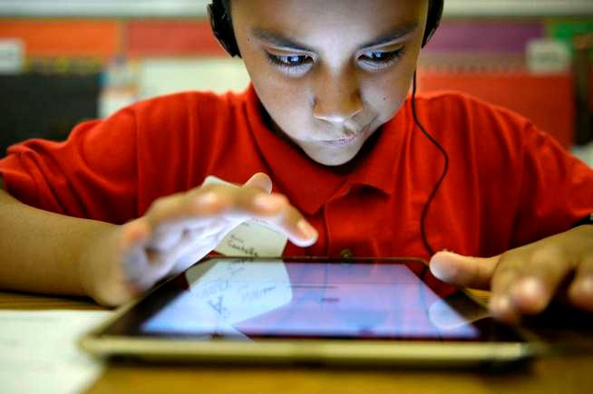
Old to Digital Classroom
Notes:
Image 1 source http://www.iloveaba.com/2016/02/calm-compliant.html
Image 2 source http://www.canoncitydailyrecord.com/news/ci_26436103/colorado-schools-finding-ways-bring-digital-devices-into

Slide 8

MOOCS COST
Available
Knowledge
Free of cost
Notes:
Image source http://www.bobbygill.co.uk/2009/11/

Slide 9
DIFFERENT KINDS OF MOOCS
MOOCs
xMOOCs
cMOOCs
bMOOCs

Slide 10
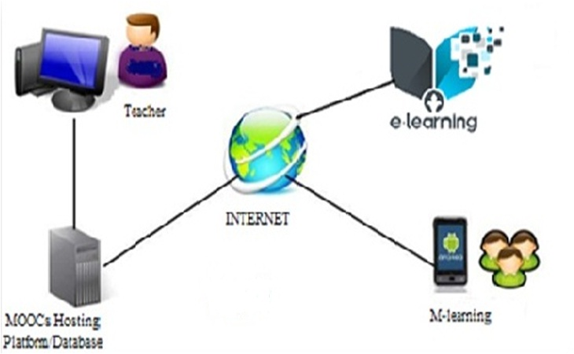
How Can Join MOOCs

Slide 11
COLLABORATION OF MOOCs & LIBRARY
E library, Libraries are transforming into learning labs
Library as an self university with diversity of subjects
Moocs in digital india
Swayam
Indian institutions a big part of global MOOCs

Slide 12
SO FINALLY
MOOCs is the future of education that provides learning in a new way
In future MOOCs can profile an institution as a leading 21st Century educational institution.
One of the famous purpose of Education is to make people see things different.

Slide 13
Thank
you
Everyone

