Slide 1




Scholarly Research Articles Published from
Anna University, Tamil Nadu during 2011-2016:
An Altmetrics Evaluation
Information and Library Network Centre
(An IUC of UGC)
Pallab Pradhan (Scientist- B)
pallab@inflibnet.ac.in
@pallabp

Slide 2
Introduction
  Assessment of scholarly research impact
  Role of social media in scholarly communication
  “Almetrics” is emerging as an alternative or complementary method for research assessment
  The term “altmetrics” was coined in September, 2010 by Jason Priem, the then a PhD student at the School of Information and Library Science at University of North Carolina, Chapel Hill, USA.

Slide 3
Objectives / Research Questions ?
To find out the density and kind of altmetrics data exist for the articles published from Anna University, Tamil Nadu during 2011-2016
To explore the presence of altmetrics for Anna University publications across broad subject fields categorized in Web of Science
To identify the differences in the presence of altmetrics in between Open and Paid publications
To prepare a list of year wise top and overall top publications with the highest altmetrics score, and
To know the Twitter demographic and geographic breakdown of the mentions for the publications

Slide 4
Methodology
Sources of Data
  “Web of Science Core Collection" of Web of Science database, a product of Clarivate Analytics
  Altmetric.com
Data Collection
  A total of 5056 publications, i.e. only articles published from Anna University, Tamil Nadu during 2011-2016 along with a total of 25850 citations
  427 (8.45%) were open access (OA) and 4629 (91.55%) were not open access (NOA) publications
  Only 4306 (85.17%) publications were found to have DOI, and the left 750 (14.83%) publications had no DOI associated with it
  Webometric Analyst 2.0 software was used to retrieve the altmetrics data from Altmetric.com
  Only 361 publications were found to have altmetrics data as per the data retrieved from Altmetric.com which includes online readership / posts / attentions / mentions, etc. in different social media platforms and web sources available over the web
  The data for the study were searched and retrieved on Friday, 30/06/2017
Data Analysis
  After all the required data collection over, the data were saved, calculated, interpreted and visualized in MS Excel

Slide 5
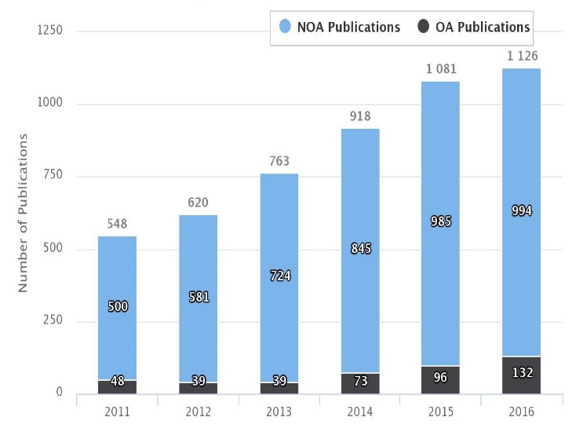
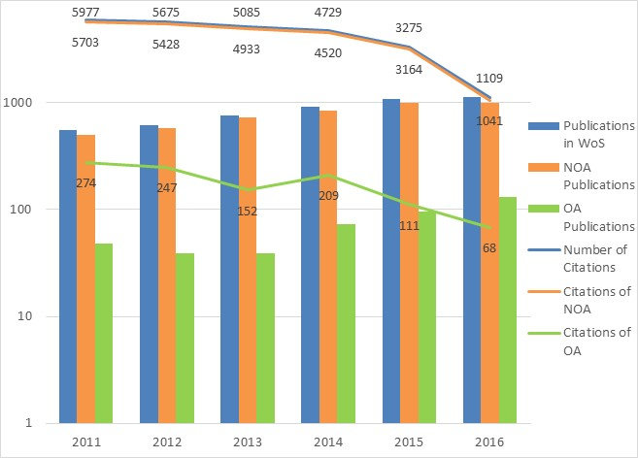
Findings and Discussions
Growth of Publications and Citations of Anna University
Chart-1 and 2: Year wise Publications (NOA & OA Publications) with Nos. of Citations of Anna University, Tamil Nadu
A total of 5056 publications, i.e. only articles were indexed in WoS published from Anna University during 2011-2016, having a total of 25850 citations
Clearly visible positive trend in both growth of publications and citations
427 (8.45%) were (OA) and 4629 (91.55%) were (NOA) publications

Slide 6
Findings and Discussions
Presence of Altmetrics for Anna University Publications
Year | Total Publications |  |  |  | NOA Publications |  |  | OA Publications
 | Publications in WoS | Publications with DOI | Publications with Altmetrics | % of Yearly Publications | Publications in WoS | Publications with DOI | Publications with Altmetrics | Publications in WoS | Publications with DOI | Publications with Altmetrics
2011 | 548 | 442 | 12 | 2.19 | 500 | 411 | 10 | 48 | 31 | 2
2012 | 620 | 518 | 28 | 4.52 | 581 | 489 | 22 | 39 | 29 | 6
2013 | 763 | 642 | 34 | 4.46 | 724 | 615 | 30 | 39 | 27 | 4
2014 | 918 | 791 | 86 | 9.37 | 845 | 728 | 77 | 73 | 63 | 9
2015 | 1081 | 930 | 94 | 8.70 | 985 | 856 | 75 | 96 | 74 | 19
2016 | 1126 | 983 | 107 | 9.50 | 994 | 862 | 93 | 132 | 121 | 14
Total | 5056 | 4306 | 361 | 7.14 | 4629 | 3961 | 307 | 427 | 345 | 54
Table-1: Altmetrics coverage of Anna University Publications
Only 85.17% of publications had DOIs associated with it
Unique identifiers like DOI, PubMed ID, arXiv ID, etc. of published article is necessary to retrieve altmetrics data from Altmetric.com
Only 7.14% of all publications collected from WoS had some kind of altmetrics data
Altmetric.com has the most extensive tracked sources for altmetrics data collection in comparison to others altmetrics data providers available in the market.

Slide 7
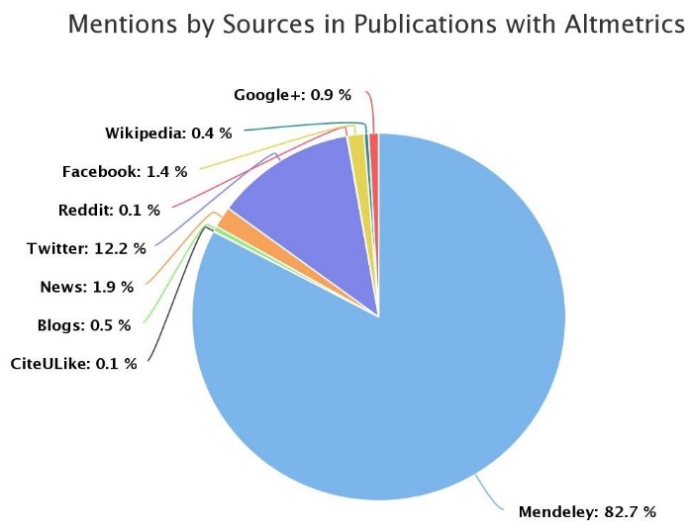
Findings and Discussions
Presence of Altmetrics for Anna University Publications
Source | Mentions in Publications with Altmetrics | Mentions in "NOA" Publications with Altmetrics | Mentions in "OA" Publications with Altmetrics
Mendeley | 4962 | 4065 | 897
CiteULike | 3 | 2 | 1
Blogs | 27 | 26 | 1
News | 112 | 112 | 0
Twitter | 730 | 631 | 99
Reddit | 3 | 3 | 0
Facebook | 86 | 77 | 9
Wikipedia | 24 | 22 | 2
Google+ | 52 | 50 | 2
Total | 5999 | 4988 | 1011
Table-2 and Chart-3: Altmetrics Mentions by Sources for Publications with Altmetrics
The presence of altmetrics for publications was mostly varied from each source.
Around 82.71% of all mentions were from Mendeley, followed by Twitter (12.2%) and News posts 1.9% respectively.

Slide 8
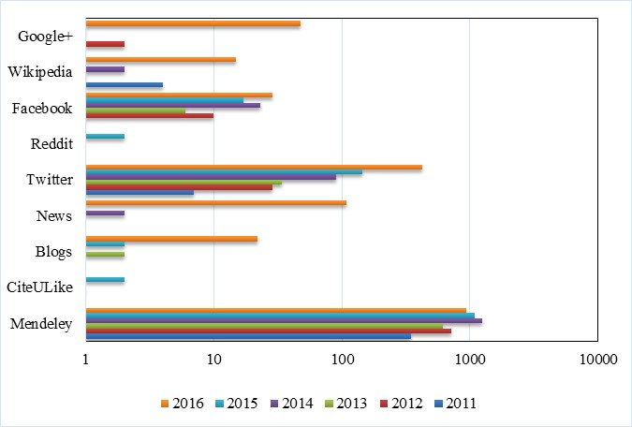
Findings and Discussions
Presence of Altmetrics for Anna University Publications
Year | Mendeley | CiteULike | Blogs | News | Twitter | Reddit | Facebook | Wikipedia | Google+ | Total
2011 | 346 | 0 | 0 | 0 | 7 | 0 | 1 | 4 | 0 | 358
2012 | 721 | 0 | 0 | 0 | 29 | 0 | 10 | 1 | 2 | 763
2013 | 614 | 1 | 2 | 0 | 34 | 0 | 6 | 1 | 0 | 658
2014 | 1258 | 0 | 1 | 2 | 90 | 0 | 23 | 2 | 1 | 1377
2015 | 1089 | 2 | 2 | 1 | 144 | 2 | 17 | 1 | 1 | 1259
2016 | 934 | 0 | 22 | 109 | 426 | 1 | 29 | 15 | 48 | 1584
Total | 4962 | 3 | 27 | 112 | 730 | 3 | 86 | 24 | 52 | 5999
Table-3: Altmetrics Mentions by Sources on Year wise Publications
Chart-4: Altmetrics Mentions by Sources on Year wise Publications

Slide 9
Findings and Discussions
Presence of Altmetrics across Subject Fields (WoS - Broad Subject Categories)
Technology publications have received the highest number of altmetrics mentions (38.50%), followed by Life Sciences & Biomedicine (34.70%) and Physical Sciences (23.61%) respectively.
361 publications were grouped under the five WoS-Broad subject categories: Life Sciences & Biomedicine, Physical Sciences, Technology, Arts & Humanities, and Social Sciences.
No publications in the subject category of Arts & Humanities published from Anna University having any altmetrics mentions during the studied period of 2011-2016.
234 publications were from one specific subject area, 73 and 10 publications were from two and three subject areas respectively.
WoS-Broad Subject categories | Nos. of Publications with Altmetrics | % of Publications | Altmetrics Mentions | % of Altmetrics Mentions | Nos. "NOA" Publications with Altmetrics | Altmetrics Mentions | Nos. of "OA" Publications with Altmetrics | Altmetrics Mentions
Life Sciences & Biomedicine | 160 | 35.71 | 2580 | 34.70 | 138 | 2039 | 22 | 541
Physical Sciences | 144 | 32.14 | 1756 | 23.61 | 130 | 1669 | 14 | 87
Technology | 137 | 30.58 | 2863 | 38.50 | 115 | 2309 | 22 | 554
Social Sciences | 7 | 1.56 | 237 | 3.19 | 7 | 237 | 0 | 0
Total | 448 | 100.00 | 7436 | 100 | 390 | 6254 | 58 | 1182
Table-4: Number of Publications with Altmetrics and Altmetrics Mentions across WoS - Broad Subject categories

Slide 10
Findings and Discussions
Presence of Altmetrics across Subject Fields (WoS - Broad Subject Categories)
The major source of altmetrics data across subject areas was Mendeley, followed by Twitter and News outlets respectively.
WoS-Broad Subject categories | Mendeley | CiteULike | Blogs | News | Twitter | Reddit | Facebook | Wikipedia | Google+
Life Sciences & Biomedicine | 2317 | 1 | 2 | 2 | 217 | 2 | 33 | 3 | 3
Physical Sciences | 1536 | 2 | 3 | 1 | 179 | 1 | 29 | 3 | 2
Technology | 2177 | 0 | 24 | 109 | 448 | 0 | 36 | 20 | 49
Social Sciences | 224 | 0 | 0 | 0 | 13 | 0 | 0 | 0 | 0
Total | 6254 | 3 | 29 | 112 | 857 | 3 | 98 | 26 | 54
Table-5: Altmetrics Mentions by Sources in WoS - Broad Subject categories

Slide 11
Findings and Discussions
Overall Top and Year wise Top Publications with the highest Altmetric Score
Altmetric Score (Altmetric.com) | Altmetrics Mentions | Title of the Publication | Source Journal | WoS Citations | Year
1232.5 | 623 | Inter-group violence among early Holocene hunter-gatherers of West Turkana, Kenya | Nature | 12 | 2016
21.888 | 63 | Photocatalytic Water Splitting under Visible Light by Mixed-Valence Sn3O4 | ACS Applied Materials & Interfaces | 40 | 2014
19.64 | 73 | Middle Palaeolithic occupation in the Thar Desert during the Upper Pleistocene: the signature of a modern human exit out of Africa? | Quaternary Science Reviews | 14 | 2013
14.45 | 60 | The effect of inorganic carbon on microbial interactions in a biofilm nitritation-anammox process | Water Research | 18 | 2015
4 | 57 | Evaluation and use of NS1 IgM antibody detection for acute dengue virus diagnosis: report from an outbreak investigation | Clinical Microbiology and Infection | 7 | 2012
3 | 40 | Relationship between process parameters and mechanical properties of friction stir processed AA6063-T6 aluminum alloy | Materials & Design | 19 | 2011
Table-6: The Year wise Top Publications with the highest Altmetric Score

Slide 12
Findings and Discussions
Overall Top and Year wise Top Publications with the highest Altmetric Score
Altmetric Score (Altmetric.com) | Altmetrics Mentions | Title of the Publication | Source Journal | WoS Citations | Year | Publication (OA / NOA)
1232.5 | 623 | Inter-group violence among early Holocene hunter-gatherers of West Turkana, Kenya | Nature | 12 | 2016 | NOA
21.888 | 63 | Photocatalytic Water Splitting under Visible Light by Mixed-Valence Sn3O4 | ACS Applied Materials & Interfaces | 40 | 2014 | NOA
19.64 | 73 | Middle Palaeolithic occupation in the Thar Desert during the Upper Pleistocene: the signature of a modern human exit out of Africa? | Quaternary Science Reviews | 14 | 2013 | NOA
14.45 | 60 | The effect of inorganic carbon on microbial interactions in a biofilm nitritation-anammox process | Water Research | 18 | 2015 | NOA
10 | 6 | Efficient reference-free adaptive artifact cancellers for impedance cardiography based remote health care monitoring systems | Springerplus | 1 | 2016 | NOA
10 | 16 | A Method to Differentiate Mild Cognitive Impairment and Alzheimer in MR Images using Eigen Value Descriptors | Journal of Medical Systems | 0 | 2016 | NOA
8.58 | 18 | Autophagy Protects Monocytes from Wolbachia Heat Shock Protein 60-Induced Apoptosis and Senescence | PLOS Neglected Tropical Diseases | 1 | 2015 | OA
7.9 | 21 | Crystal structure of E-coli lipoprotein diacylglyceryl transferase | Nature Communications | 6 | 2016 | OA
7 | 5 | Site-specific structural dynamics of alpha-Synuclein revealed by time-resolved fluorescence spectroscopy: a review | Methods and Applications in Fluorescence | 0 | 2016 | NOA
7 | 2 | Polyphenolic and phytochemical content of Cucumis sativus seeds and study on mechanism of preservation of nutritional and quality outcomes in enriched mayonnaise | International Journal of Food Science and Technology | 1 | 2016 | NOA
7 | 16 | Graphene Oxides Show Angiogenic Properties | Advanced Healthcare Materials | 13 | 2015 | NOA
6.2 | 31 | Ostrich expansion into India during the Late Pleistocene: Implications for continental dispersal corridors | Palaeogeography Palaeoclimatology Palaeoecology | 4 | 2015 | NOA
Table-7: The Top Twelve Publications with the highest Altmetric Score

Slide 13
Findings and Discussions
Overall Top and Year wise Top Publications with the highest Altmetric Score
Altmetric Score (Altmetric.com) | Altmetrics Mentions | Title of the Publication | Source Journal | WoS Citations | Year
8.58 | 18 | Autophagy Protects Monocytes from Wolbachia Heat Shock Protein 60-Induced Apoptosis and Senescence | PLOS Neglected Tropical Diseases | 1 | 2015
7.9 | 21 | Crystal structure of E-coli lipoprotein diacylglyceryl transferase | Nature Communications | 6 | 2016
3.6 | 42 | Nitric oxide rescues thalidomide mediated teratogenicity | Scientific Reports | 21 | 2012
3 | 37 | Apoptosis Inducing Effect of Plumbagin on Colonic Cancer Cells Depends on Expression of COX-2 | PLOS One | 23 | 2011
3 | 14 | High-Level Expression of Functionally Active Dengue-2 Non-Structural Antigen 1 Production in Escherichia coli | Biomed Research International | 1 | 2013
2.25 | 52 | The effect of indoor office environment on the work performance, health and well-being of office workers | Journal of Environmental Health Science and Engineering | 2 | 2014
Table-8: The Top Six Open Access (OA) Publications with the highest Altmetric Score

Slide 14
Findings and Discussions
Correlation between Citations and Altmetrics
Correlations (p)
Citations – Altmetric Score (Altmetric.com) | 0.050625
Citations – Mendeley Readers | 0.496387
Citations – Total Readers | 0.496178
Citations – Tweets | 0.063899
Citations – Total Tweets & Other Sources Citations | 0.04822
Table-9: The Correlation between Citations and Altmetrics

Slide 15
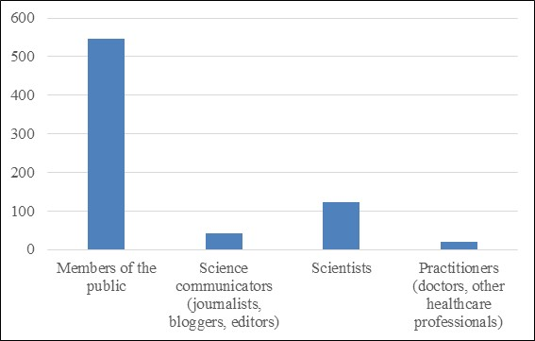
Findings and Discussions
Twitter Demographics and Twitter Geographic (Country) for Publications with Altmetrics
Category | Twitter Mentions | % of Twitter Mentions | Twitter Mentions in "NOA" Publications with Altmetrics | Twitter Mentions in "OA" Publications with Altmetrics
Members of the public | 546 | 74.79 | 474 | 72
Science communicators (journalists, bloggers, editors) | 42 | 5.75 | 32 | 2
Scientists | 123 | 16.85 | 108 | 10
Practitioners (doctors, other healthcare professionals) | 19 | 2.60 | 17 | 15
Total | 730 | 100.00 | 631 | 99
Table-10 and Chart-5: Twitter Demographics for the Publications with Altmetrics
Tweets (74.79%) were tweeted by the members of the public, followed by scientists (16.86%)

Slide 16
Findings and Discussions
Twitter Demographics and Twitter Geographic (Country) for Publications with Altmetrics
Country | Twitter Mentions | Twitter Mentions in NOA Publications with Altmetrics | Twitter Mentions in OA Publications with Altmetrics | Country | Twitter Mentions | Twitter Mentions in NOA Publications with Altmetrics | Twitter Mentions in OA Publications with Altmetrics
Algeria | 1 | 1 | 0 | Korea | 1 | 1 | 0
Argentina | 2 | 2 | 0 | Malaysia | 2 | 2 | 0
Australia | 12 | 8 | 4 | Mexico | 4 | 2 | 2
Austria | 1 | 0 | 1 | Netherlands | 5 | 4 | 1
Bangladesh | 1 | 0 | 1 | Norway | 1 | 1 | 0
Belgium | 2 | 1 | 1 | Oman | 1 | 1 | 0
Brazil | 1 | 1 | 0 | Other | 22 | 22 | 0
Canada | 9 | 9 | 0 | South Africa | 1 | 1 | 0
Colombia | 1 | 1 | 0 | Spain | 33 | 31 | 2
France | 13 | 9 | 4 | Sweden | 6 | 6 | 0
Germany | 13 | 12 | 1 | Switzerland | 3 | 0 | 3
Greece | 3 | 3 | 0 | Uganda | 1 | 0 | 1
India | 11 | 8 | 3 | United Arab Emirates | 1 | 0 | 1
Ireland | 2 | 1 | 1 | United Kingdom | 89 | 68 | 21
Italy | 1 | 1 | 0 | United States | 77 | 69 | 8
Japan | 23 | 23 | 0 | Unknown | 381 | 337 | 44
Kenya | 5 | 5 | 0 | Venezuela, Bolivarian Republic of | 1 | 1 | 0
Table-11: Twitter Geographic (Country) for the Publications with Altmetrics

Slide 17
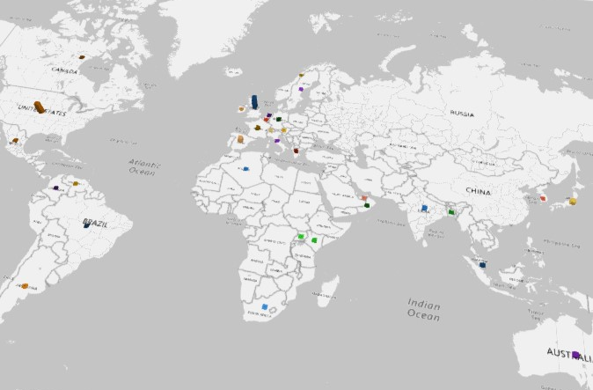
Findings and Discussions
Twitter Demographics and Twitter Geographic (Country) for Publications with Altmetrics
Chart-6: Display of Twitter Geographic (Country) for the Publications with Altmetrics in World Map

Slide 18
Conclusions
Basic purpose of this study was to present the altmetrics landscape of scholarly research publications published from Anna University, Tamil Nadu during 2011-2016.
It was a small study with a sample of only 361 articles having altmetrics data collected from Altmetric.com.
The altmetrics coverage was very low with only 6.56% of all publications during 2011-2016.
Mendeley readerships was the major part of all altmetrics mentions with 82.71%.
The “Technology” publications which has the third highest share of publications have received the highest number of altmetrics mentions (38.50%).

Slide 19
Conclusions
Life Sciences & Biomedicine publications which has highest share of publications have received the second highest number of altmetrics mentions (34.70%).
Higher altmetrics mentions for most recent publications was observed in the study.
Most publications with the highest altmetrics mentions are published in not open access (NOA) journals.
Majority of tweets (74.79%) were tweeted by the members of the public for the publications.
Tweets tweeted by “Unknown” tweeters forms the major parts of all Twitter mentions.

Slide 20
"WHAT”
Questions do you have for me?”
Thank You!

