Slide 1

Issues in Preservation of Digital Cultural Heritage
Presented by:
Somipam R. Shimray
Research Scholar
Department of Library and Information Science School of Media and Communication
Pondicherry University
Puducherry-605014

Slide 2
Contents
Introduction
What is Cultural Heritage?
Types of Cultural Heritage
Role of the LIS, Archives & Museum professionals in preserving traditional cultural heritage
Digital Preservation of Cultural Heritage
Advantages of Digital Preservation
Problems in Digital Preservation of Cultural Heritage
Economic Impacts of Digital Cultural Heritage Preservation
  Individual Impacts and Benefits
  Economic Impact and Benefits
  Social Impact and Benefits
Conclusions

Slide 3
Introduction
Over the years one of the agenda over and over again overlooked by libraries, archives and museums is how to preserve cultural heritage.
Cultural Heritage (CH) is the remembrance of its living civilization.
CH has to be valued with utmost care as it is given by ancestors.
Libraries, archives, museums and information centres are using several ICT tools for collecting, organizing, managing and providing access to Cultural Heritage Information.
There are many valuable tangible assets and intangible CH presently positioned at high risk.
Digital preservation is alternatively used for safeguarding and administering original CH objects.

Slide 4
What is Cultural Heritage?
Cultural Heritage is an expression of the ways of living developed by a community and passed on from generation to generation, including customs, practices, places, objects, artistic expressions and values.
CH is described as artifacts, places, custom, celebration and ritual practices that compose with history.
CH provides a link to past and present, thus it is a prime key of any community for its identify.
Cultural Heritage is often expressed as either Intangible or Tangible Cultural Heritage.
Cultural heritage is the legacy of physical artefacts and intangible attributes of a group or society that are inherited from past generations, maintained in the present and bestowed for the benefit of future generations - UNESCO.

Slide 5
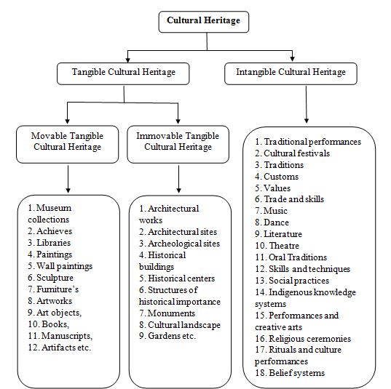
Types of Cultural Heritage

Slide 6
Role of the LIS, Archives & Museum professionals in preserving traditional cultural heritage
For many years, all information centres aimed to preserve and conserve records of cultural heritage so that it can be useful to the later generations.
Libraries, Archives and Museums can be involved in documenting and safeguarding of cultural heritage resources in the following ways (Chibuzor & Ngozi, 2009):
Provision of cultural heritage resources for all sections of the community.
Providing sufficient space for cultural works.
Supporting cultural heritage activities, e.g. organizing book fair, exhibitions and storytelling.
Organizing seminars, conferences and workshops, and presentation of talks to propagate information on cultural events.
Ensuring that Libraries, Archives and Museums collected works and transform them into services to help citizens.

Slide 7
Digital Preservation of Cultural Heritage
Digital preservation is best defined as safeguarding and administering digital objects for long-term usage (Bakhshi, 2016).
Digital preservation bind variety of issues, ranging from short to long-term access on use of digital objects.
Advantages of Digital Preservation
Digital preservation increases wider access by breaking all existing physical boundaries.
The preserved collections can be accessed locally and remotely via internet.
Provides administrative stability, i.e. recognition, preservation and safeguarding by ensuring administrative continuity (CDAC, 2013).
CH digital preservation promotes reuse and it aids in lawful obligations of document preservation and protects from lawsuits.
CH digital preservation forms heritage for upcoming generations (CDAC, 2013).
Digital preservation of CH generates revenue for the society through the use of images, audio and video contents in the form of publications.

Slide 8
Problems in Digital Preservation of Cultural Heritage
Lack of Funds
Lack of practical experience/Trained manpower
Technology Obsolesce
Technology Dependency
Copyright

Slide 9
Economic Impacts of Digital Cultural Heritage Preservation
Cultural heritage preservation can impact on the economy of the community directly and indirectly.
Individual Impacts and Benefits
Use value
  Direct
  Indirect
  Future use
Non-use value
2. Economic Impact and Benefits
3. Social Impact and Benefits

Slide 10
Conclusions
International agencies, governments, NGOs and every citizen should value and safeguard one’s own cultural heritage.
Involvement of educational institutes in promoting and safeguarding CH assets by way of introducing cultural related courses like Cultural Heritage Studies (CHS), Heritage Conservation, and Cultural Heritage Management (CHM) to produce required trained manpower.
A well action plan at national level has to be prepared considering the scope, purpose, policy, preservation techniques, implementation and maintenance of digital CH.
Adequate funds should be provided to run the CH institutions to safeguard CH assets.
Web online exhibition, VR, web base museums, second life, etc. are the technological tools helping us in providing access and cutting distance factor.

Slide 11
Thank you very much

