Slide 1

Assessment of Infrastructure and Services in Maulana Azad Library, Aligarh Muslim University: Issues and Scope for Improvement
Shamim Aktar Munshi, Mehtab Alam Ansari
&
Mohd. Shikoh
Department of Library & Information Science
Aligarh Muslim University, Aligarh

Slide 2

Introduction
The fundamental objective of the academic libraries and librarians are to fulfil their user’s needs by providing proper information resources. Only users can inform the librarians through their feedbacks to improve the quality of services. Therefore, the primary goal of the library can never be achieved unless overall services and facilities are endorsed by the users.
This study aims to evaluate the infrastructural facilities and the quality of services of Maulana Azad Library among the users.

Slide 3

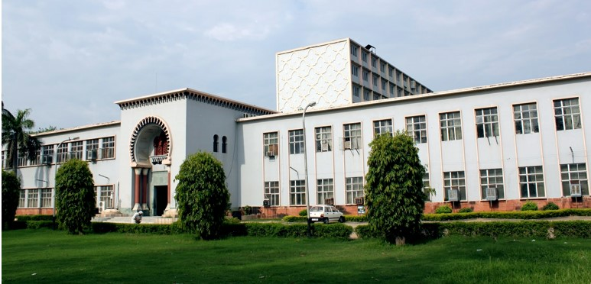
Maulana Azad Library
.

Slide 4
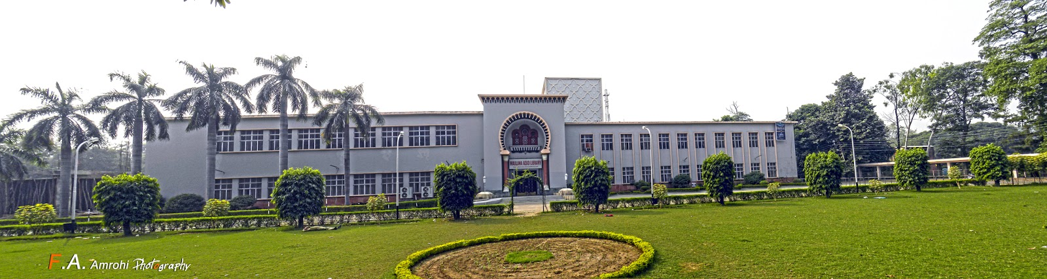
M. A. Library has been declared as the Best Amongst all Indian University Libraries by a visiting team of the National Assessment and Accreditation Council (NAAC, 2015)

Slide 5
Objectives of the Study
To know the different categories of library resources in accordance with the need of different categories of users;
To assists the preferences of users with regard to different categories of library collections;
To evaluate the available infrastructural facilities and services in Maulana Azad Library; and
To know the suggestions of library users with respect to improvement of library services and facilities.

Slide 6

Scope and Limitation of the Study
Aligarh Muslim University
12 Faculties
98 Departments
Faculty of Arts
Faculty of Social Science
Undergraduate Students
Postgraduate Students
10
Departments
Research Scholars
13
Departments

Slide 7

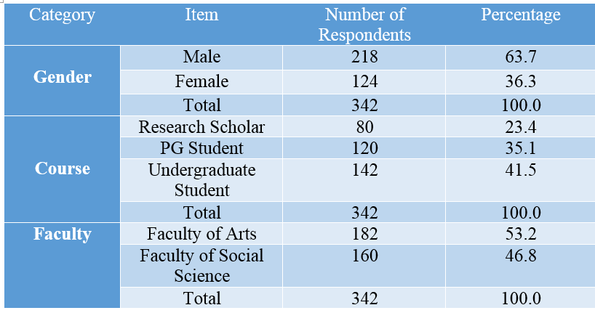
Methodology
Table: 1

Slide 8

Data Analysis and Interpretation
This study report users perception through four dimensions (Services & Infrastructural Facilities):
(1) Measurement of Library Collection,
(2) Library Services,
(3) Measurement of Library Facilities; and
(4) Assessment of Infrastructural Facilities.
In this section the measurement of each questions is gauged by using a statement of on a five-point Likert Scale.

Slide 9
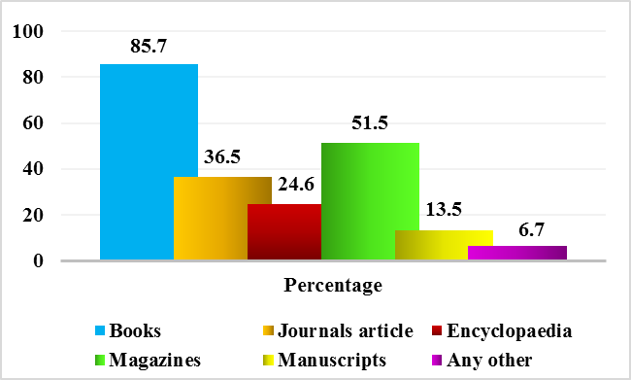
Categories of Information Use by the Users
Figure: 1

Slide 10

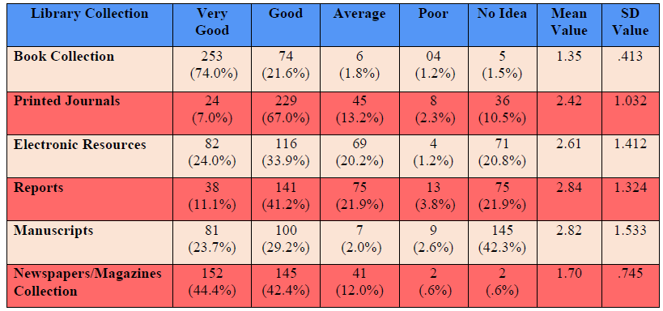
Measurement of Library Collection
Table: 2

Slide 11
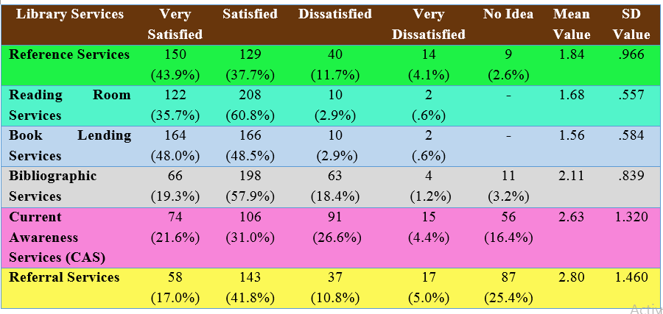
Measurement of Library Services
Table: 3

Slide 12
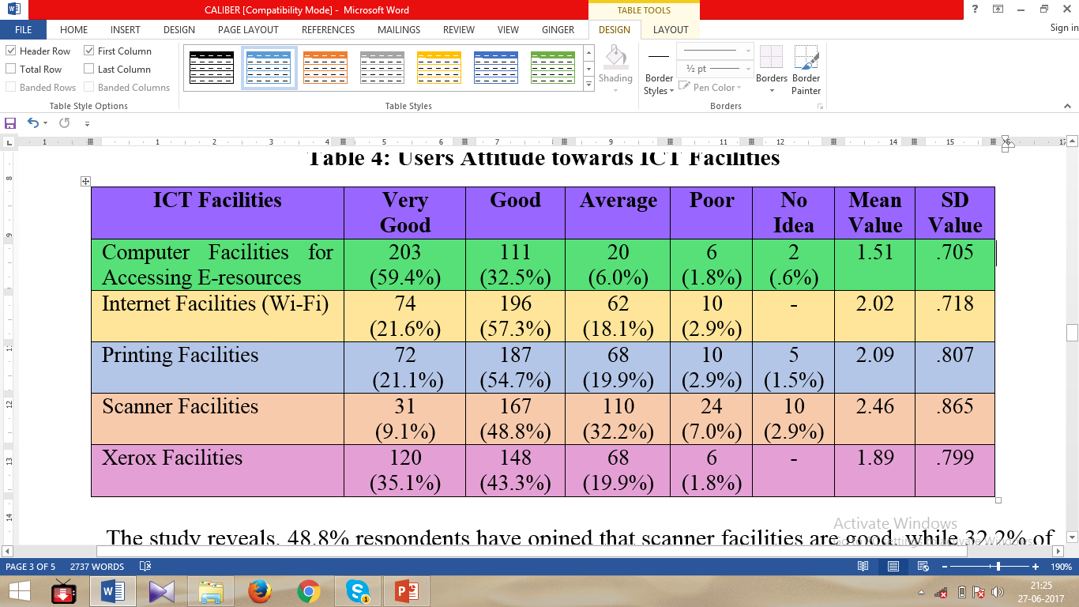
ICT Facilities
Table: 4

Slide 13
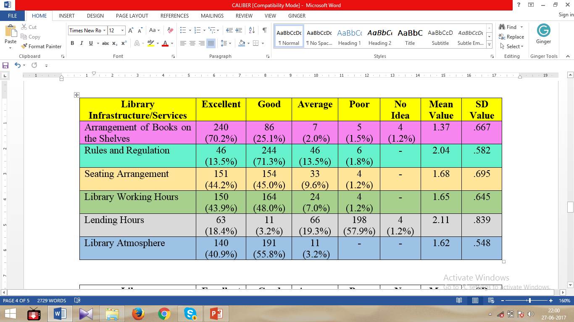
Assessment of Infrastructure/ Services Facilities
Table: 5
Continue…

Slide 14
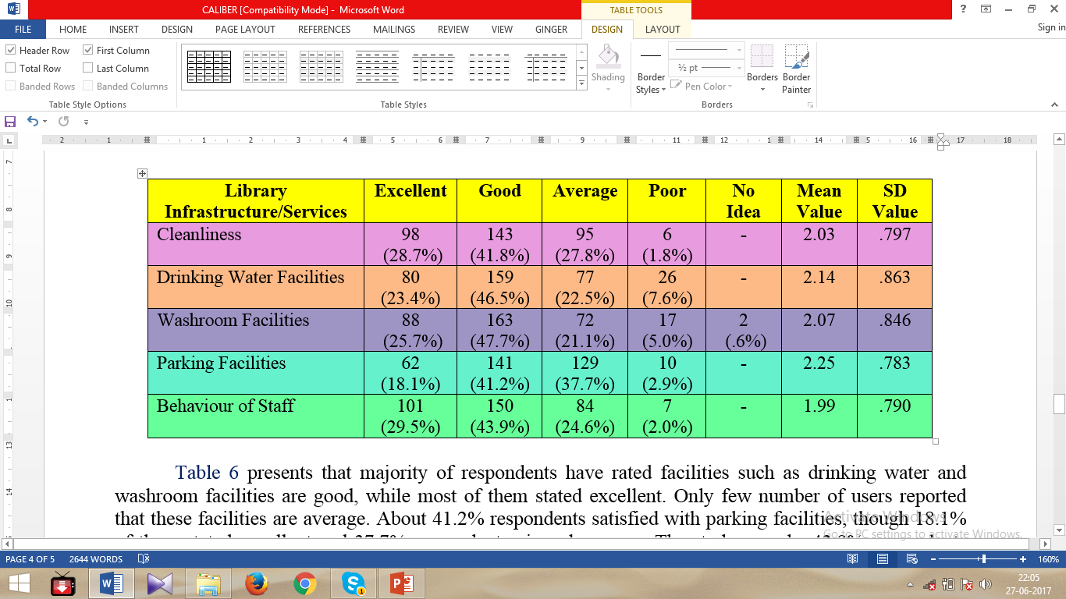

Slide 15
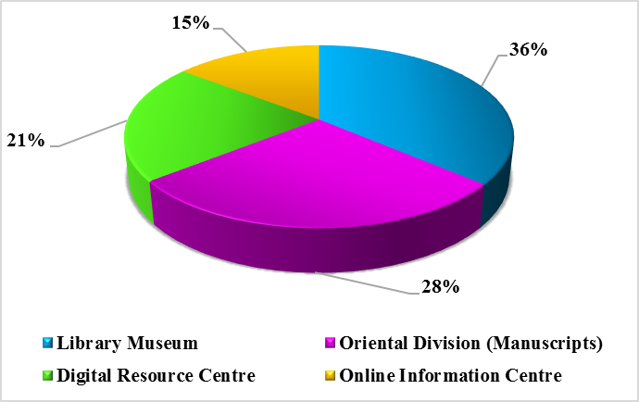
Most Impressed Area in the M. A. Library
Figure: 2

Slide 16
Suggestions for Improvement
Extent library lending hours: About 71.2% respondents suggested that the lending hours should be change. Especially, PG and UG students face problems for borrowing the book regularly, because the lending hours and classes’ time are same.
Need training programmes for information literacy: Out of 342 respondents, 32.8% of them wish to seek training programmes on how to find out the information quickly and download on the Internet.
Online renewal facilities: More than 41.5% respondents suggested that M. A. Library should initiate online renewal services so that they can easily renew the books for their needs from home and hostel.
Continue…

Slide 17
RFID: Majority of the respondents (67.9%) suggested that library should implement RFID technology including self-issue and book drop box services.
Started new services/facilities: Number of users (23.5%) mentioned that Selective Dissemination of Information (SDI) services are essential to start the library. Besides this, users also proposed many suggestions like separate report section for research scholars, colour printing facilities, subscribed more printed as well as electronic journal, query and demand services (reference quarry), more sitting arrangement in research division, etc.
Need to organize workshop for using web OPAC: About 22.9% respondents suggested that library should organize workshop dealt with the use of the Web OPAC facilities. Apart from this, it is essential to create awareness about the use of electronic journals which are available through E-Shodh Sindhu (UGC-INFONET Digital Library Consortium).

Slide 18

THANK YOU

