Slide 1



COPYLEFT LICENSES FOR REPOSITIONING THE FRONTIERS OF OPEN ACCESS ENVIRONMENT: AN EVALUATION
Presented by
Mr. Muruli
National Power Training Institute (NPTI)
Power Systems Training Institute (PSTI)
Bangalore
Co-Author: Dr. Dalimi Devi
NPTI-NER, Guwahati

Slide 2
Introduction
Need of Open Access
In the electronic age, sharing and managing information have become the most crucial part of social development. Knowledge sharing through open access has significant positive impact on every walk of life.
Why Open Access?
“Knowledge is to be shared”.
Open Access to information has changed the dimensions of information utility and visibility.
An open access environment gets the author credit to a maximum extent.
Collaboration, big decisions and solutions to issues

Slide 3

From Copyright to Copyleft
The existing copyright issues have become an obstacle in sharing information mainly that of academic and research.
Richard Stallman coined the word ‘Copyleft’ which is a parallel concept to copyright.
‘Some rights reserved’, an alternative to ‘all rights reserved’.

Slide 4
What is Copyleft?
Copyleft is an idea or practice that allows users to copy, modify and redistribute the content of a work. Copyleft includes everything that can be governed by copyright law (software, document, etc.).
It allows the modification and re-distribution retaining the credit for the creators contributed along the way.
Different from Public domain.

Slide 5
What is Copyleft?
A copylefted work inherently remains copylefted from first provider to the last user no matter how many times no matter to what extent the user makes modification.
Creative Commons Share Alike (CCSA) and GNU Free Documentation License (GFDL) are similar to Copyleft principles.

Slide 6
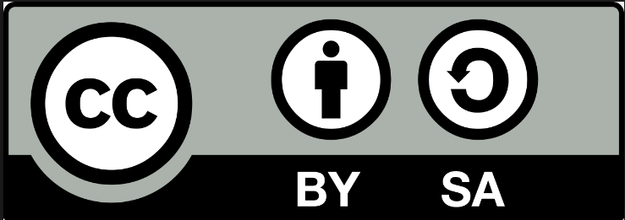
Creative Commons Share Alike (CC-SA)
In the group of the CC licenses, Creative Commons Share-Alike (CC-SA) has similarities with copyleft concept.
Attribution on derivatives
Viral license – Share-alike
Though Copyleft and CC-SA appear to be same, CC-SA may differ in terms of restriction on commercialization of work.
Comparatively more popular and has wider visibility.

Slide 7

GNU FREE DOCUMENTATION LICENSE
GNU Free Documentation License is a platform for OA distribution, founded by Free Software Foundation.
GFDL is the counter part of GNU GPL. GFDL deals with textbooks, manual, reference and instructional materials, music and art.
Every distribution of derived work needs to be available along with the full copy of license.
Every derived work under GFDL unconditionally remains GFDL.
Invariant Sections: GFDL facilitates the original creator to place restrictions on certain section of the work not to be changed/modified .
Commercialization of the work is permitted under the same license.
Every derived work includes all the changes made through the time and contributors list .

Slide 8
Issues with Copyleft license
The gap between Copyright and Copyleft widens as they cannot be blended with each other for new knowledge.
Lengthy documents for even small modifications in case of derived work in GFDL.
The invariant sections of GFDL.
GFDL documents can be used with non-GFDL materials but at every occurrence of GFDL extracted material the user is obligated to mention the source.

Slide 9
Issues with Copyleft license
Though copyleft supports open access, the infringement may land up the user in legal issues.
At many instances existing copyleft licenses are incompatible with each other.
Difficulties in understanding the license terms.
Within Creative Commons there are many levels which may not be compatible with each other (CC-BY can turn into CC-SA not vise versa).
Irreversibility of CC-SA.

Slide 10
Recommendations
Policy making at global level.
Confluence of information professionals, creators, policy makers and users in policy making.
Influencing authors/creators to adopt copyleft.
Tracking system for monitoring violation of license terms.
Merging the existing methods or devising a new framework.
Green open access and Gold open access.

Slide 11
Libraries and Open Access Policies
A librarian needs to be aware of legal aspect of information.
Being instrumental in advocating open access.
Congregation of open access sources (Project Gutenberg, Biodiversity Heritage Library and Digital Library of India).
Influencing potential users to choose open access for their work.

Slide 12
Conclusion
The existing copyleft policies have drawbacks with incompatibility in combining works, monitoring of violation of terms, invariant sections and difficulties in comprehending policy terms.
Correcting the imperfections and ruling out the inconsistencies of existing policies or new policy made to be in place.
Seeding the awareness of open access to information.
Convergence of related professionals and users.

Slide 13

Liberty cannot be preserved without a general knowledge among the people, who have a right and a desire to know.
John Adams

