Slide 1



Mapping the Women’s Voices in India: An Analysis
Shrabani Majumdar
sm210764@gmail.com
9339150339
Dr. Swaguna Datta
swaguna.datta@gmail.com
9830565944
Jadavpur University
Kokata-700032

Slide 2

“One is not born, but rather becomes, a woman.”
Simone de Beauvoir. The Second Sex (1949)

Slide 3

0-3
8-9
3-5
6-7

Slide 4


Slide 5
1
Analysing the research trend in the arena of Women’s Studies, with special reference to Indian context
2
Mapping women’s voices in research themes through controlled vocabularies (keywords)

Slide 6


Slide 7
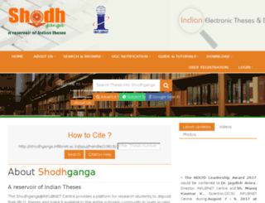
Shodhganga:
A Reservoir of Indian Theses

Slide 8
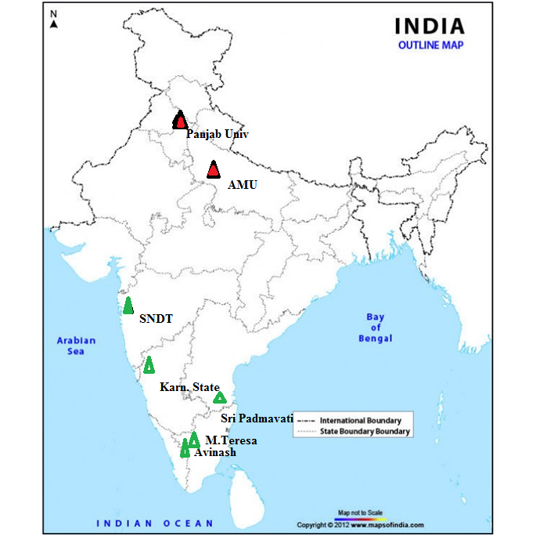
Location of Universities

Slide 9


Slide 10
1
2
3
To identify the suitability of a thesis to be fit in the considered subject area of women’s studies the keywords in thesis title are analyzed.
4
The number of theses is subdivided on a decadal basis and the decadal growth in PhD research in the subject area and the corresponding research trend has been observed.
About 19 different keywords have been identified from SEARS List of Subject Headings pertaining to broad subject area of women’s studies.
A detailed account of all PhD theses related to women related issues and submitted to the seven considered universities since 1970’s has been taken.

Slide 11

Women-Employment (Women’s Work)
Women-Education
Women-Health and Hygiene
Women-Social Conditions
Women in Literature
Women’s Rights
Adolescence
Child Psychology
Women-Mental Health
Muslim Women
Women-History
Domestic Violence
Women in Development
Women-Political Activity
Marriage/ Family
Social Classes
Reproduction
Female Foeticide
Women’s Movement

Slide 12


Slide 13
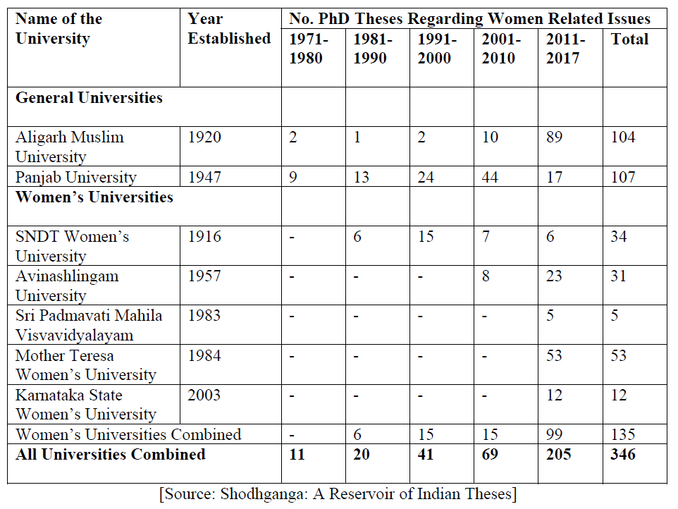
Trend of Growth of PhD Research Regarding Women Related Issues

Slide 14
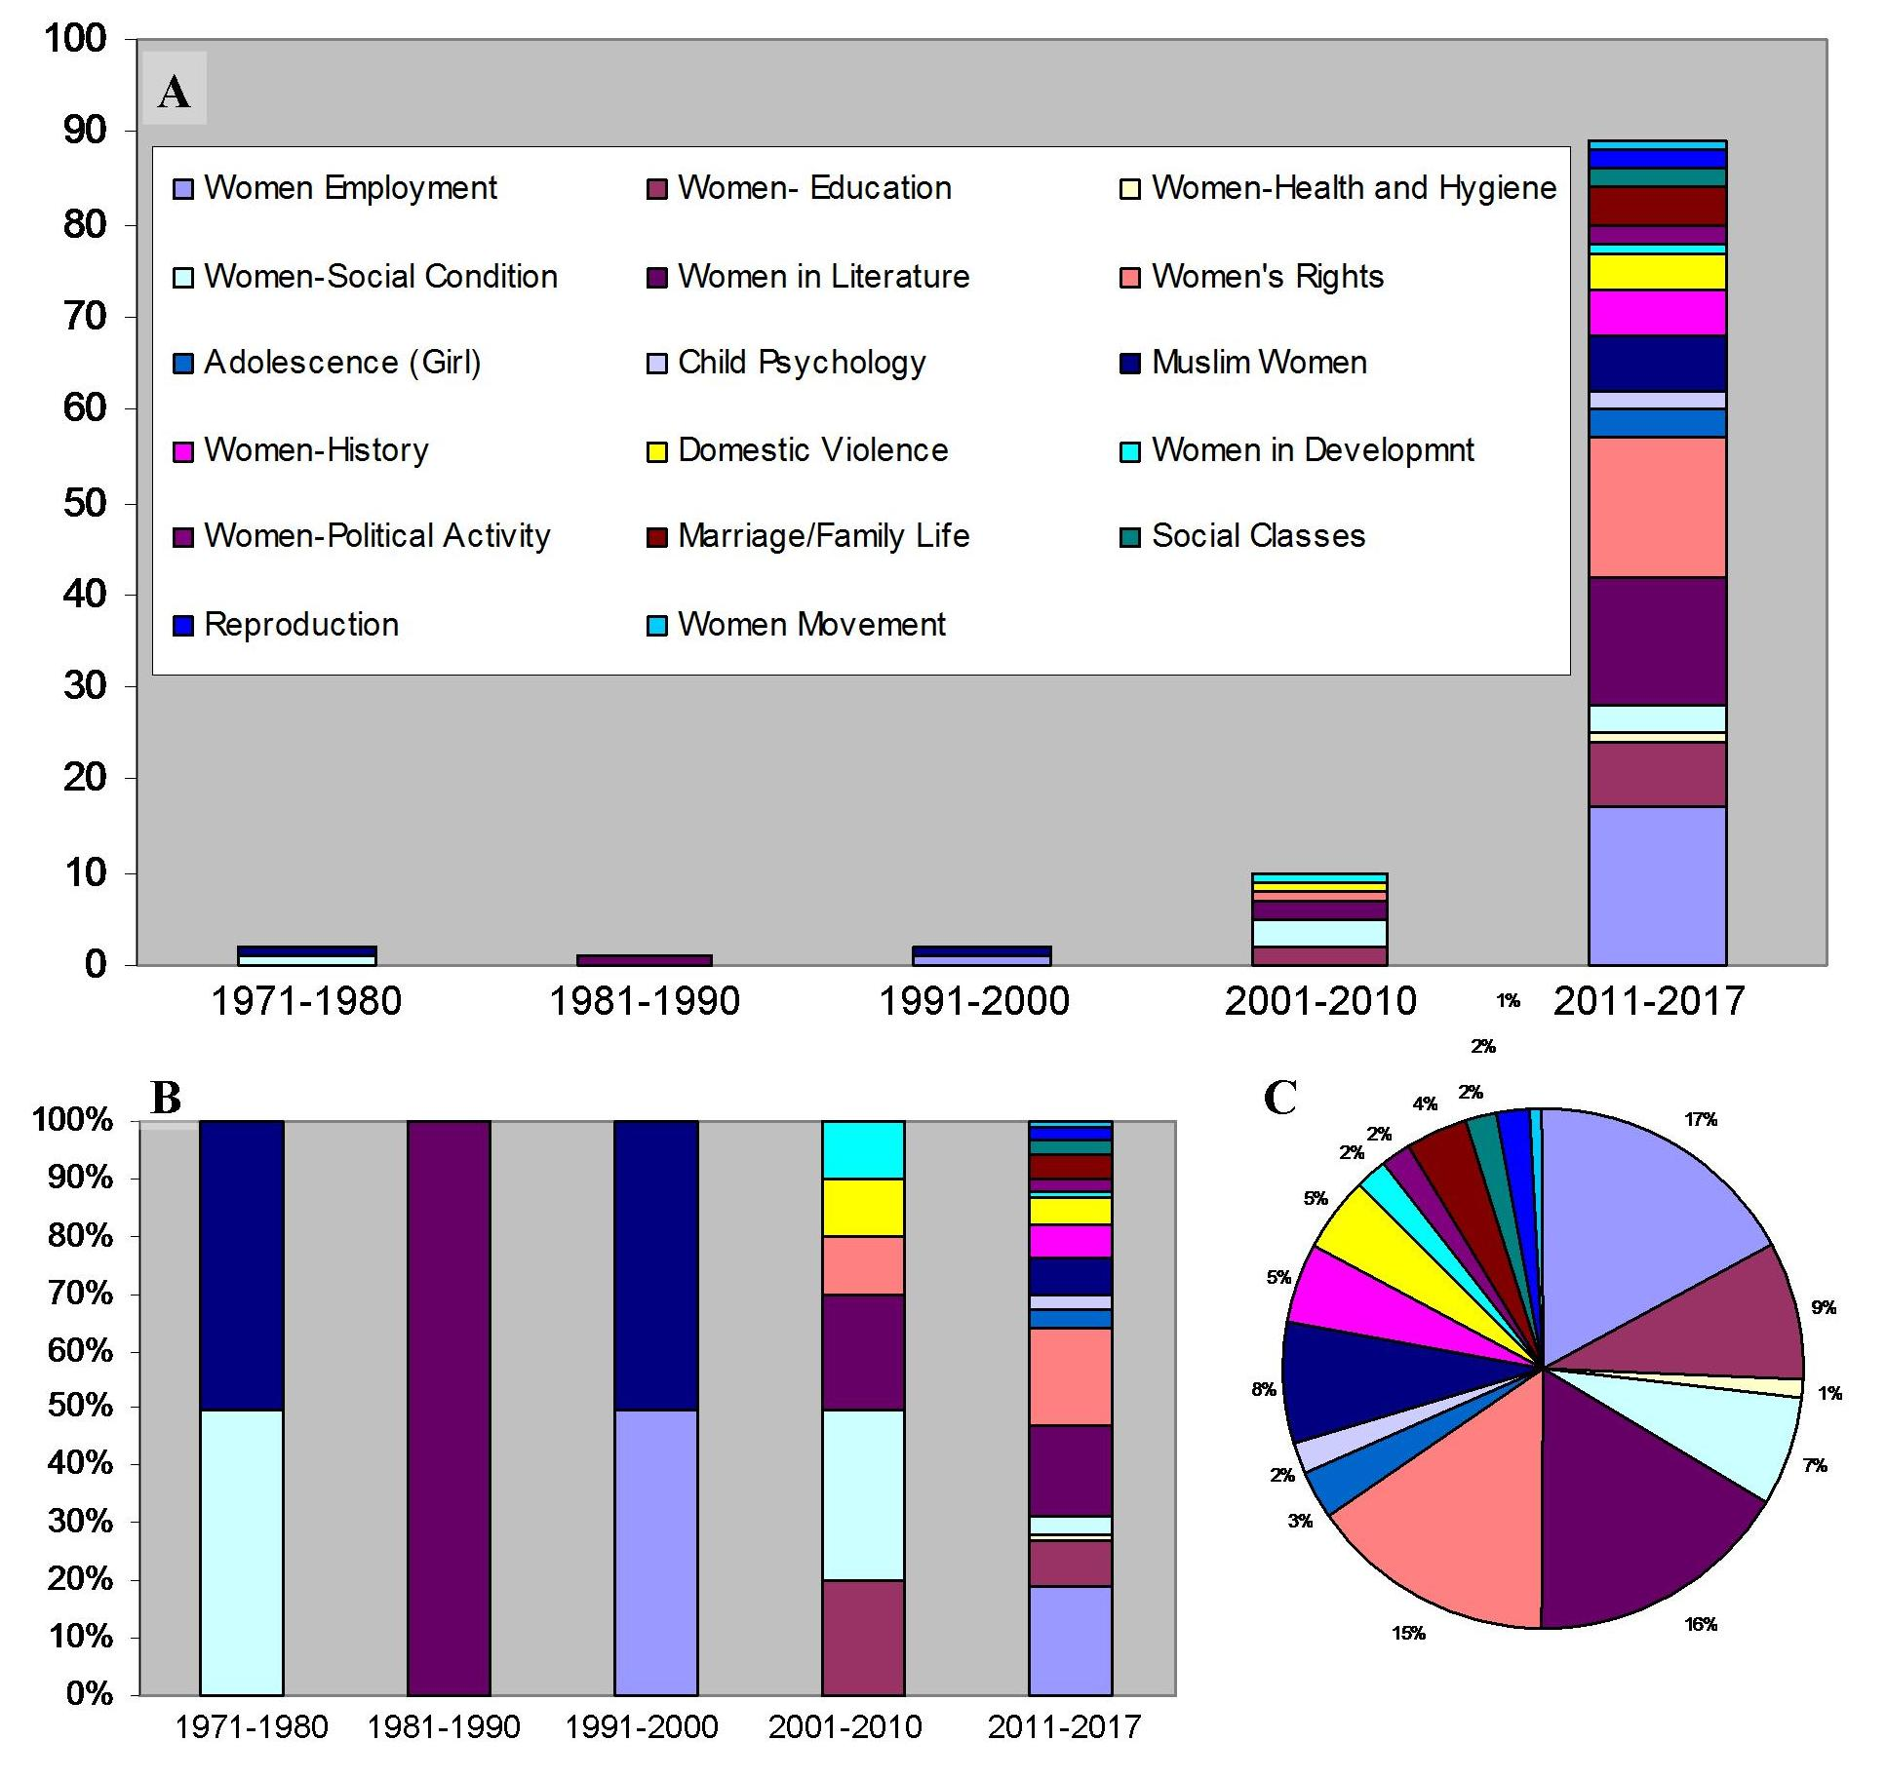
Research Trend Regarding Women Related Issues in Aligarh Muslim University

Slide 15
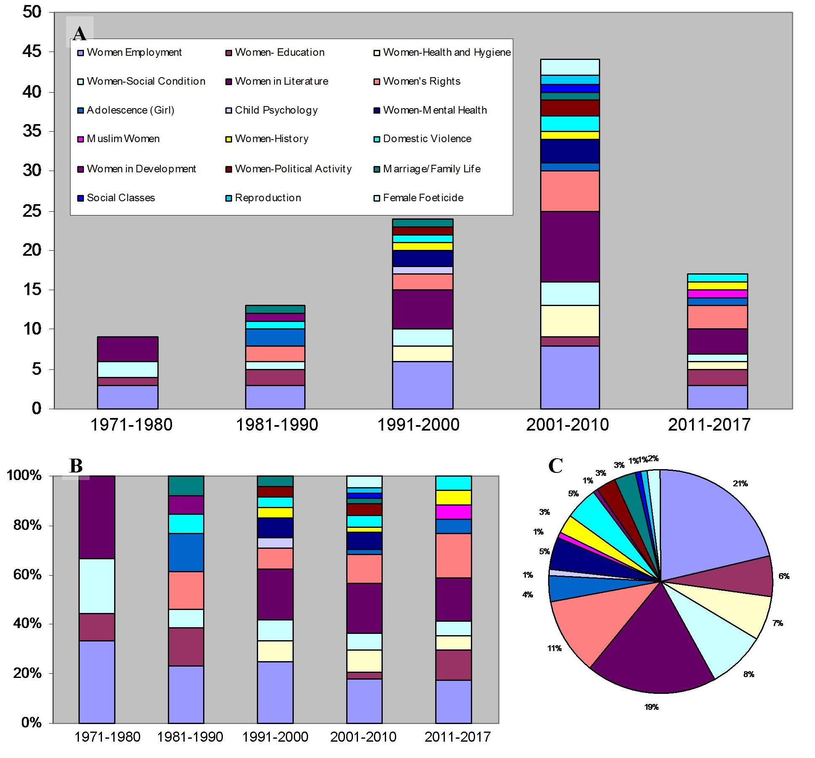
Research Trend Regarding Women Related Issues in Panjab University

Slide 16
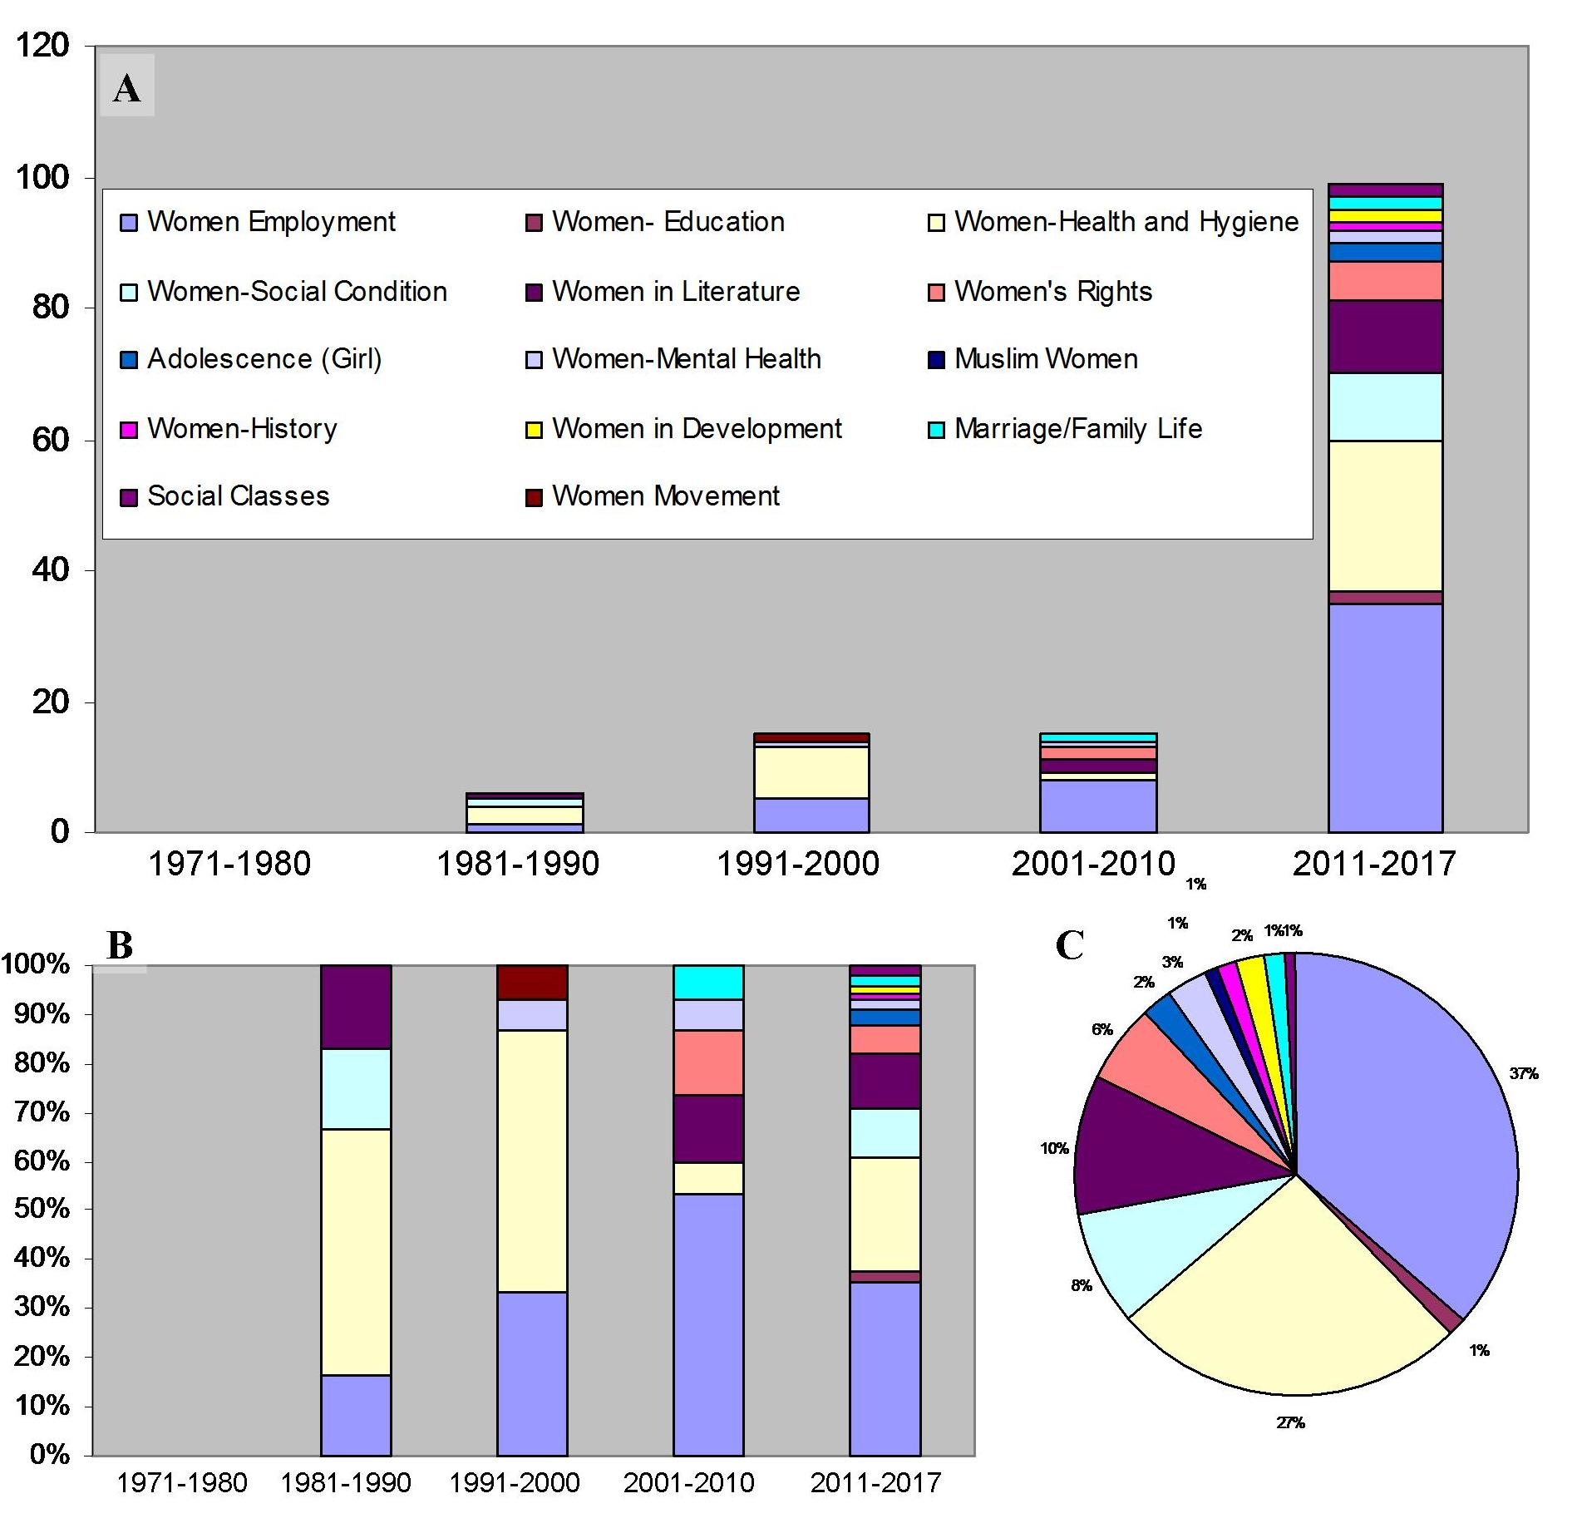
Research Trend Regarding Women Related Issues in Women’s Universities

Slide 17
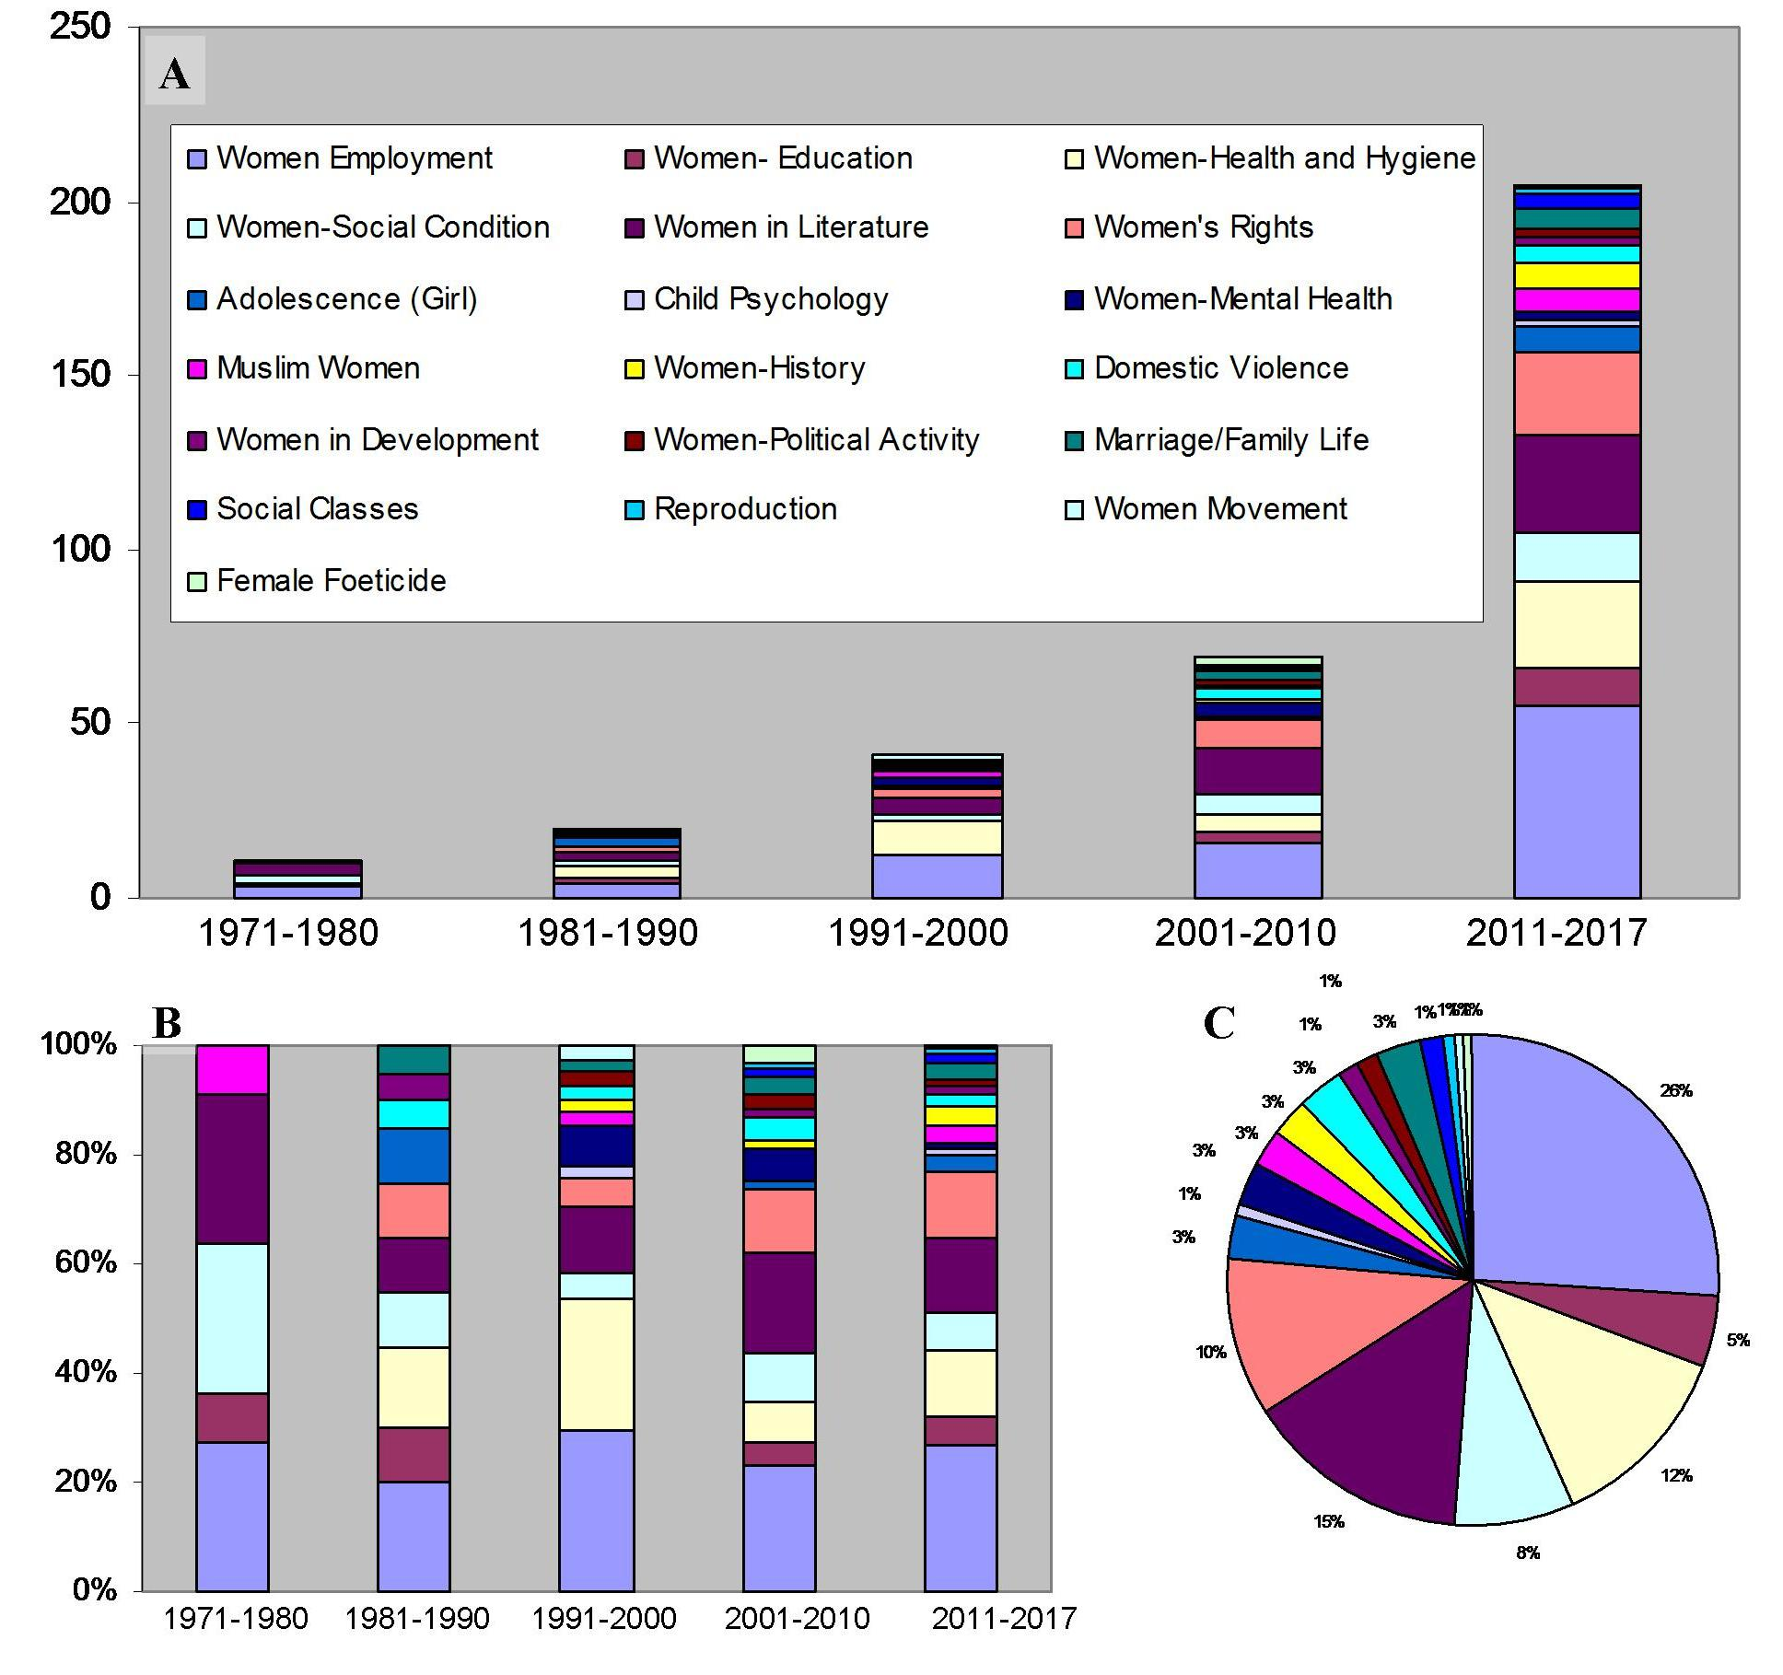
Research Trend Regarding Women Related Issues in Indian Universities

Slide 18

CONCLUSION

Slide 19
1
2
‘Women Employment’ shared the major percentage of research topics for all the universities.
Within Women’s universities the leading topic of research is ‘Women Employment, closely followed by ‘Women Health and Hygiene’ and ‘Women in Literature’.
3
Thrust areas of research within the realm of Women’s Studies are ‘Women in Literature’ and ‘Women’s Rights’ in Aligarh Muslim University and Panjab Universities.

Slide 20
4
The researches regarding women related issues in Indian universities are experiencing almost an exponential growth in recent years. Almost 80% of the total theses in the subject area have been submitted after 2000 and the current decade i.e. 2011-17 is undoubtedly the most productive one.
5
6
The research areas got more diverse from 1990’s and particularly in the new millennium newer fields are started to be explored.
The diversity of research topics is also notable for women’s universities.

Slide 21
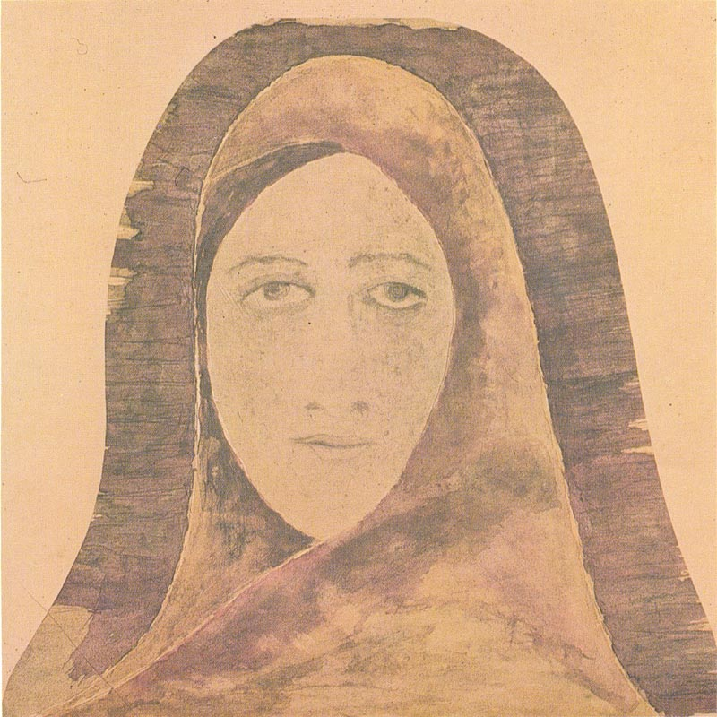
“Men can only think, Women have a way of understanding without thinking. Women was created out of God’s own fancy. Man he had to hammer into shape”
Rabindranath Tagore
The Home and the World

Slide 22


